Slide 1
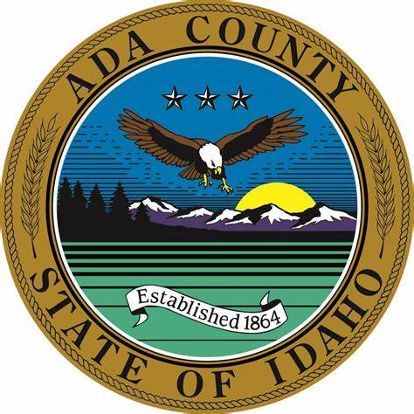

Ada County Parks & Waterways
Master Plan
Key Study Findings
November 8-9, 2023

Slide 2

No decisions have been made.
We want your input!

Slide 3
Vision for the Plan
A 10-Year update to the 2007 Parks & Waterways Master Plan
A fully implementable plan with a phased capital improvement plan ​
A plan with a clear vision and action plan to guide management and maintenance of recreation spaces, programs, and services
A plan in concert with existing county planning documents and initiatives​
A plan based on robust community engagement
A plan that Identifies shortfalls and gaps in parks level of service
Vision for the Plan

Slide 4
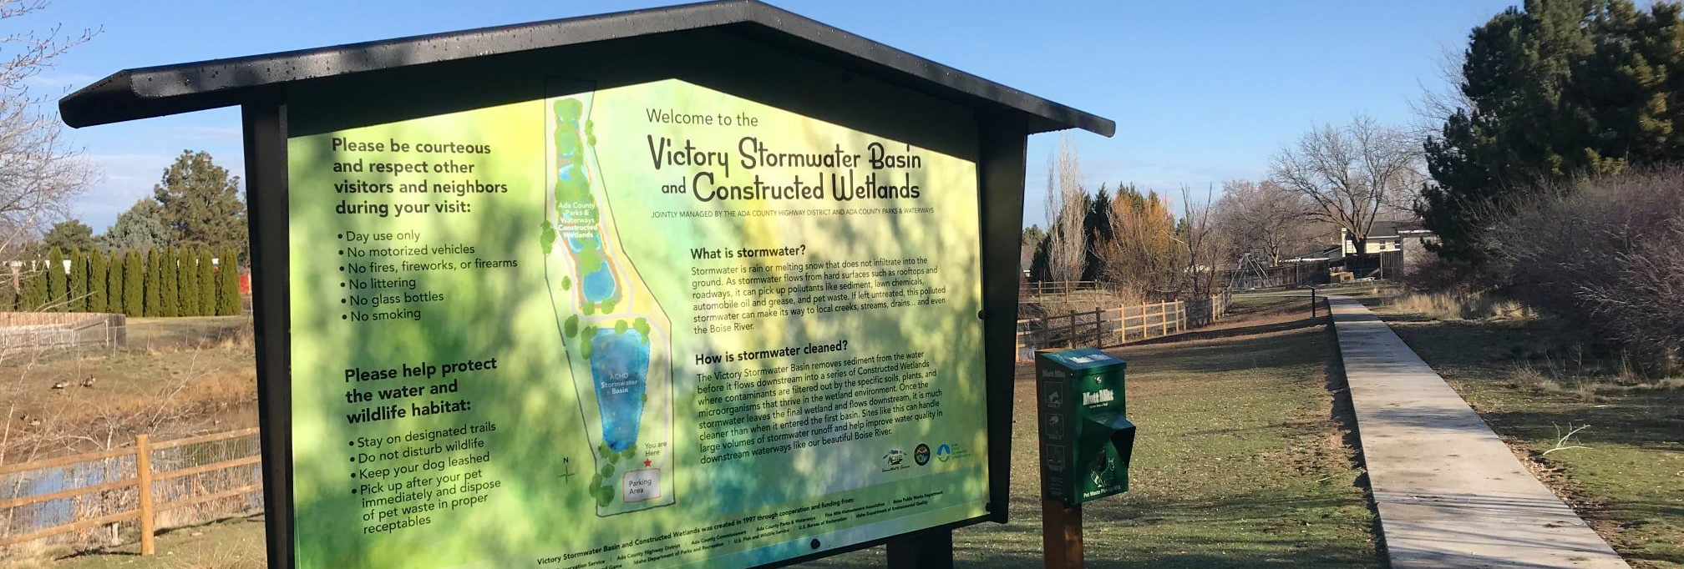
Ada County Profile

Slide 5
Ada County Profile
Population 1990, Projected to 2050

Slide 6
Ada County Profile
Age

Slide 7
Ada County Profile
White population is projected to fall from 82.1% in 2022 to 80.6% in 2027
Race and Ethnicity
Hispanic population is shown for reference and can be identified in any other race

Slide 8
National and Regional Trends
The Economic Impact of Outdoor Recreation in Idaho
The Outdoor Recreation economy in Idaho generates nearly:
78,000 direct jobs
$7.8 billion in total outdoor recreation spending
Medical savings and improved physical and mental health

Slide 9
National, Regional, and Local Trends
Activity participation and consumer behavior are based on a specific methodology and survey data to create what Esri terms “Market Potential Index.”
esri.com/data/esri_data.
Fitness Trends

Slide 10
National and Regional Trends
National Water Sport Overall Percentage Change in Participation 2016 – 2021
 | 1-year change 2021 | 2-year change 2020 | 5-year AAG 2016
Boardsailing/Windsurfing | 2.3% | -7.6% | -5.5%
Canoeing | -4.1% | 2.3% | -1.6%
Jet Skiing | 3.3% | -0.9% | -2.6%
Kayaking (Recreational) | 2.7% | 17.3% | 6.0%
Kayaking (Sea/Touring) | 3.1% | -2.5% | -3.6%
Sailing | -0.7% | -4.3% | -3.3%
Stand-Up Paddling | 1.8% | 5.0% | 3.0%
Water Skiing | 0.2% | -4.5% | -3.7%

Slide 11
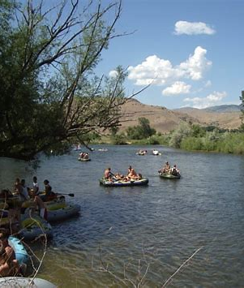
Public Engagement
Notes:
Pat

Slide 12
Public Engagement
Participation – March and August 2023
11 people participated in Stakeholder Interviews
76 people participated in Focus Group Meetings
10 staff members provided 157 comments
11 people participated in a public forum
133 people participated in intercept events in Barber Park

Slide 13
Public Engagement
Department’s Top Priorities
Open space preservation
Education and stewardship (map of greenbelt)
Connecting trails and access
Preservation – keeping things wild
Coordination with other jurisdictions and partnerships

Slide 14
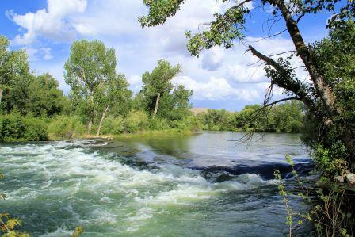
Public Engagement
Vision for the Department’s Mission
Protecting/Preserving/Expanding
Balance preservation with active recreation
A need for a more cohesive network of trails throughout the county

Slide 15
Public Engagement
Preferred New Park Components
Dog off-leash parks/trails and dog waste bags
Development at the Hubbard Reservoir
Put-ins and take-outs on the Boise River for other water vehicles (Paddleboards, kayaks, canoes)

Slide 16
Public Engagement
Underserved Areas of the County
South/southwest County, SW Boise, lack of parks and facilities
Connections to the greenbelt in the south part of the County
Glenwood/Garden City lack of open space (Expo Idaho in development to help fill this void)
Hubbard Reservoir area in the south part of the County

Slide 17

Public Engagement
Areas of Potential Improvement
Better connectivity and coordination with various entities within the County
A better understanding of conservation needs by users
Reduce conflicts on greenbelts and trails between users (trail etiquette)
Better define County responsibilities
Develop a long-term and sustainable funding plan
Increased geographic distribution of opportunities

Slide 18
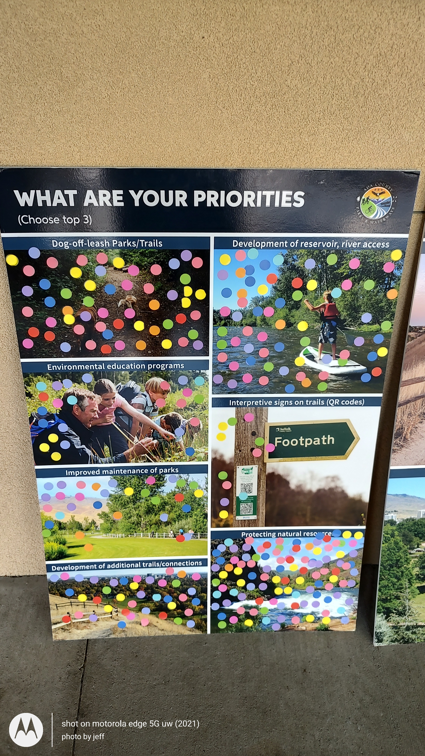
Public Engagement
Intercept Event at Barber Park – August 2023

Slide 19
Public Engagement
Top three Priorities Among Selected Choices (August Dot Board Exercise)

Slide 20
Public Engagement
Top Priorities Among Selected Choices (August Dot Board Exercise)

Slide 21
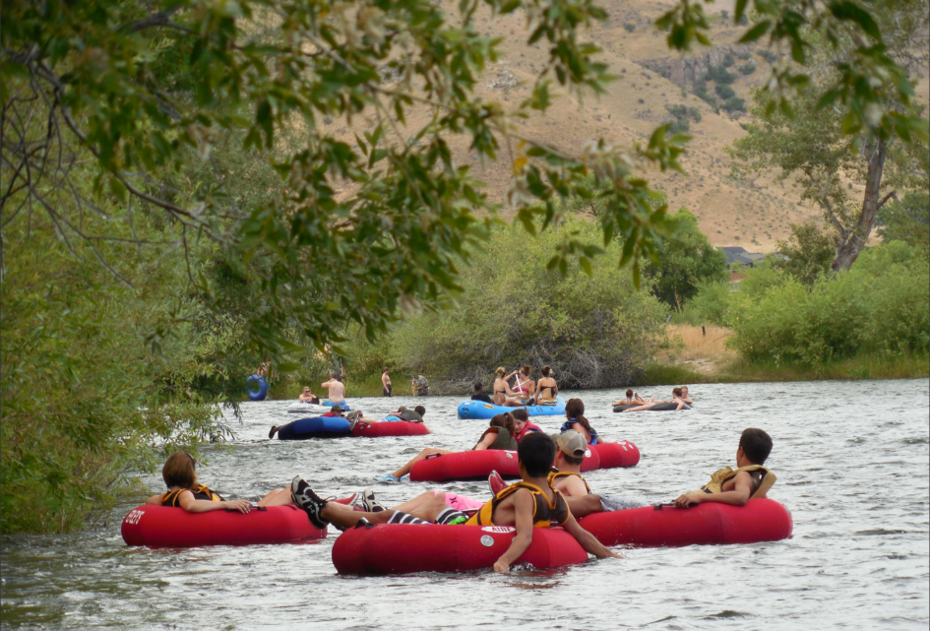
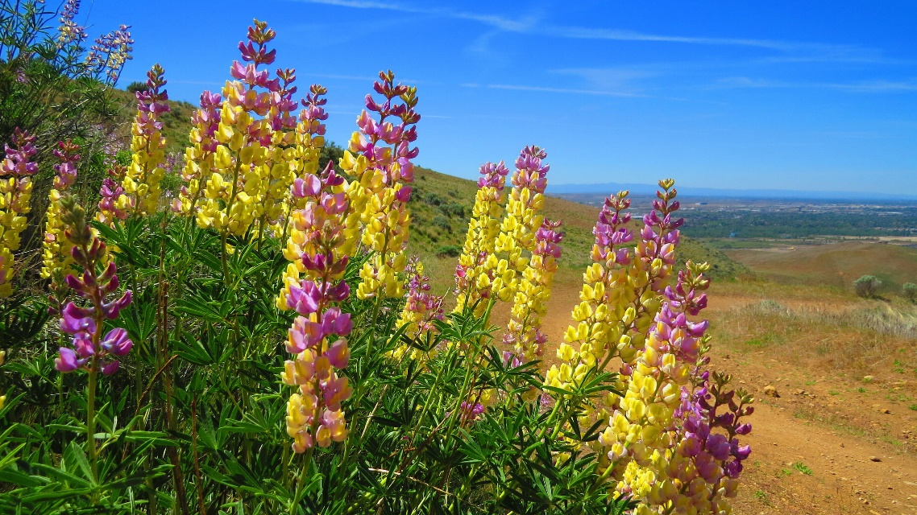
Social Pinpoint
Interactive Website
Forum
What offerings, programs and services would you like to see in the future?
START 7 Mar 2023
Join The Discussion
Share Your Ideas
Add your comment and join the conversation regarding parks, waterways, open space, programs, and facilities.
START 7 Mar 2023

Slide 22
Social Pinpoint Engagement
Online Engagement by the Numbers
958 Unique Users
98 Map Comments 32 Ideas Wall Comments
63 Budget Responses
32 Ideas Wall Comments
17 Forum Responses
43 Unique Stakeholders
4,039 Site Visits (including the map)

Slide 23
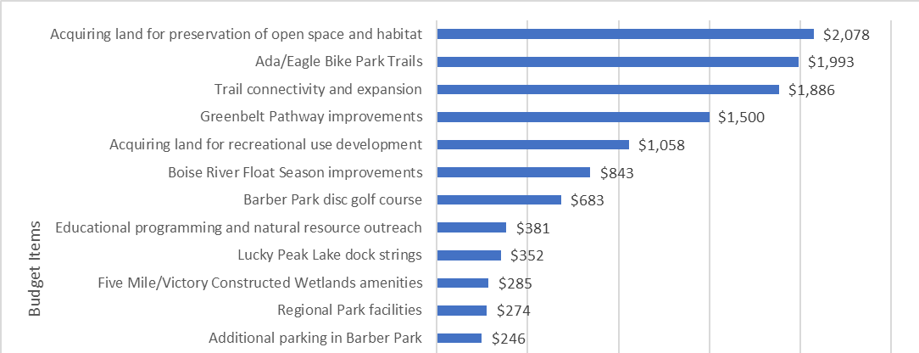
Social Pinpoint Engagement
Budgeting Exercise – Prioritize mock funding

Slide 24
Social Pinpoint Engagement
Many comments were received for both Ada County Parks & Waterways and other jurisdictions.
Greenbelt improvements and expansion
Preserving and protecting the Boise River
Judy Peavey Derr Greenbelt expansions and improvements for bicyclists, walkers and families

Slide 25
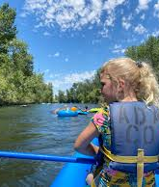
Needs Assessment Survey

Slide 26




Research Methods
Needs Assessment Survey
Statistically Valid (Invitation Survey)
The survey was available in Spanish online.
689
Total Surveys Completed
Invitation surveys completed
+/- 4.5% Margin of Error
471
Open Link Survey
The online survey was made available to all Ada County stakeholders.
4,500 Surveys Mailed
Open Link surveys completed
218

Slide 27
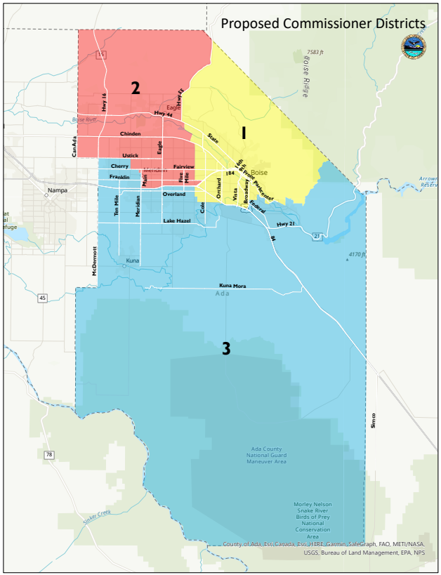
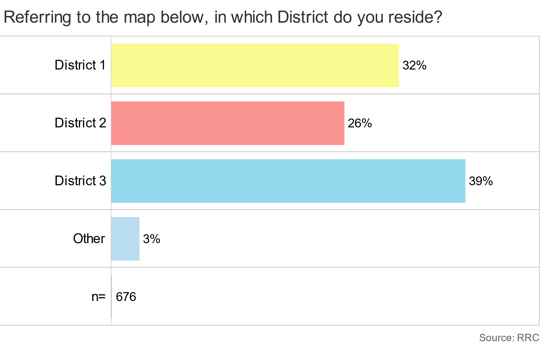
Needs Assessment Survey
Responses were collected from the three Districts in the county.

Slide 28
Survey Respondent Demographics
Needs Assessment Survey
49% are male
57% are 44 years old and younger
44% of households have children at home
64% have a dog
91% own their home
8% have a need for Americans with Disabilities Act support
9% are Hispanic
60% of respondents earn at least $100,000 annually.

Slide 29


Needs Assessment Survey – Key Findings
Restrooms in parks and large regional parks are the most important facilities and amenities but scored lower in meeting community needs.
Respondents feel that acquiring open space and providing opportunities for active outdoor recreation opportunities are most important.
Providing interpretive programs is of lesser importance.

Slide 30



Needs Assessment Survey – Key Findings
Most familiar park sites, and those most frequently visited, are the Boise River Greenbelt and the Ridge to Rivers trails
Respondents are less aware of Hubbard Reservoir Recreation Area and Red Hawk Conservation Area.
The overall physical condition and cleanliness of Ada County Parks & Waterways sites receive high ratings. A total of 91% of survey respondents rated physical condition and cleanliness as good or excellent.
The main reason for visiting the park sites is to walk or hike.
Over half (51%) of respondents float the Boise River between Barber Park and Ann Morrison Park at least once a summer.
Additional locations outside of Barber Park to launch and take out personal watercraft and better or additional parking would most improve the floating experience.

Slide 31




Needs Assessment Survey – Key Findings
Respondents generally feel very welcome in Ada County Parks & Waterways parks and recreation areas.
Acquiring land for preservation of open space and habitat, and Boise River Greenbelt Pathway management or improvements are the two most important future needs.
Communication to the public is somewhat average - 2.8 out of 5, with 5 being “very effective.”
Residents and visitors prefer communication from email, the Current Newsletter, and Ada County social media. There are differences based on age
Increasing the financial allocation from the county is the most supported funding source for Ada County Parks & Waterways followed by more private/public partnerships.

Slide 32
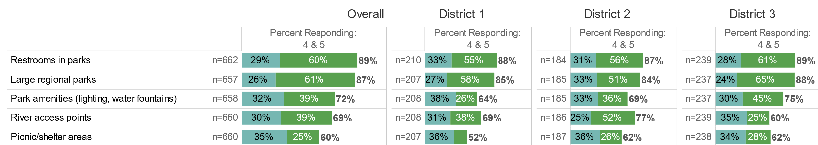
Needs Assessment Survey – Facilities & Amenities
By District
Most Important facilities and amenities in each district
On a scale of 1 (not important) to 5 (very important) Blue = 4 Green = 5

Slide 33
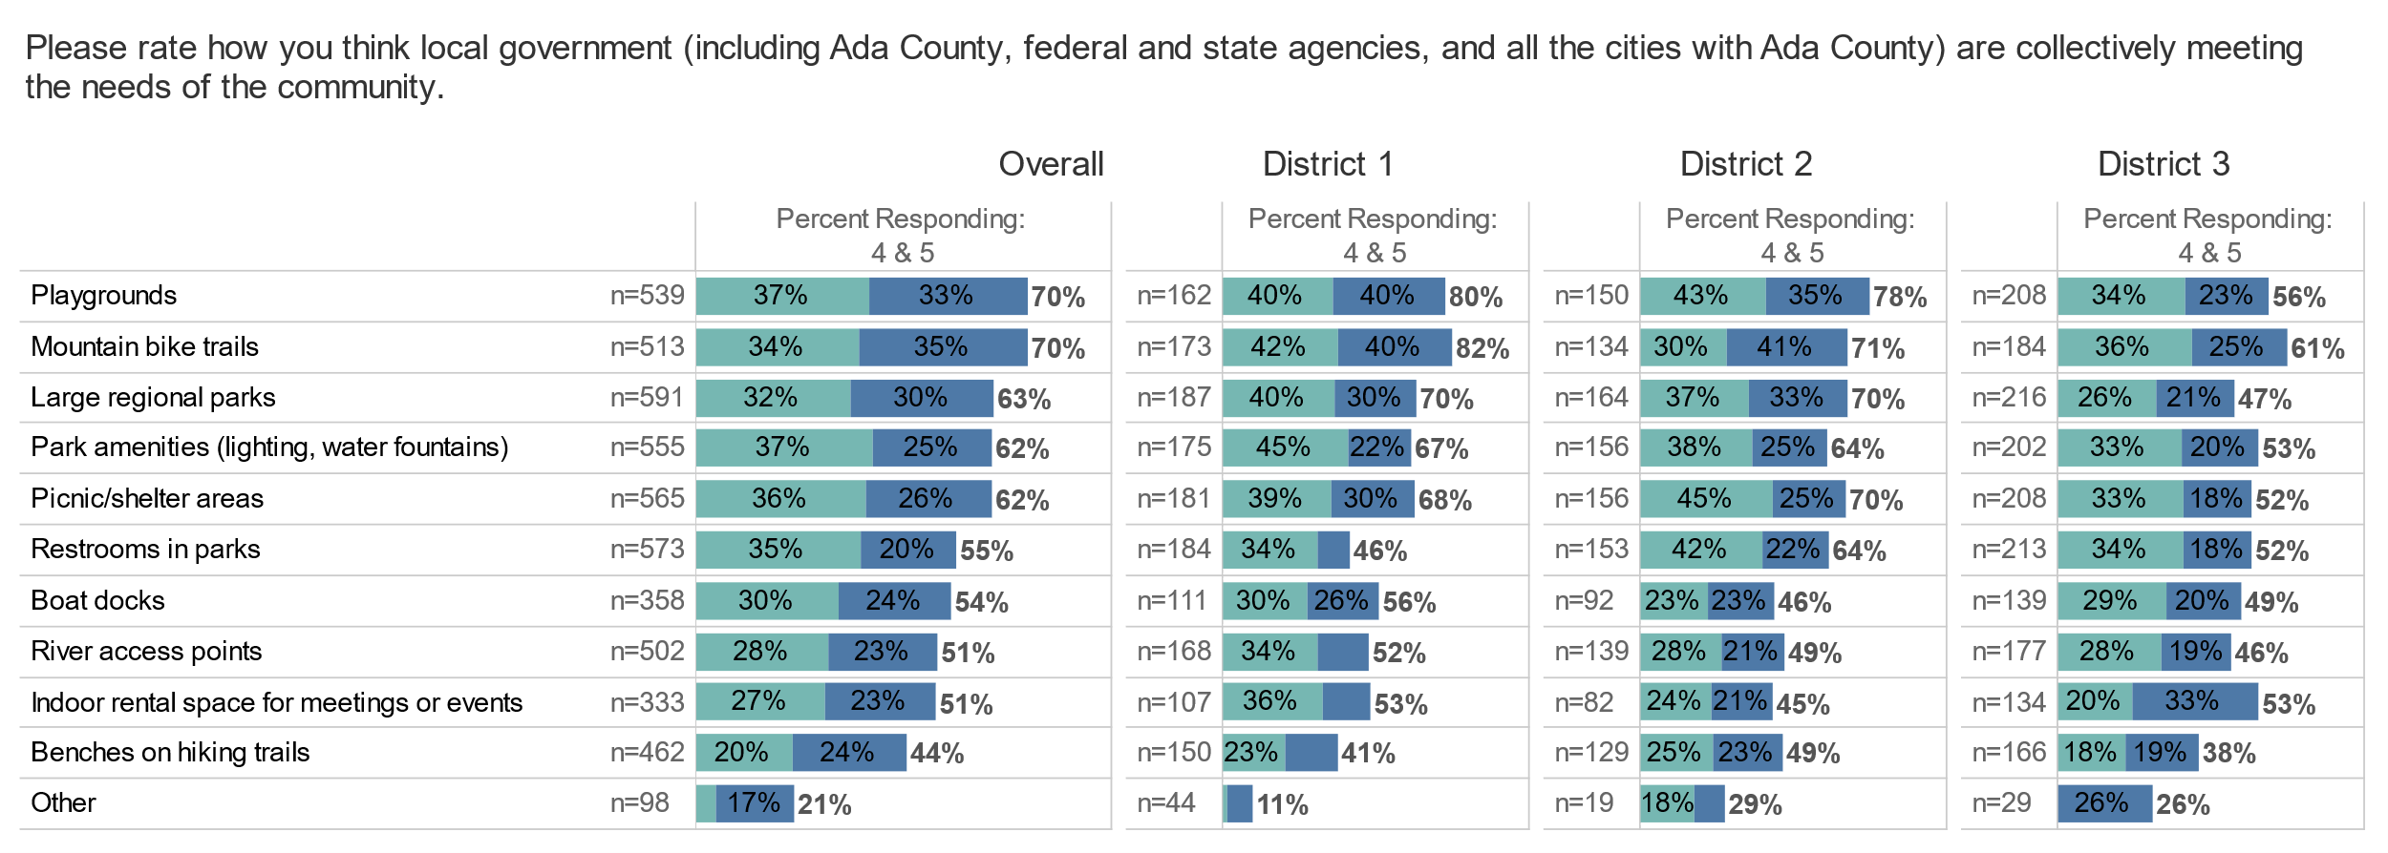
Needs Assessment Survey – Facilities & Amenities
By District
Meeting Needs
On a scale of 1 (not meeting needs) to 5 (meeting needs) = Green = 4, blue = 5

Slide 34
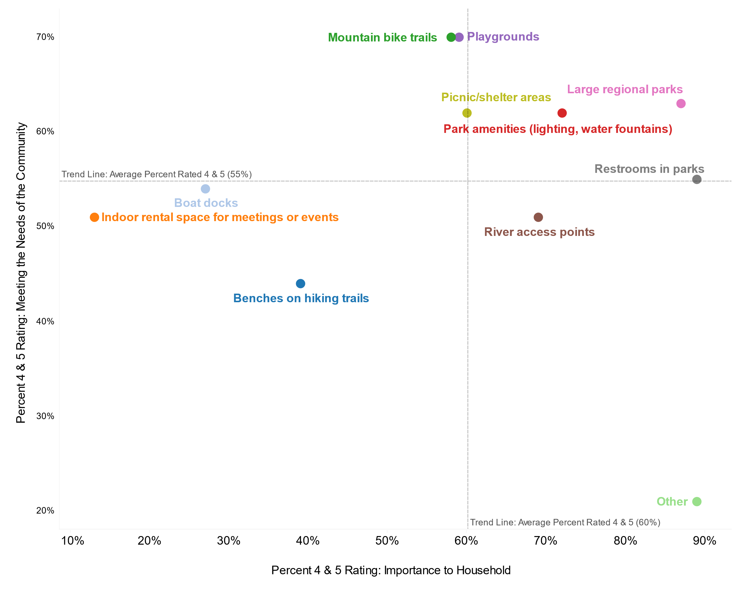
Needs Assessment Survey – Facilities & Amenities
Importance vs. Meeting the need
Unnecessary Strengths
Required Strengths
Acceptable Weaknesses
Areas Requiring Improvement

Slide 35
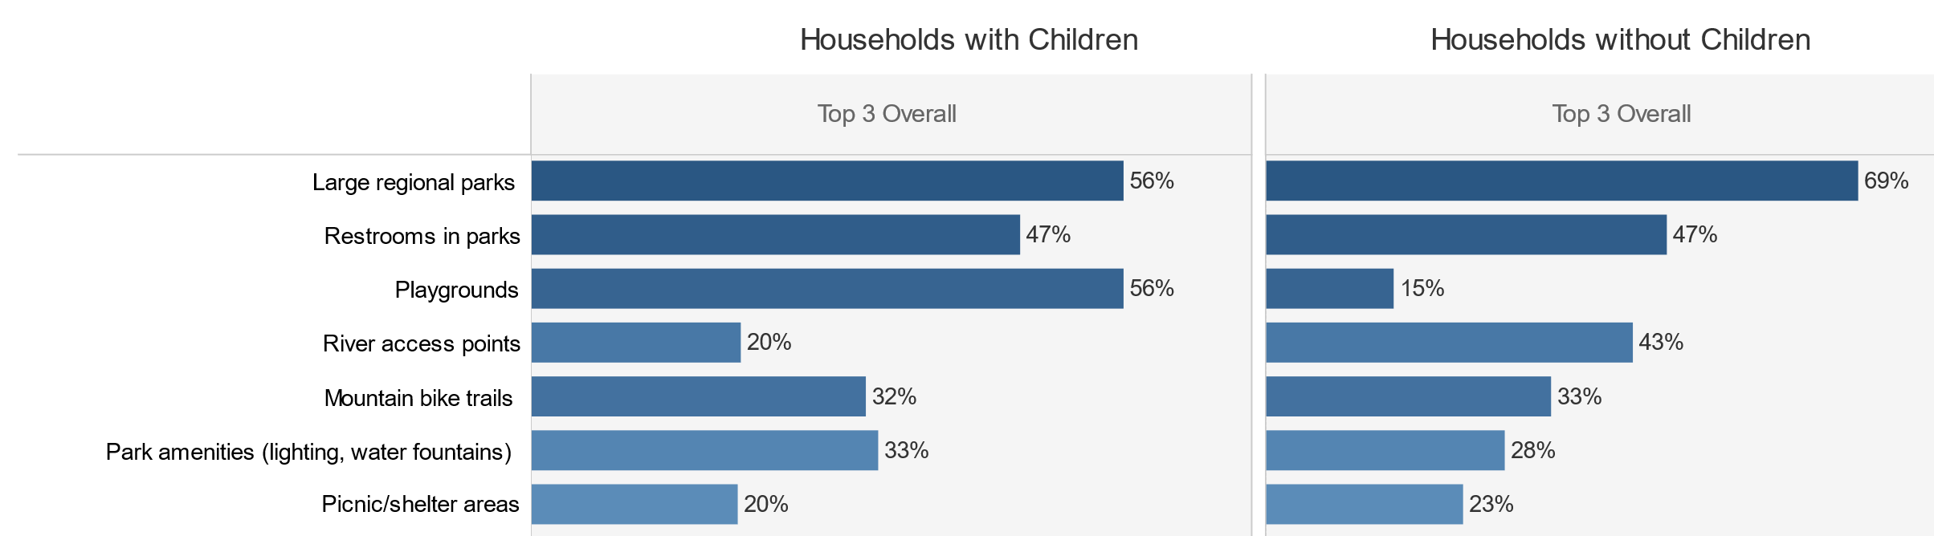
Needs Assessment Survey –Facilities and Amenities
Top 3 Importance With and Without Children
Top, second, and third choices combined.

Slide 36
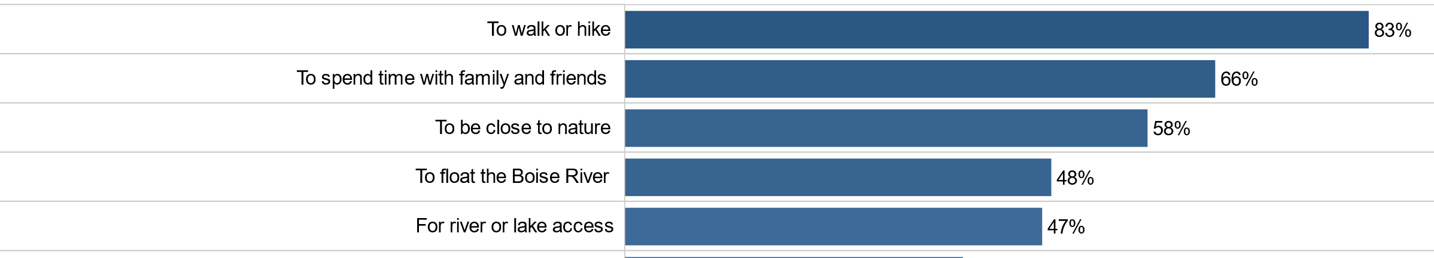
Needs Assessment Survey – Reasons for Visitation
Main reasons for visiting a park site operated by Ada County Parks & Waterways

Slide 37
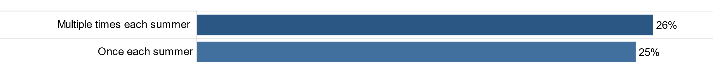
Needs Assessment Survey – Frequency of Floating Boise River
More than half of respondents (51%) float the Boise River between Barber Park and Ann Morrison Park at least once a summer and 19% report not floating at all.

Slide 38
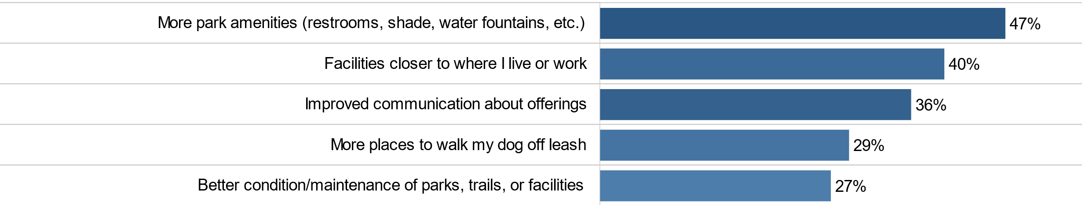
Needs Assessment Survey – Increasing Use

Slide 39
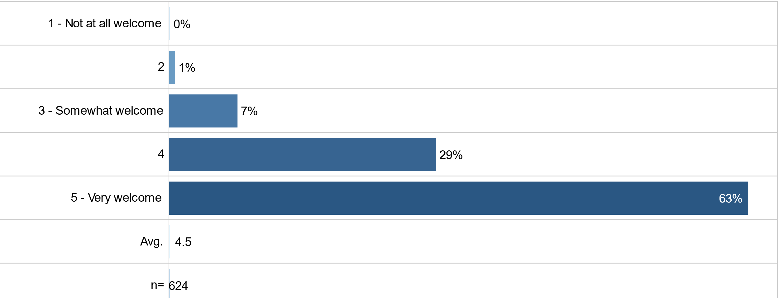
Needs Assessment Survey – Feeling Welcome in Parks & Facilities

Slide 40
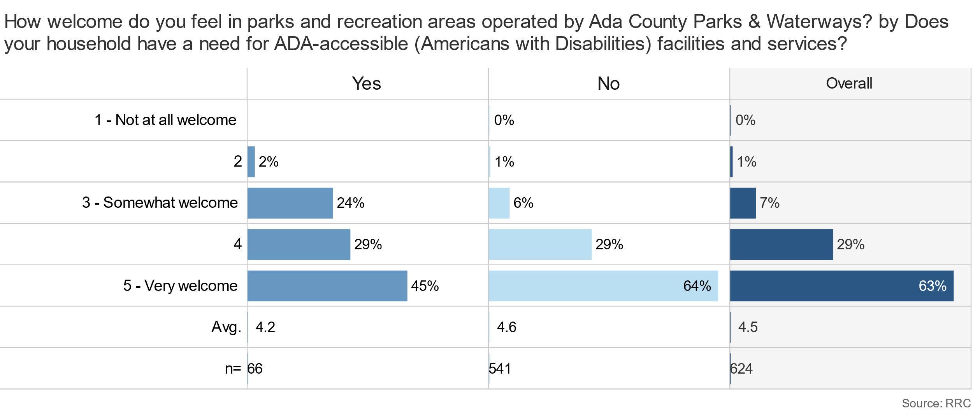
Needs Assessment Survey – Feeling Welcome
By ADA Need for Service

Slide 41
Needs Assessment Survey – Feeling Welcome
By Hispanic Ethnicity

Slide 42
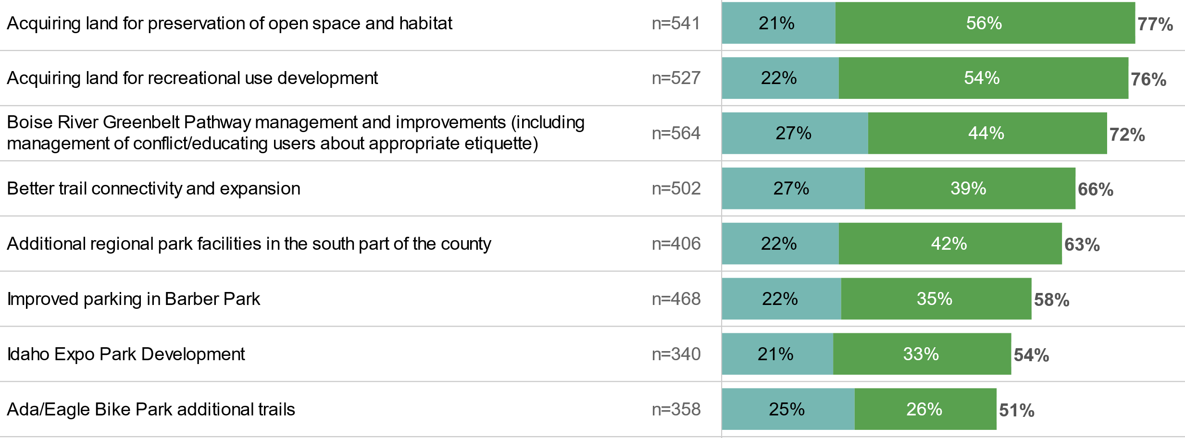
Needs Assessment Survey – Future Priorities

Slide 43
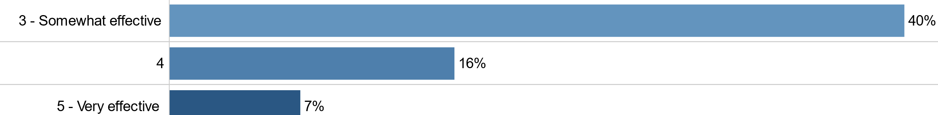
Needs Assessment Survey – Effectiveness of Communication
Survey respondents were asked to rate effectiveness of communication from Ada County Parks & Waterways on a scale of 1 to 5 with 1 being not effective and 5 being very effective. Ratings of 1 and 2 made up 37% of responses.

Slide 44
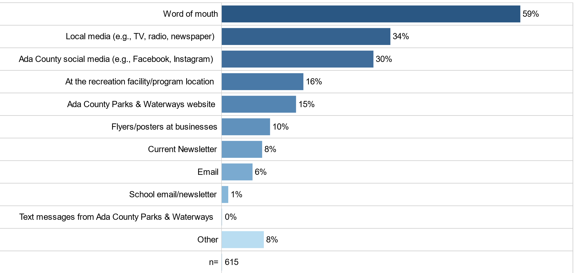
Needs Assessment Survey – Current Communication Methods

Slide 45
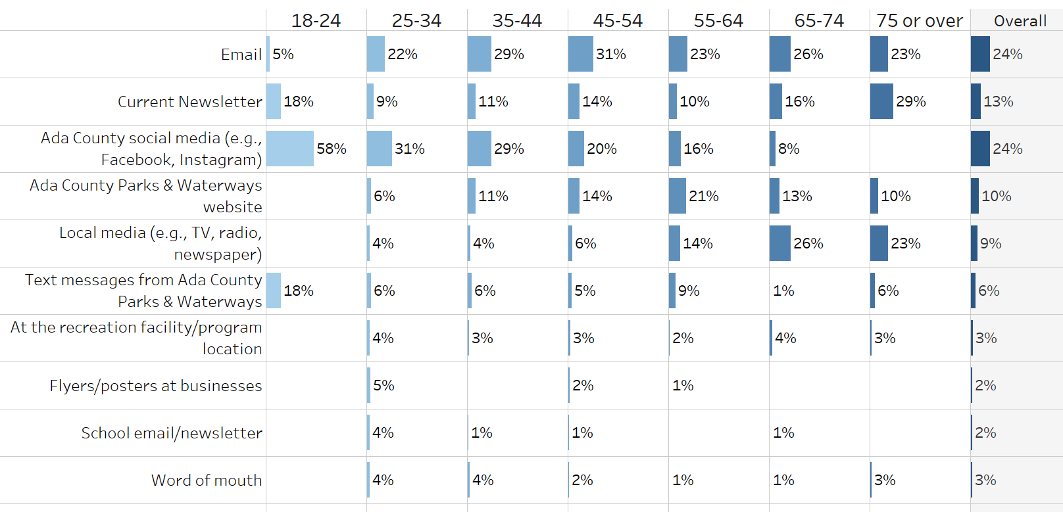
Needs Assessment Survey – Preferred Communications
Respondents prefer a variety of communication options

Slide 46
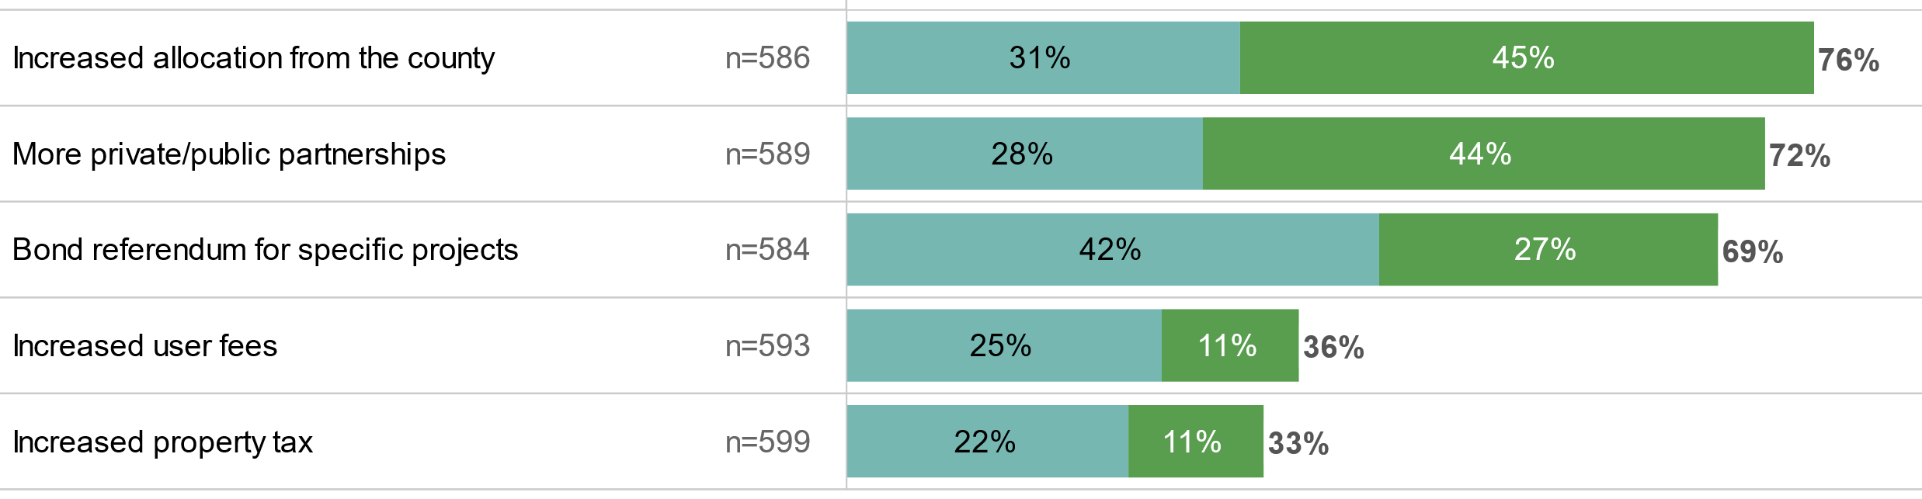

Needs Assessment Survey – Types of Funding Support

Slide 47
Needs Assessment Survey – Additional Comments & Suggestions
At the end of the survey, respondents were given an opportunity to provide any additional comments or suggestions for Ada County Parks & Waterways. A total of 195 comments were collected, with key themes highlighted below. A full list of comments can be found in the Appendix.
- Need new parks, especially in South Boise and South Meridian
- Improve maintenance of current trails
- Create accessible trails
- Build green and blue rated downhill runs
- Maintain existing runs
- Desire for hiking, biking, fishing, and paddleboarding
- More pickleball courts needed
- Request for walking paths
- Overcrowding on trails
- Diverse biking trails required
- Improve communication
- Provide printable maps
- Enhance website information
- Use email newsletters
- Share updates and offerings
- Preserve open spaces and habitats
- Address river management concerns
- Focus on river cleanup efforts
- Better fish habitat management
- Protect wildlife and greenbelts
- Increase parking, especially at Barber Park and Lucky Peak
- Enhance trail connectivity
- Ensure safe access points and signage
- Address floaters’ needs along the Boise River
Environmental Conservation & River Management
Park Development & Maintenance
Recreation & Activities
Communication & Information
Accessibility & Parking

Slide 48
Placer AI Data - Frequency of Barber Park Visits
Barber Park Education and Events Center (500 feet catch area)
Visits 130.5K
Unique Visitors 99.0K
Placer AI uses cell phone data to capture visits. The number of people floating that do not bring their cell phones into the park is unknown, potentially understating the number of visitors

Slide 49
Placer AI Data - Frequency of Barber Park Visits
Daily Visit Counts at Barber Park

Slide 50
Placer AI Data - Frequency of Barber Park Visits
Visits to Barber Park by Day of the Week

Slide 51
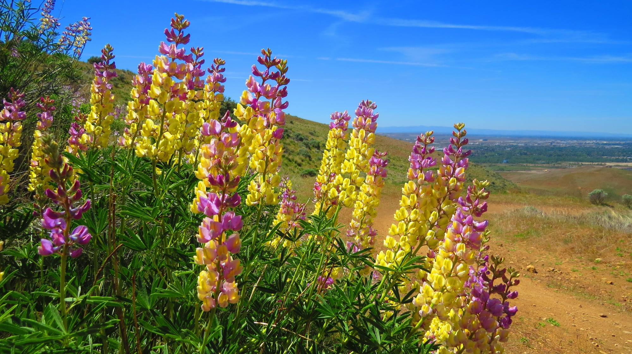
Level of Service Provided by Ada County Parks & Waterways

Slide 52
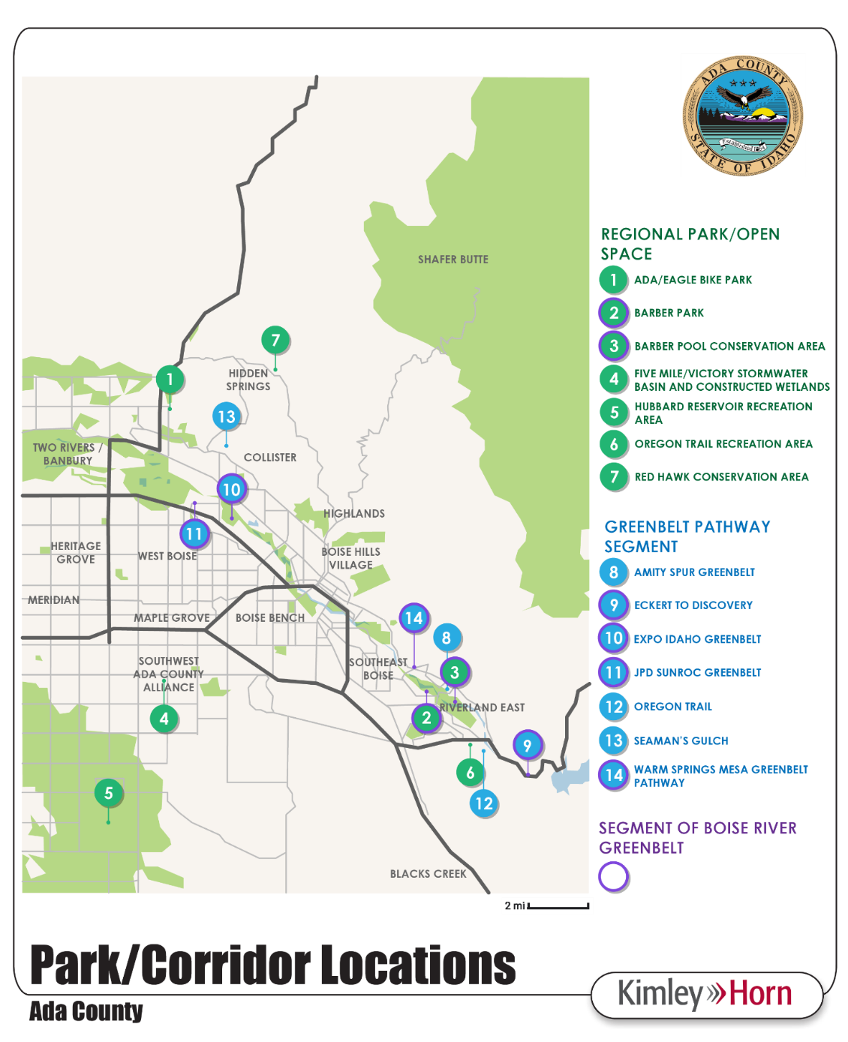
Park, Trails, and Open Space Inventory

Slide 53
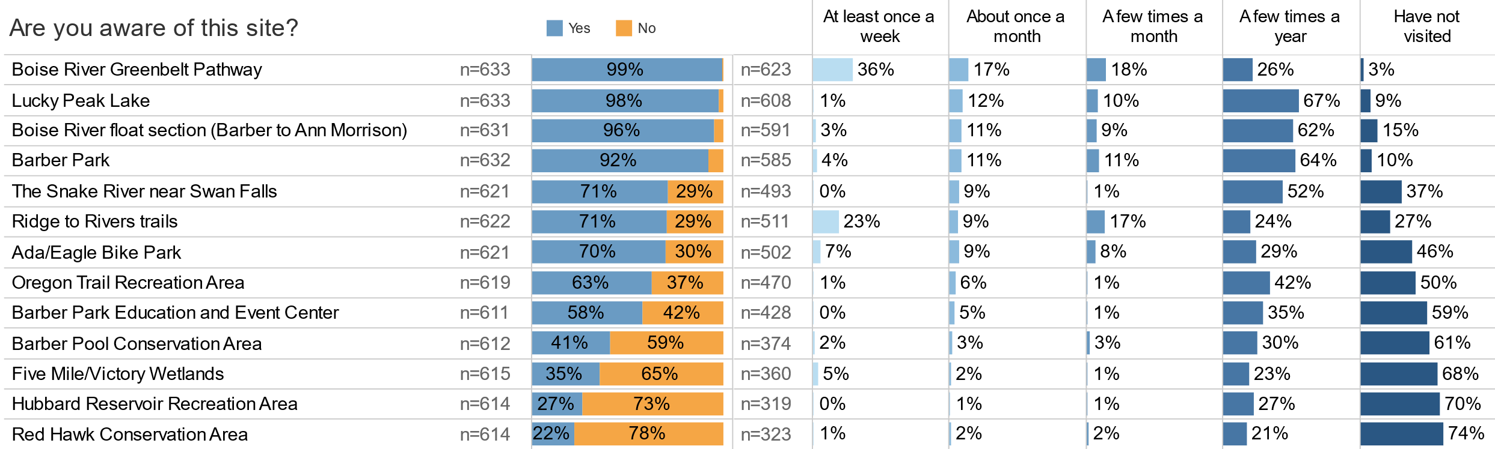
Needs Assessment Survey – Awareness and Frequency of Use

Slide 54
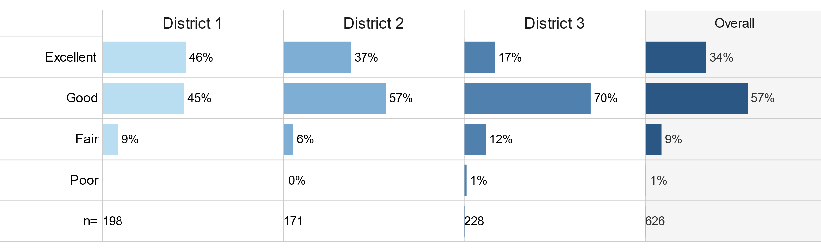
Needs Assessment Survey – Overall Physical Condition of Park Sites

Slide 55
Park, Trails, and Open Space Inventory
RELATED WATERWAYS Not managed by Ada County | ACRES
Snake River | 1,593.00
Total: | 1,593.00
REGIONAL PARKS | ACRES
Ada/Eagle Bike Park | 214.00
Barber Park* | 68.00
Total: | 282.00
OPEN SPACE | ACRES
Barber Pool Conservation Area* | 35.00
Hubbard Reservoir Recreation Area | 365.00
Five Mile/Victory Stormwater Basin and Constructed Wetlands | 3.00
Oregon Trail Recreation Area | 39.00
Red Hawk Conservation Area | 246.00
Total: | 688.00
GREENBELT PATHWAY SEGMENTS | MILES
Oregon Trail | 4.50
Amity Spur Greenbelt Property | .75
JPD Sunroc Greenbelt* | 1.65
Eckert to Discovery* | 4.45
Expo Idaho Greenbelt* | .78
Warm Springs Mesa Greenbelt Pathway* | 1.24
Seaman’s Gulch | 3.24
Total: | 16.61
REGIONAL PARK AND TRAIL PARTNERSHIPS Collaboratively Managed with Ada County
Ridge to Rivers Trails | 210.00 mi
Lucky Peak Lake | 2,750.00 ac
Total: | 2,960.00

Slide 56
Park, Trails and Open Space Inventory and LOS
Hubbard Reservoir Recreation Area
Size: 365 Acres
Classification: Open Space Area
Location: Near the intersection of E Hubbard Rd and S Stewart Rd
Grading Standard F/ Priority 1 – Currently Critical
Grading Standard D / Priority 2 – Potentially Critical
Grading Standard C / Priority 3 – Necessary, But Not Yet Critical
Grading Standard B / Priority 4 – Recommended
Grading Standard A / Priority 5 – Early in Lifecycle
Amenity | Qty | Priority | Comments
MULTI-USE TRAIL (MI) | ~5 Mi | 2 | Okay Condition; path is narrow and ill defined with vegetation, signage about being “potentially dangerous” may require more explanation
VAULT RESTROOM | 1 | 3 | Fair Condition
MONUMENT SIGNAGE | 1 | 3 | Good Condition; sign is blank, no map

Slide 57
Park, Trails and Open Space Inventory and LOS
Assessment of Priority Needs for Improvement to Existing Amenities
This chart shows the percentage of amenities in each priority area. Note that there are no Priority 1/Critical amenities

Slide 58
Park, Trails, and Open Space Inventory and LOS
The parks and facilities are well maintained. There were no instances of public safety hazards observed.
There is a significant amount of undeveloped open space.
Many county parks are managed in partnership with other agencies.
Trail delineation, section, conditions, and quality vary based on site.
Park and trail users are extremely active within the biking community.
Limited bicycle or pedestrian connectivity or access exists to and between trailheads or parks.
Some park and trail users may be dog owners. There is limited signage relating to off-leash dogs outside of conservation areas.

Slide 59
Park, Trails, and Open Space Inventory and LOS
Bikers, walkers, and joggers use the trails simultaneously and are sometimes in conflict with one another. There is limited signage regarding trail etiquette and policies.
Barber Park sees heavy traffic, parking challenges, and many competing activities in a relatively small space during the Float the Boise River floating season.
Parks and facilities do not have a consistent variety of amenities at each location.
There is a lack of trail maps and wayfinding signage. Signage often lacks information on level of difficulty or loop length.
Some parks have detailed interactive trail maps while others do not.
Finding trail access areas can be difficult and older sites generally lack uniqueness and individuality.
Access to the Boise River Greenbelt with appropriate parking can be challenging to users.

Slide 60

Next Steps
Visioning Workshop
Draft Plan with Recommendations and Cost Estimates
Final Master Plan

Slide 61
Here’s our contact information:
Jeff Milkes
Senior Consultant, BerryDunn
jeffrey.milkes@berrydunn.com
Art Thatcher
Manager, BerryDunn
Art.thatcher@berrydunn.com

Slide 62
National, Regional, and Local Trends
Outdoor Recreation

Slide 63
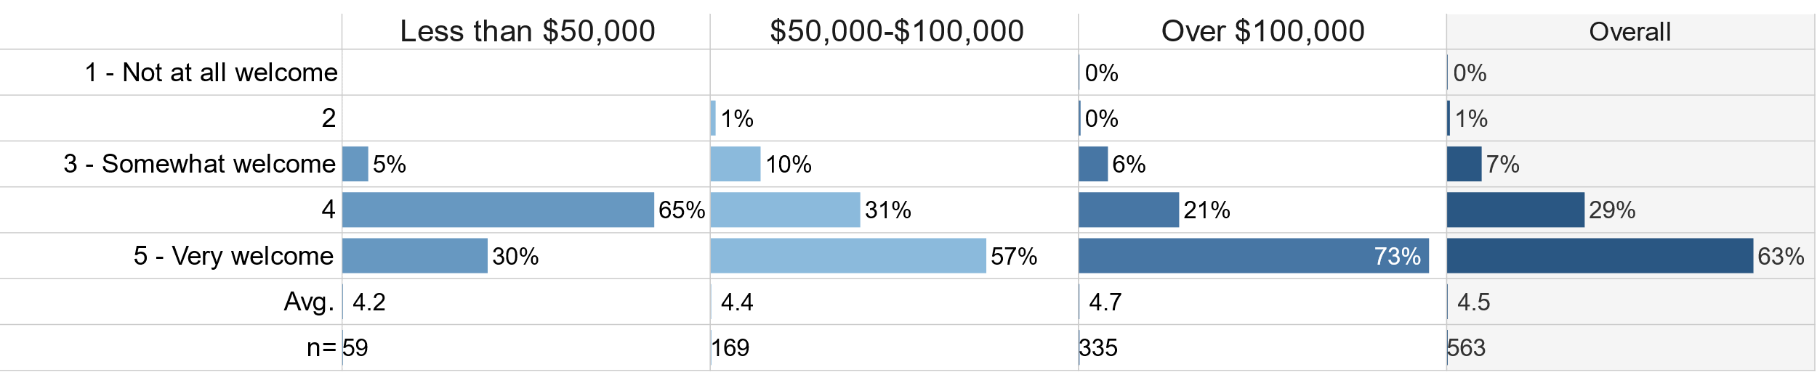
Needs Assessment Survey – Welcome
By Income
Those with lower income levels are less likely to feel “very welcome” in parks and recreation areas operated by Ada County Parks & Waterways.

Slide 64
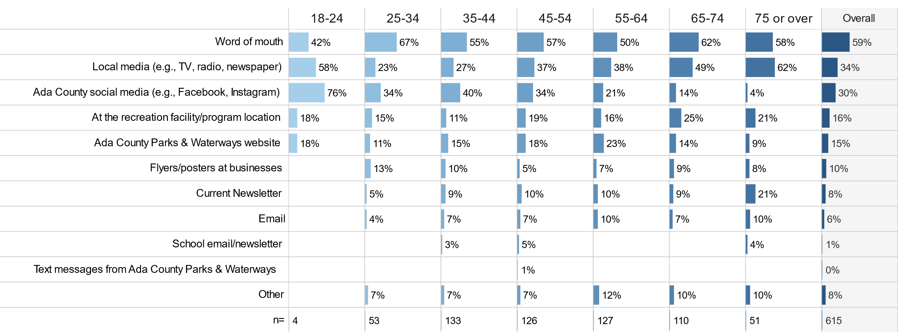
Needs Assessment Survey – Preferred Communications (By Age)

Slide 65
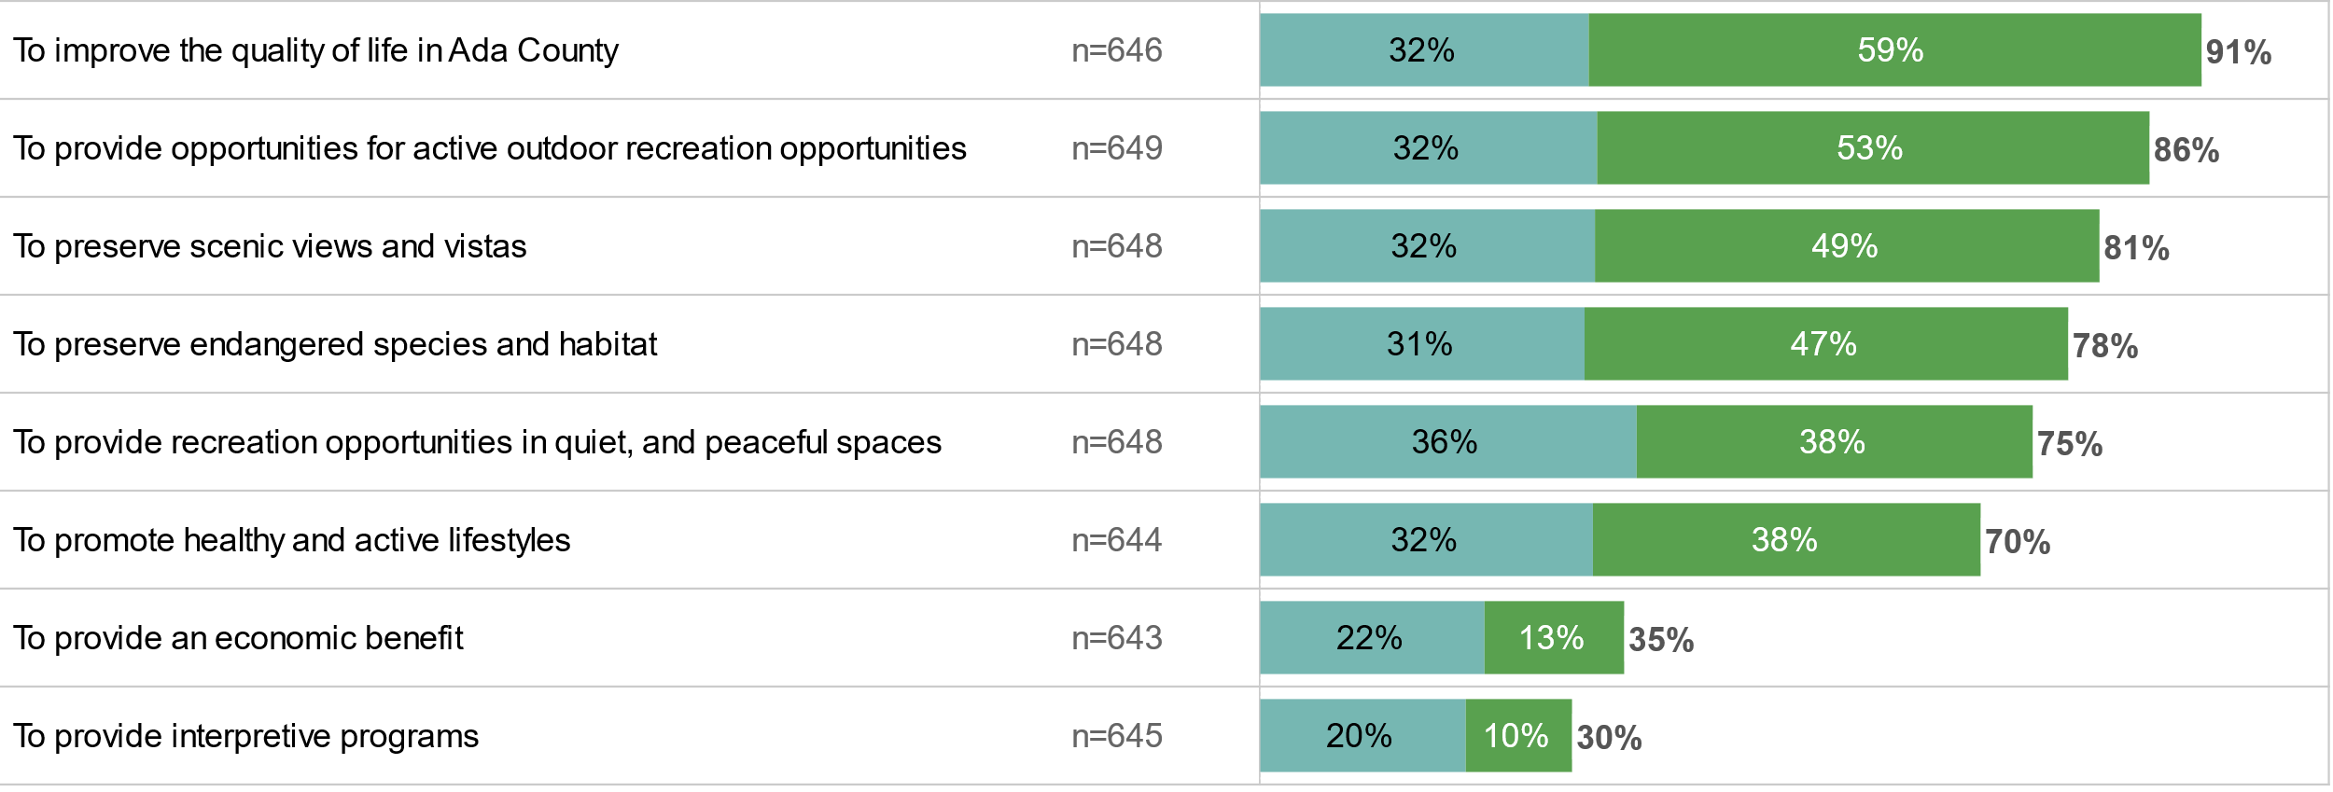

Needs Assessment Survey – Future Priorities
Ada County Open Space

Slide 66
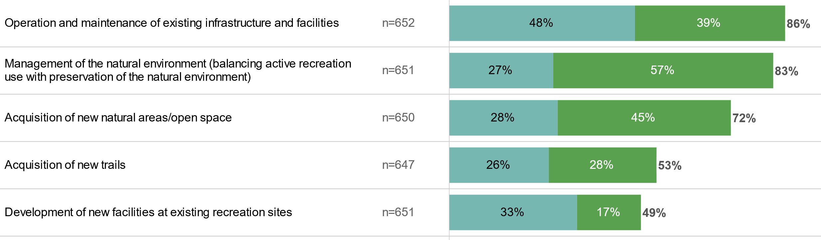

Needs Assessment Survey – Future Priorities
Ada County Parks & Waterways’ Future Priorities

Slide 67
Placer AI Data - Frequency of Barber Park Visits
Prior and Post Visit Travel

Slide 68
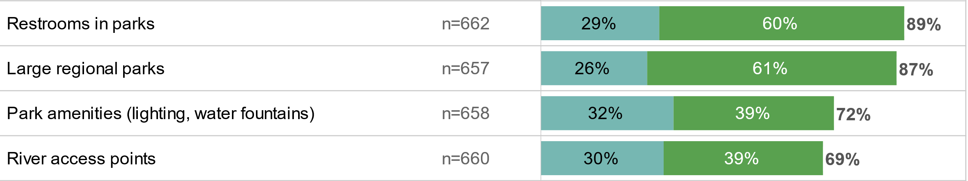
Needs Assessment Survey – Facilities and Amenities
Most Important facilities and amenities
On a scale of 1 (not important) to 5 (very important) Blue = 4 Green = 5

Slide 69
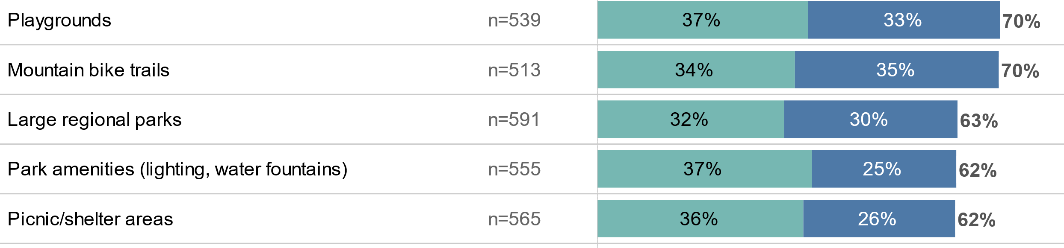
Needs Assessment Survey – Facilities & Amenities
Facilities and Amenities that best meet Community Needs
On a scale of 1 (not meeting needs) to 5 (meeting needs) = Green = 4, blue = 5
The survey asked residents about their experiences provided by both Ada County and other jurisdictions in the county

