Slide 1

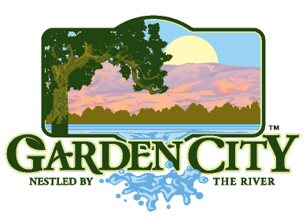
Garden City’s Comprehensive Plan
&
Expo Idaho

Slide 2
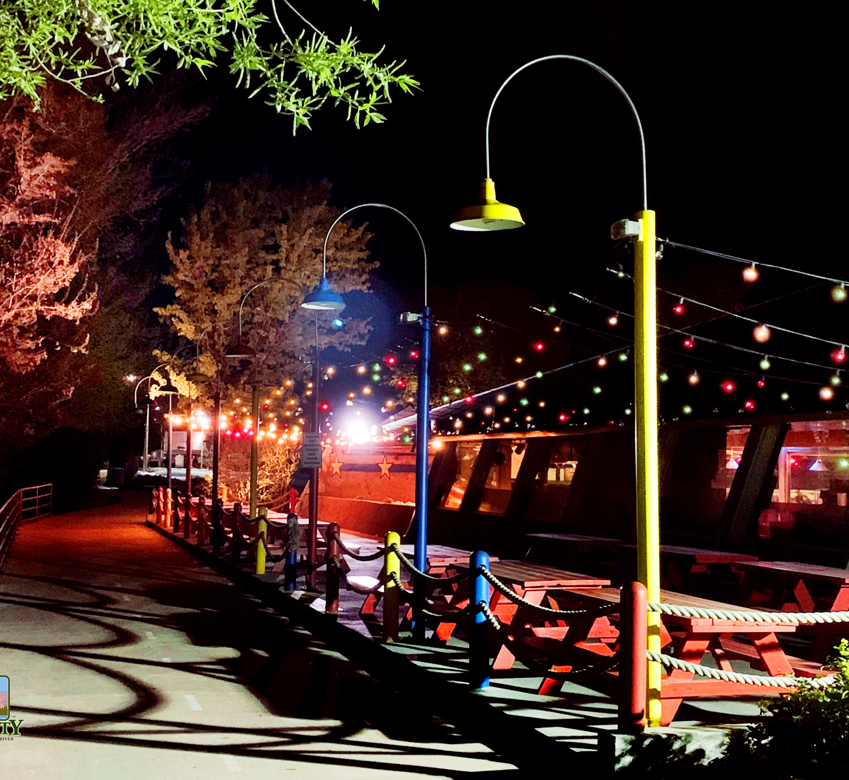
A snapshot of Garden City…
4.04 land square miles
6 miles of River
12,000 population/ 2,000 businesses
Average density 2,716 (Average density in Idaho 19.5) - Urban issues on a small-town budget
Diverse socioeconomic spectrum
Part of a rapidly growing region
Physically constrained by river, bench and 3 highways, and adjacent cities
Costs of services increasing
Lacks downtown
Average of 160,000 cars/ day (GCPD)
Limited sidewalks, bike paths, transit, especially in eastern portion of city
Lack of safe-routes to schools
Expo Idaho is in the middle

Slide 3
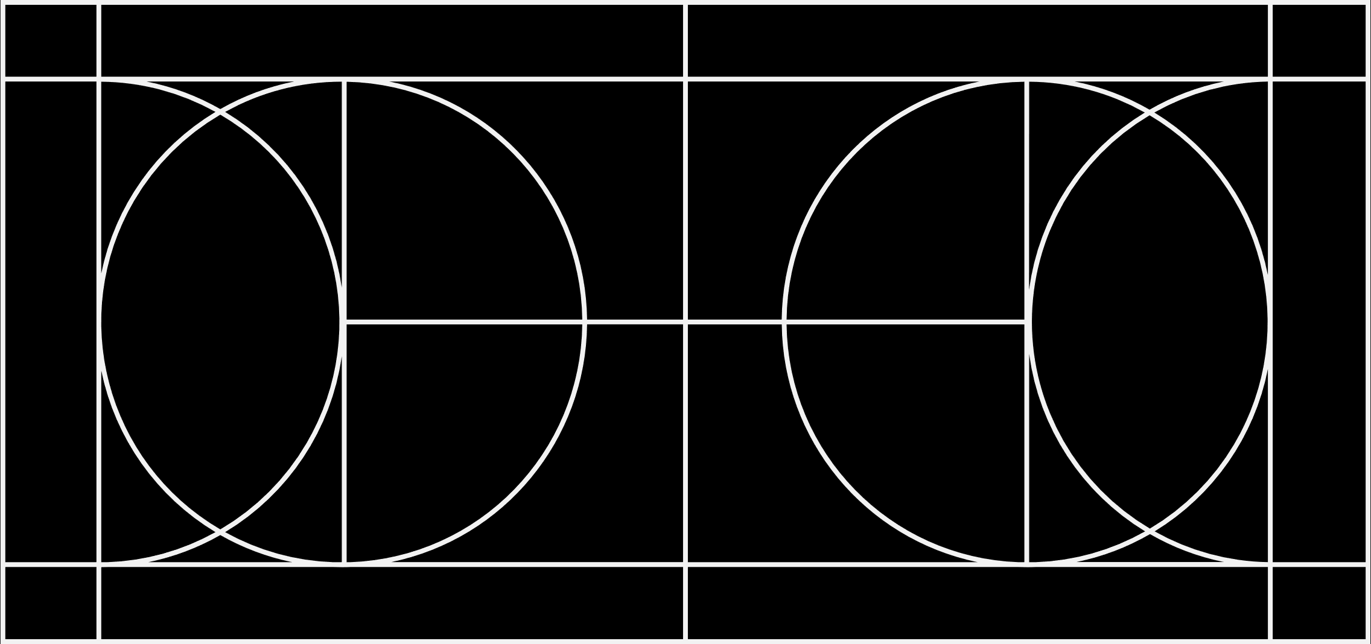
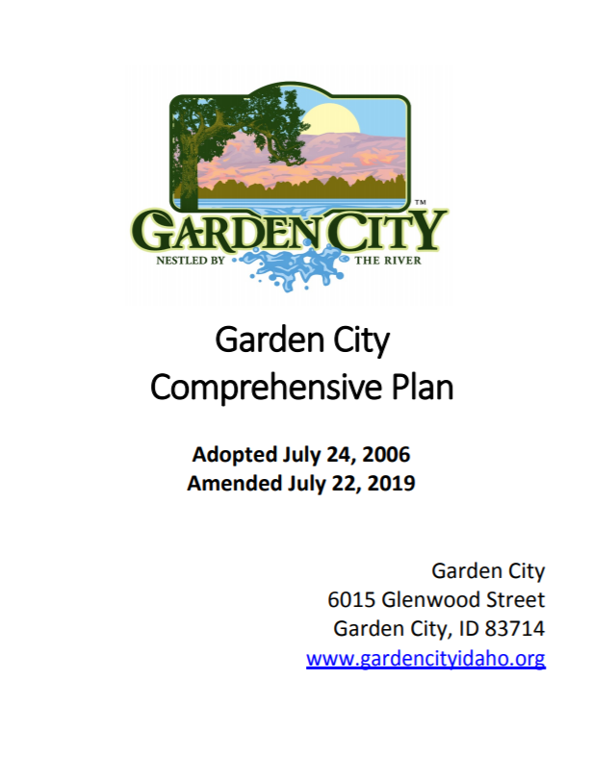
COMPREHENSIVE PLAN
The adopted plan for Garden City pursuant to the Local Land Use Planning Act, Idaho Code section 67-6501.

Slide 4
Comprehensive Plan: Goals and Objectives
Objective
1.3
Consider the needs of all citizens, businesses and the environ-ment
Objective
1.4
Create a premier destination place to live, work, and recreate.
Goal
5
Focus on the River
Goal
6
Diversity in Housing
Goal
7
Connect the City
Goal
8
Maintain a safe City
Goal
9
Develop a Sustainable City
Goal
10
Plan for the Future
Goal
11
Serve the City
Goal
12
Evolve as a Destination

Slide 5
Roads and mobility
Connect the City
Consider the needs of all citizens
Maintain a safe City
Serve the City

Slide 6
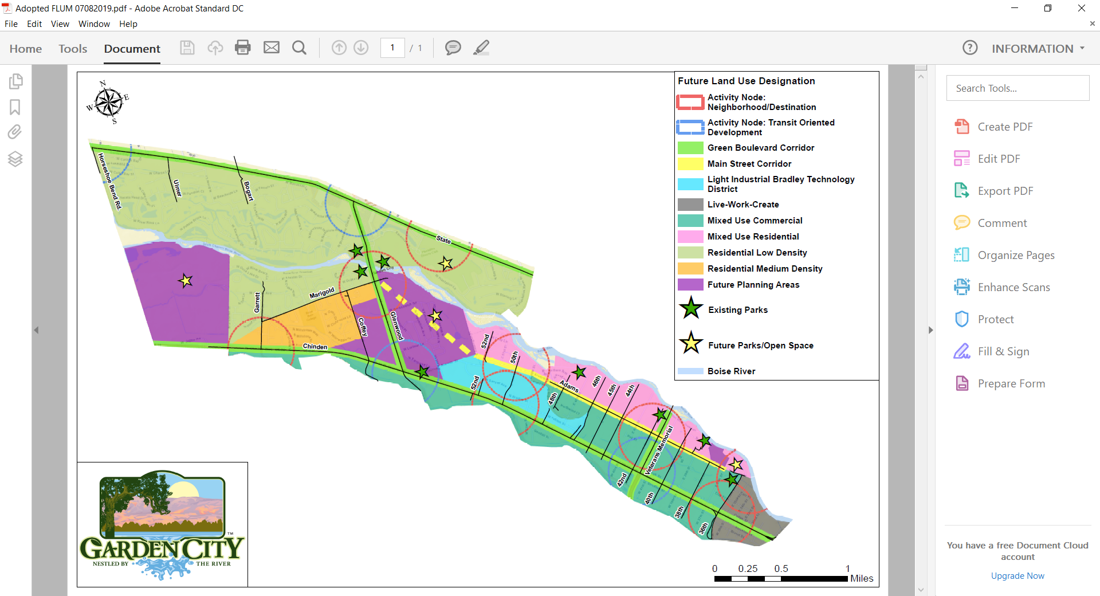
Connect Marigold and Adams/Alworth local spine and dynamic Main Street

Slide 7
Safe Routes to School
Riverglen Jr. High
Pierce Park Elementary
Capital High

Slide 8
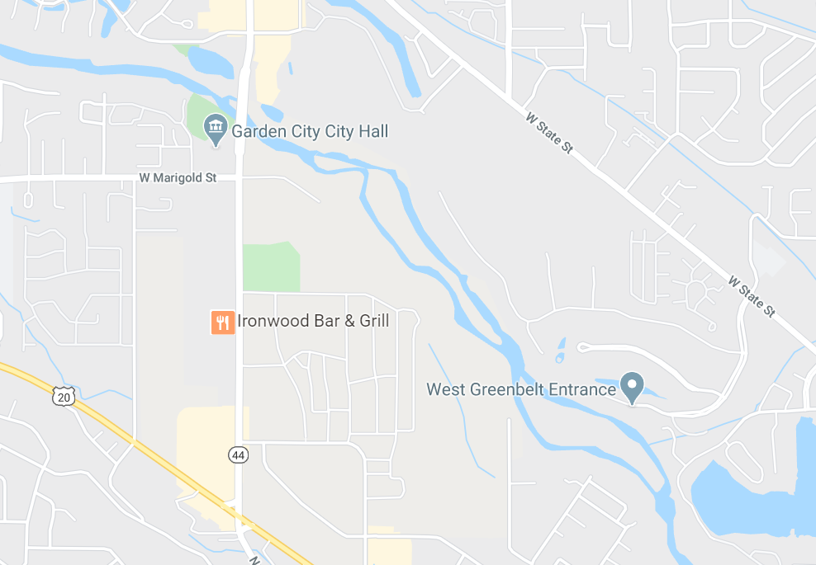

Glenwood

Slide 9
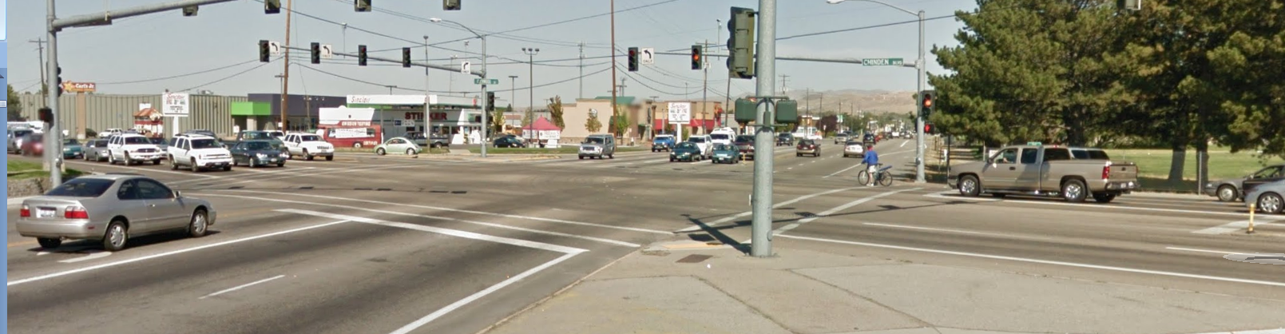
Chinden in 2017
991 citations= 18.5% of citations in Garden City (state facilities 1,453/ 5,367 total)
32 accidents = 25% of the accidents in Garden City (74% on State facilities)
~ 40,000 cars/ day at Glenwood (ACHD counts in 24-hour period)
Census track 11 from Glenwood to east end of town
Robert Wood Johnson Foundation Program County Health Rankings & Roadmaps indicates that Social and Economic factors in conjunction with Physical Environment = 50% determinant of health and life expectancy (Other 50% is health behaviors and clinical care)

Slide 10
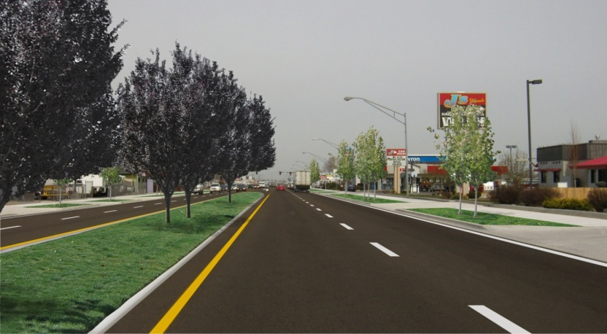
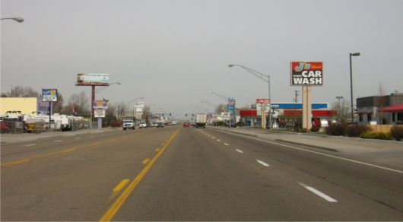

Slide 11
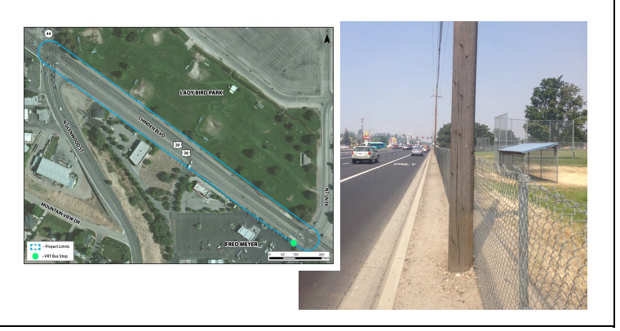
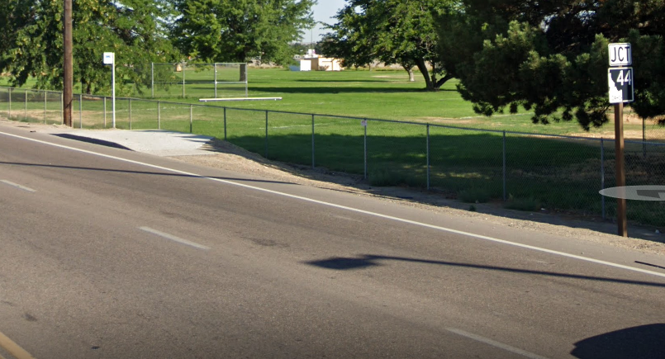
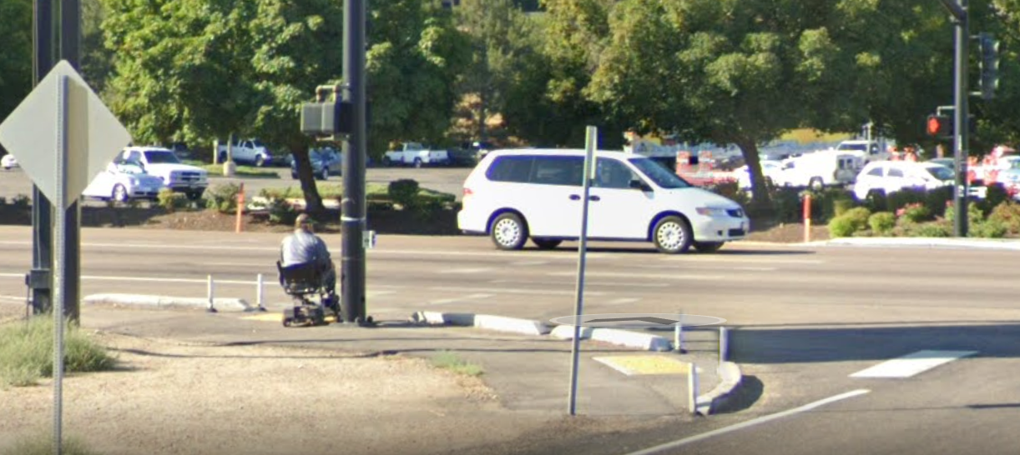
Glenwood to Kent
A. Lady Bird Park Trail
B. VRT Bus Pad Relocation

Slide 12
Floodplain
Focus on the river
Develop a sustainable City
Maintain a safe City
Serve the City

Slide 13
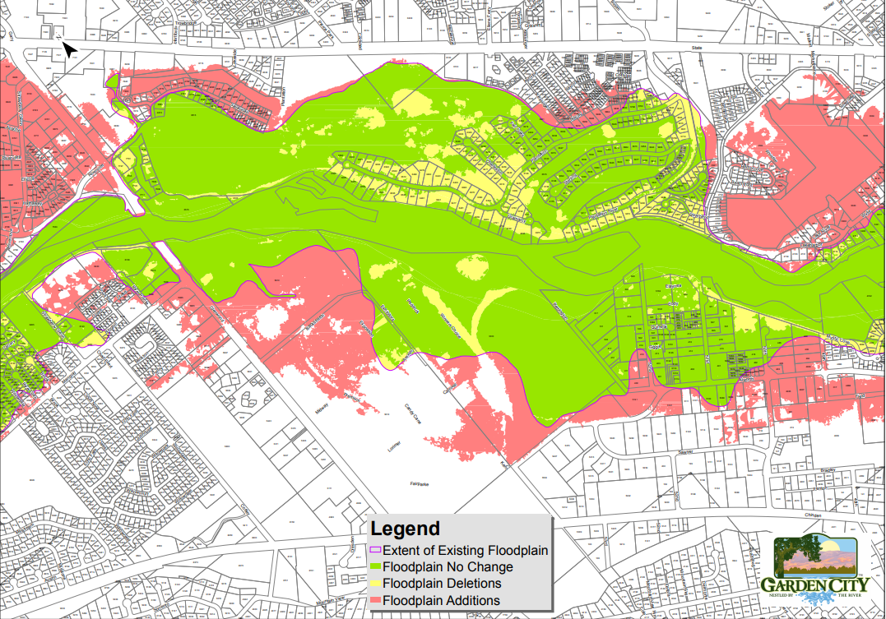
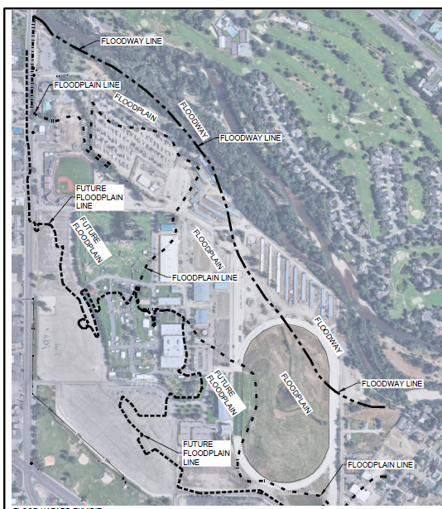
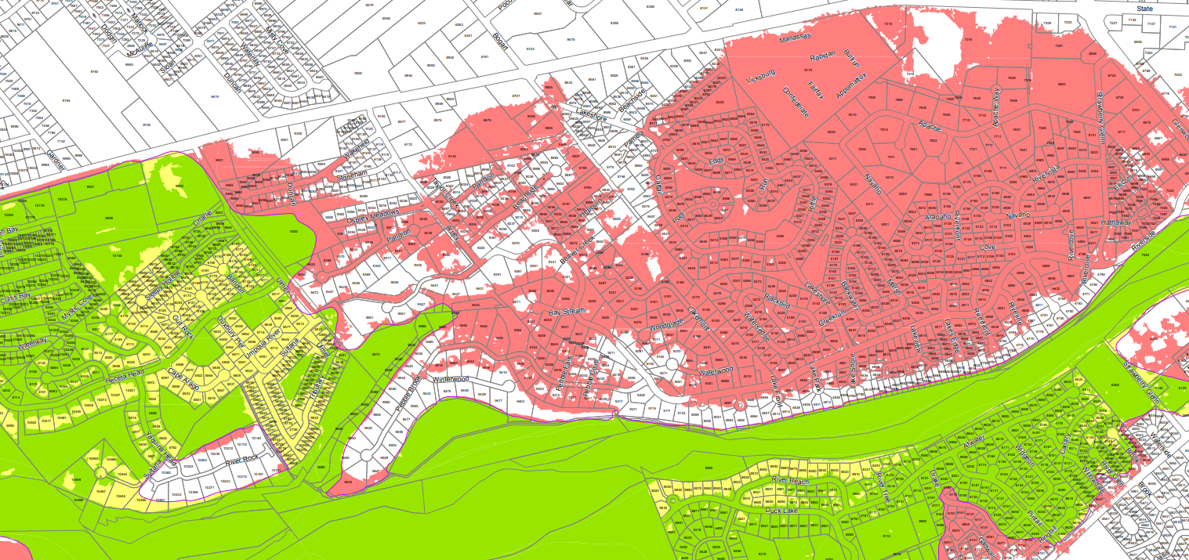

Slide 14
Other City Systems
Plan for the future
Serve the City
Maintain a safe City
Consider the needs of all citizens, businesses, and the environment

Slide 15
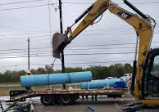
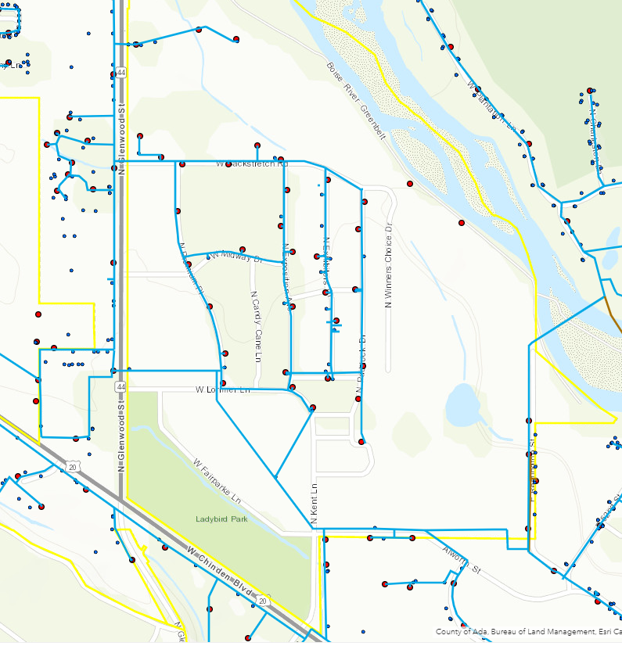
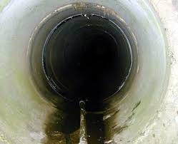
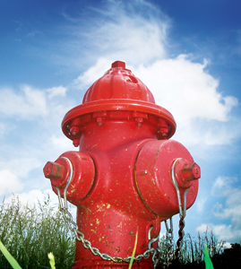
Utilities

Slide 16
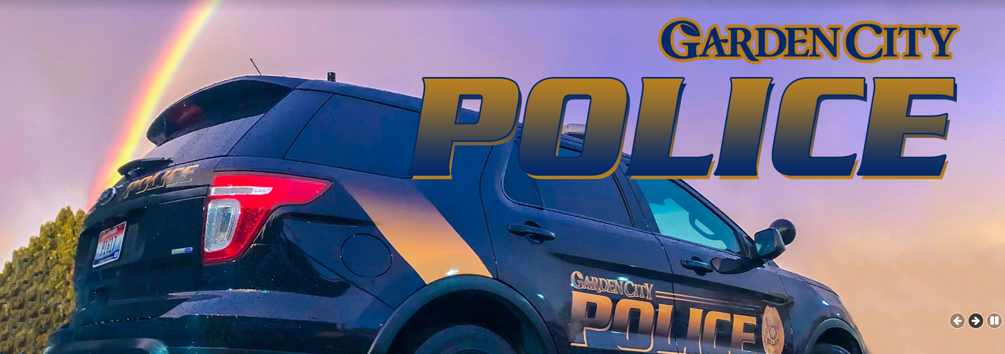

Slide 17
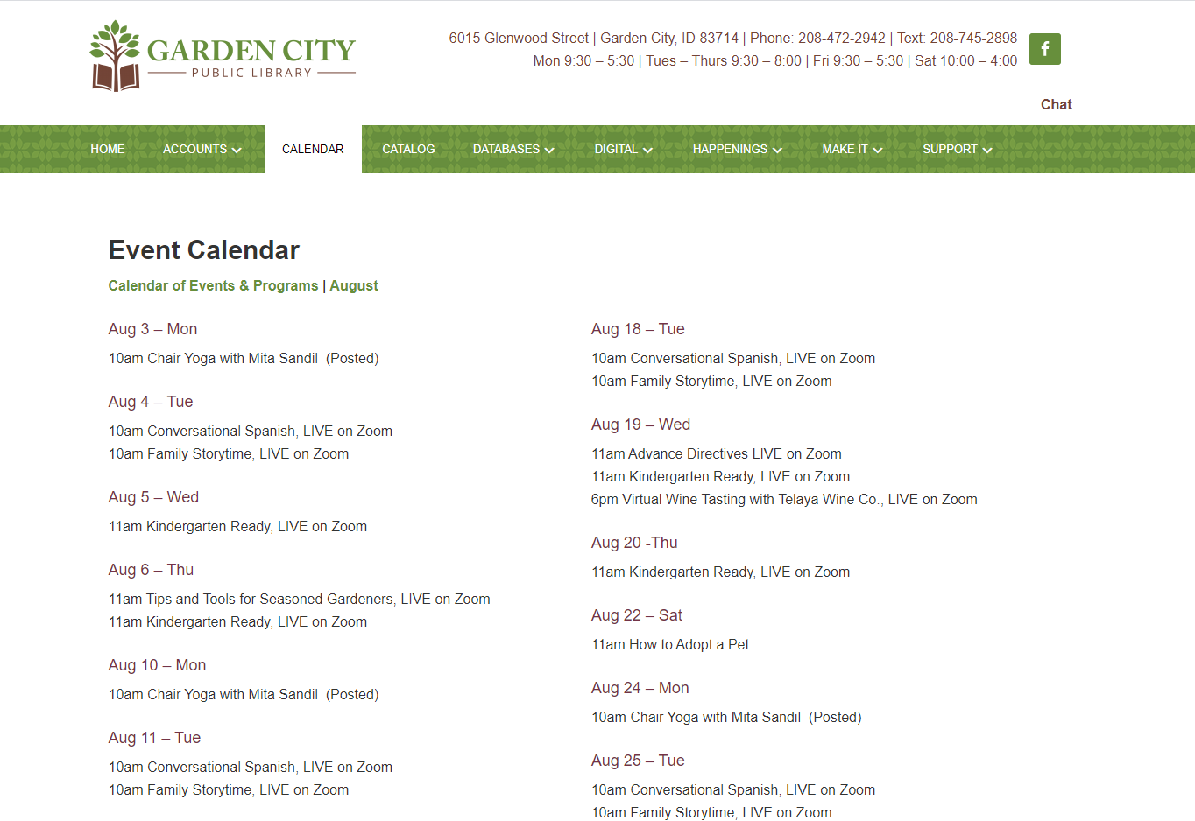

Slide 18

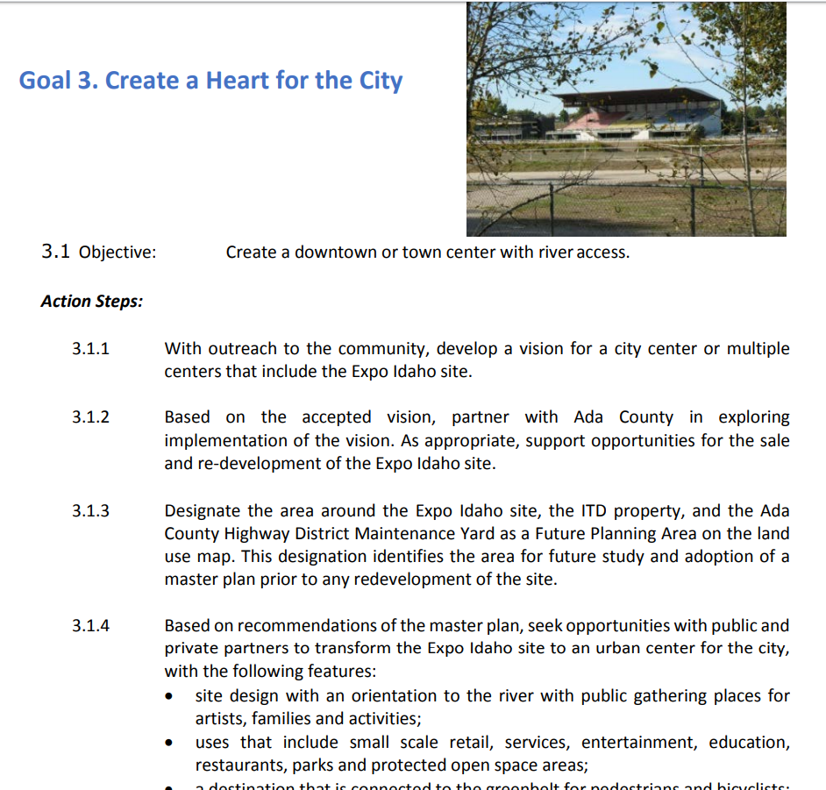

Slide 19
2019 Comprehensive Plan: Future Land Use Designations

Slide 20
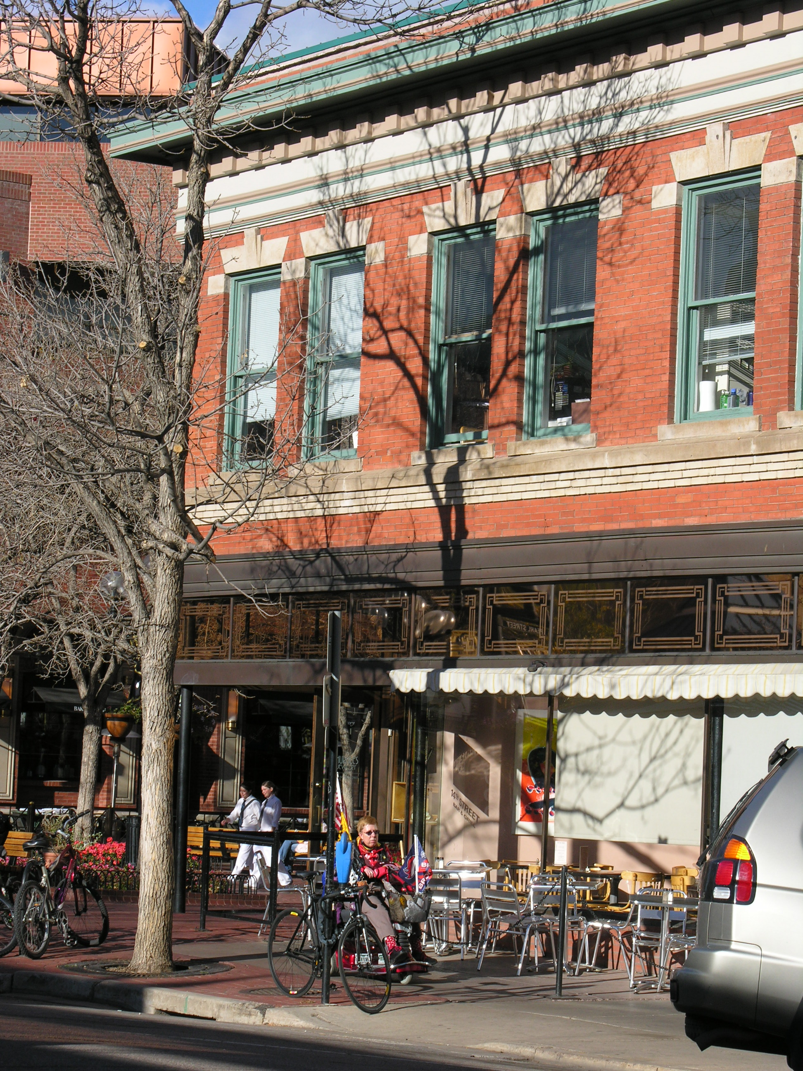
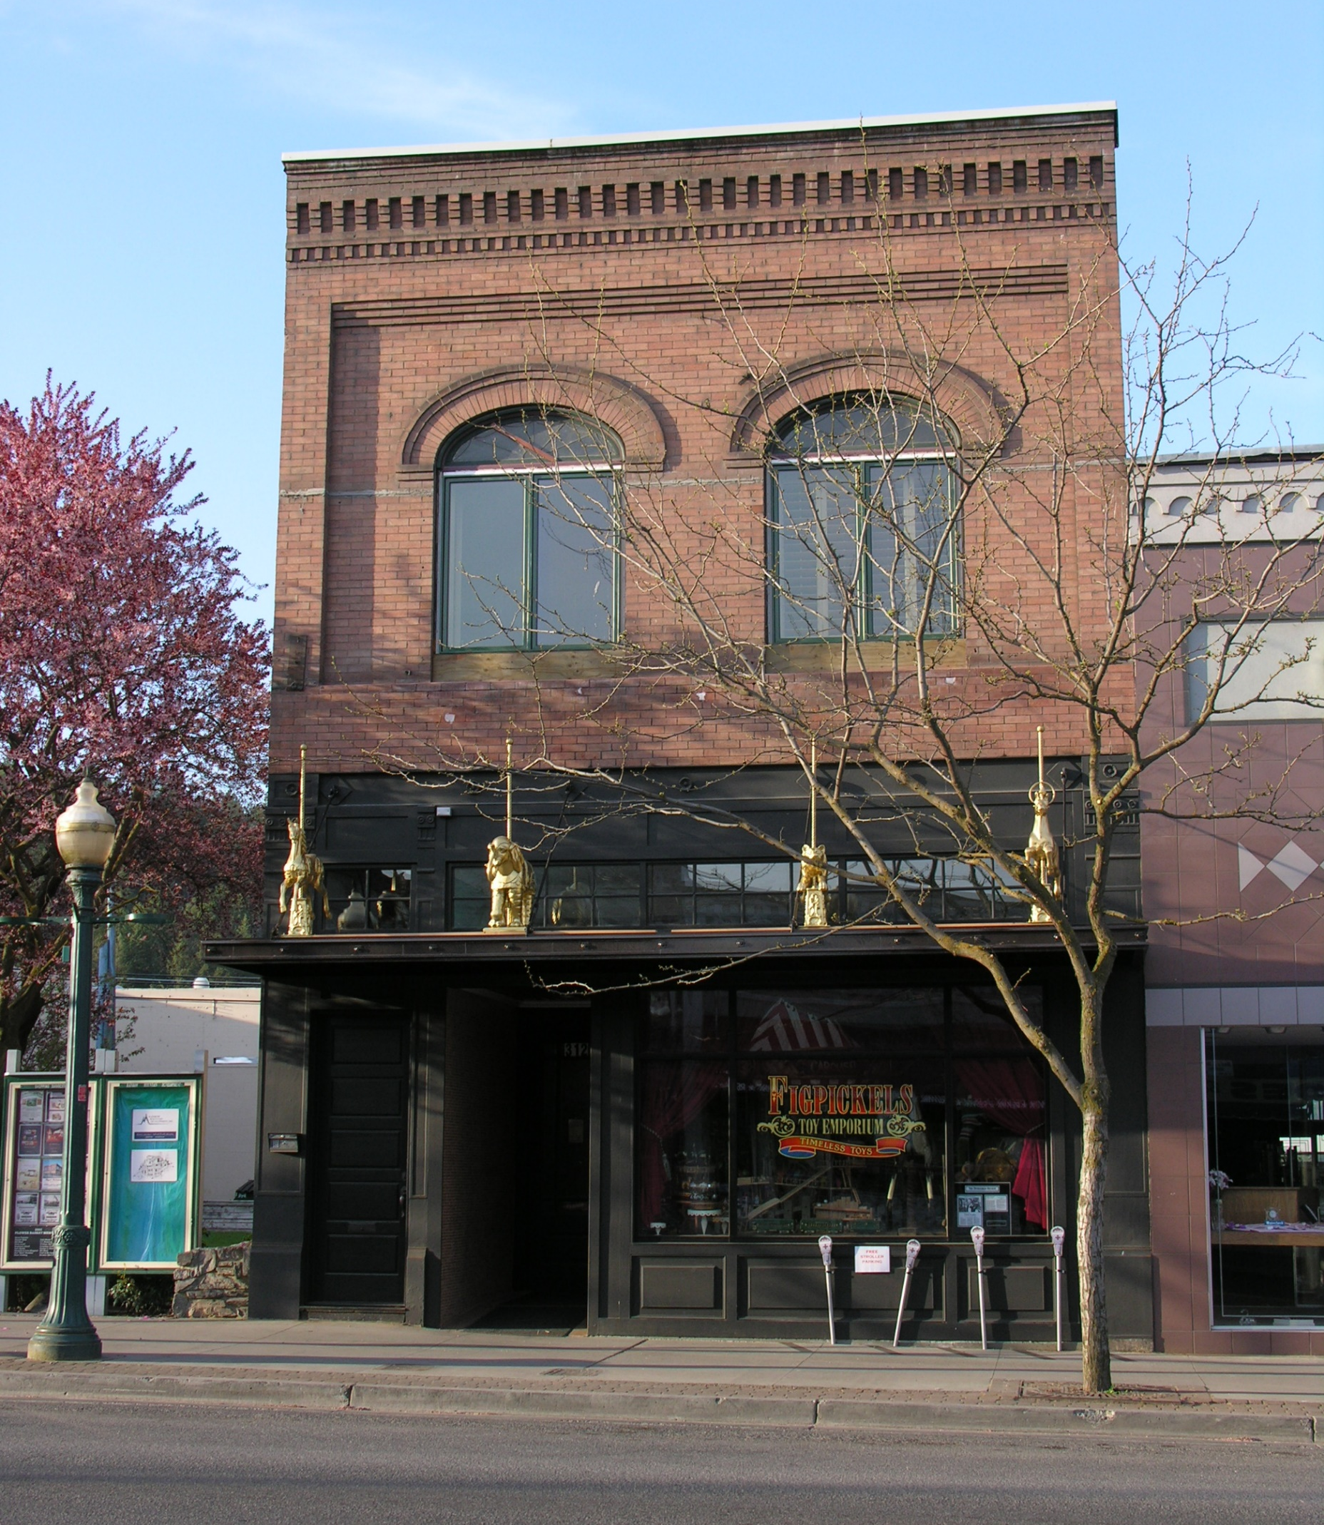
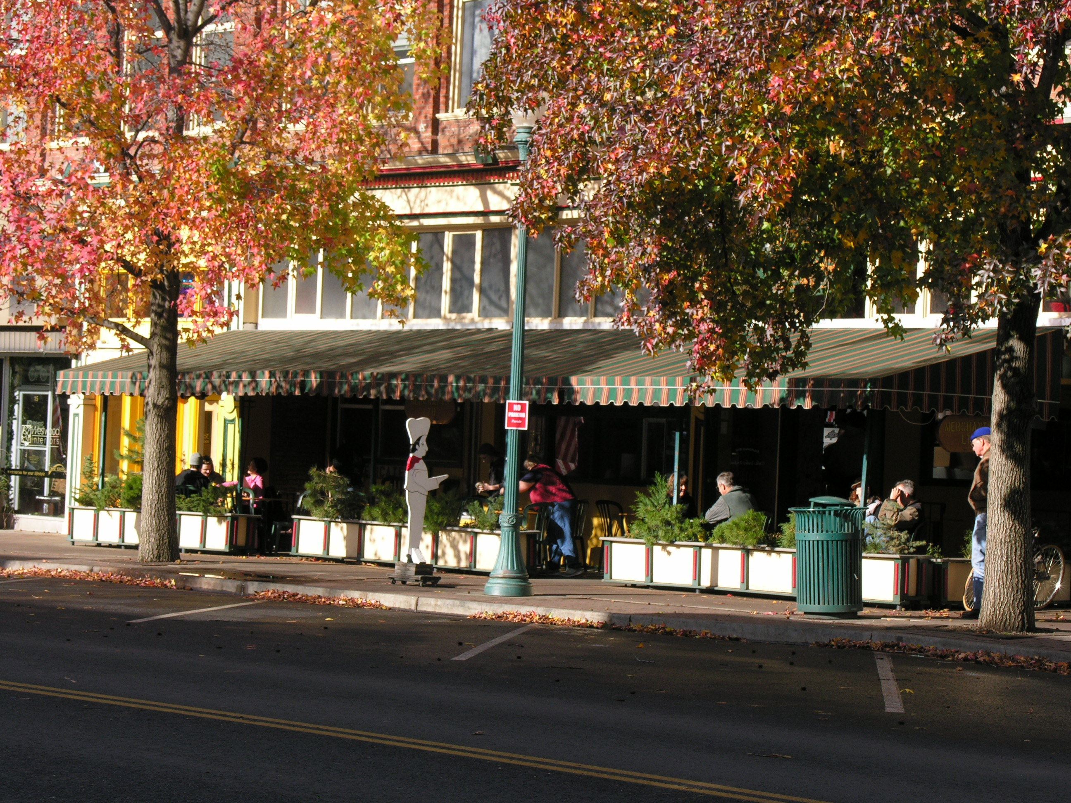

Slide 21
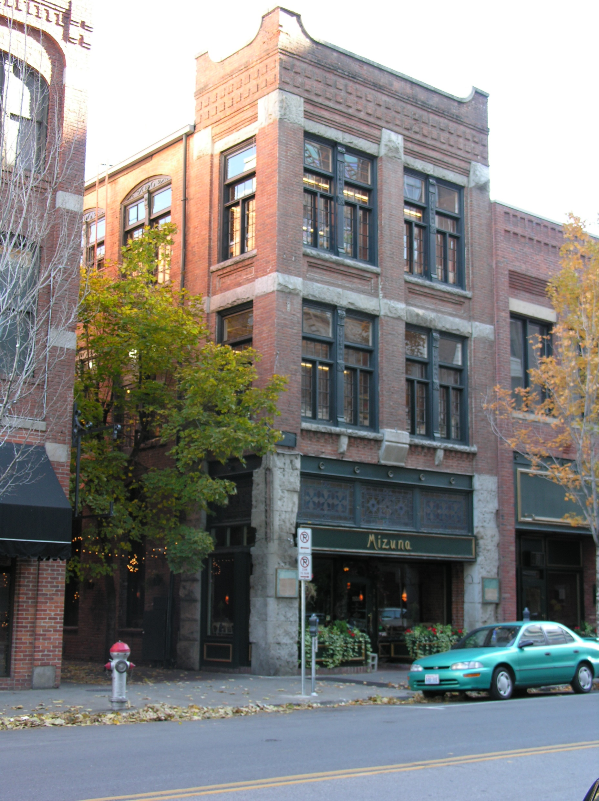
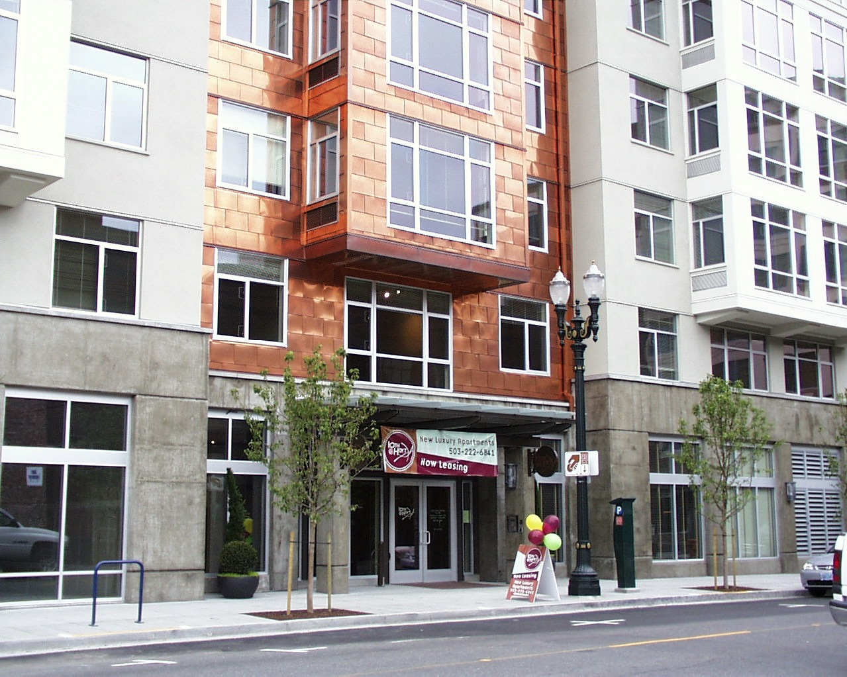
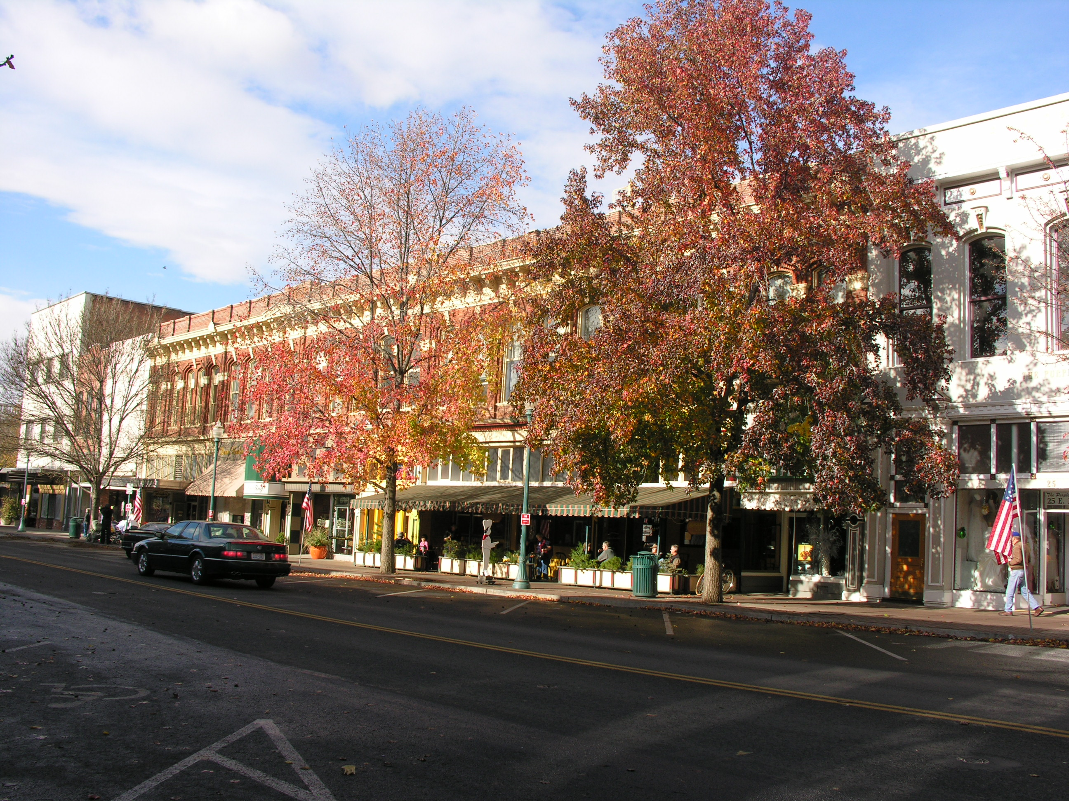
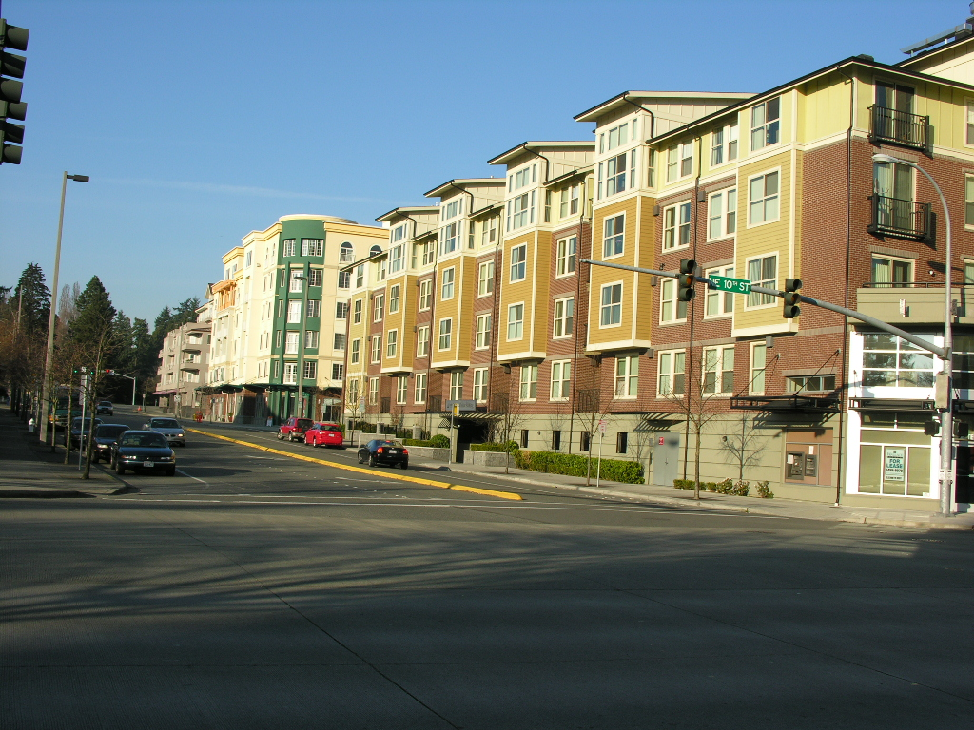
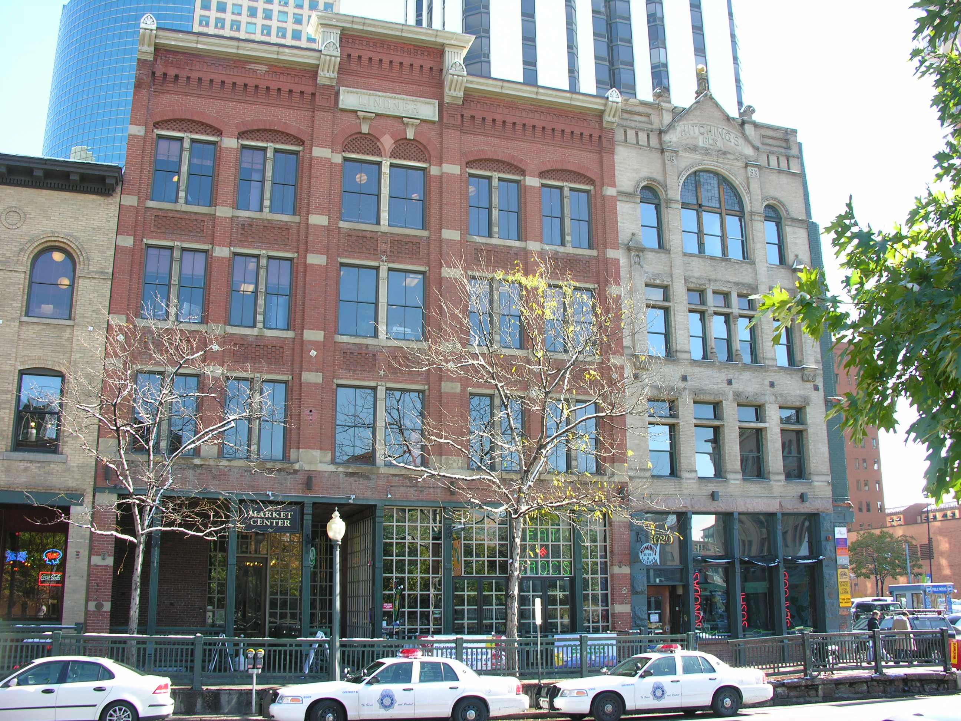

Slide 22
Garden City Urban Center
Adapted from Misty (Royball) Kreissler presentation utilized as an exhibit in the creation of the 2006 Comprehensive Plan

Slide 23
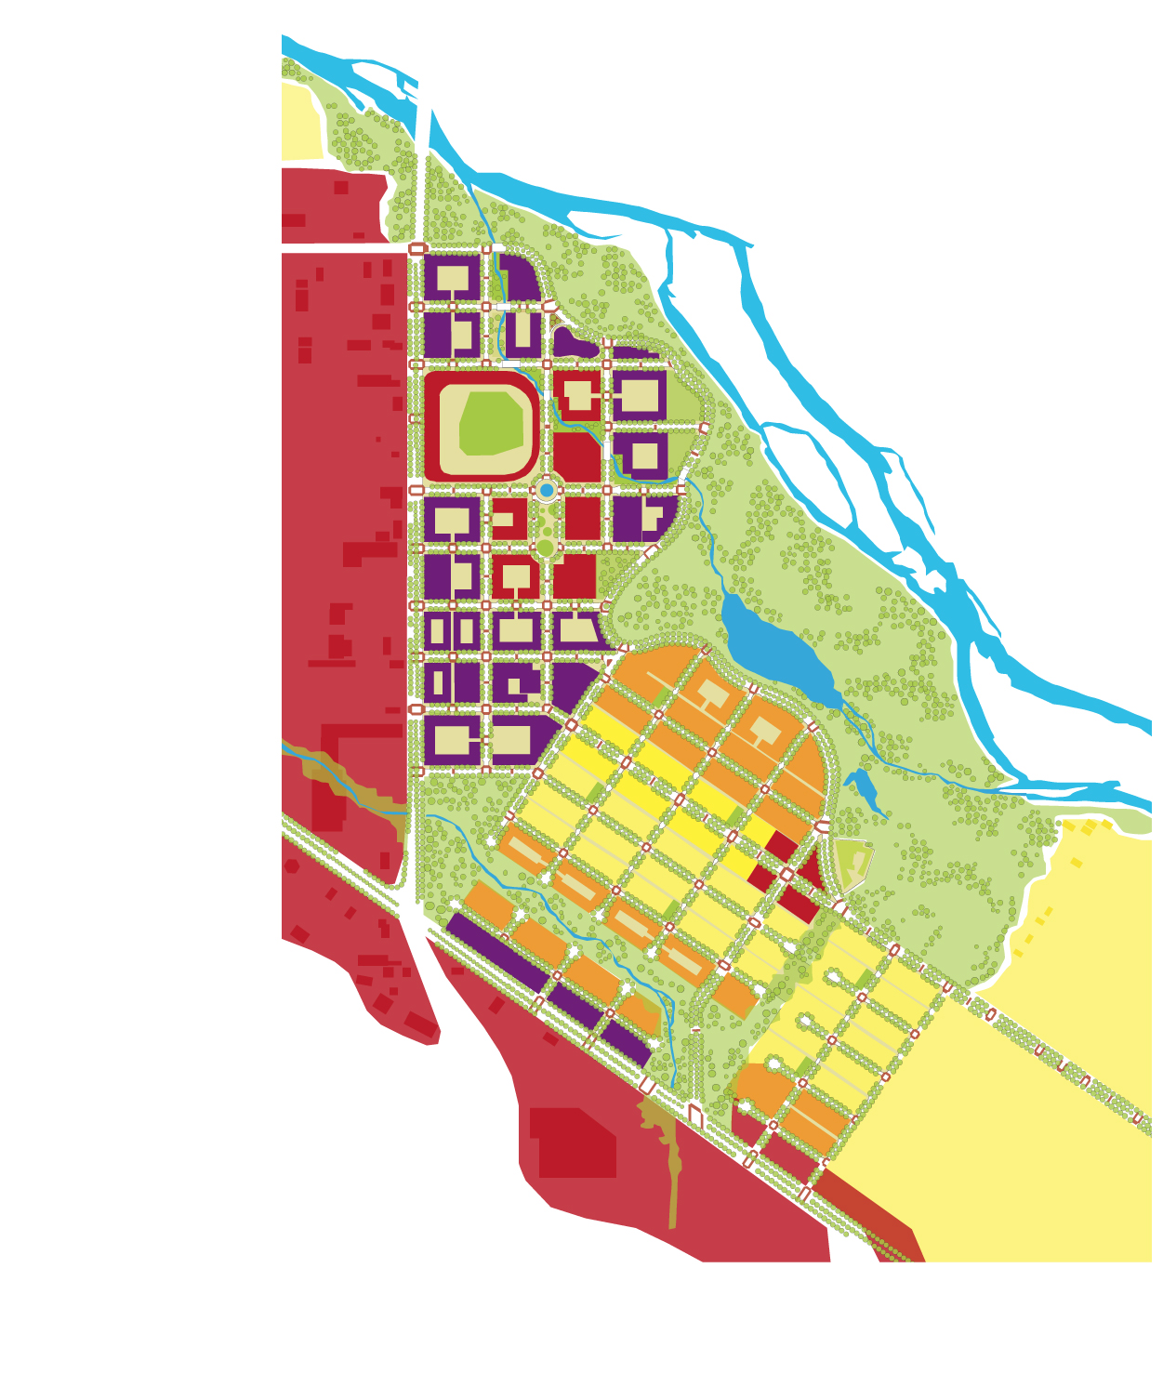

Slide 24
Garden City + Chinese Garden

Slide 25
Chinese Garden
Cultural experience- not scenic
A spiritual utopia for man to connect with nature
Artificial, but made to look natural
Naming Conventions
Three-fold space
Human scale living spaces with a poetic response
Urban Design
Community experience
A place for sustainable living, work, and recreation
Architecture and landscape responsive to historical patterns, precedents, and boundaries
Place and order
Character and identity
Designed community with a response to commercial, social, psychological needs

Slide 26
Design Generators

Slide 27
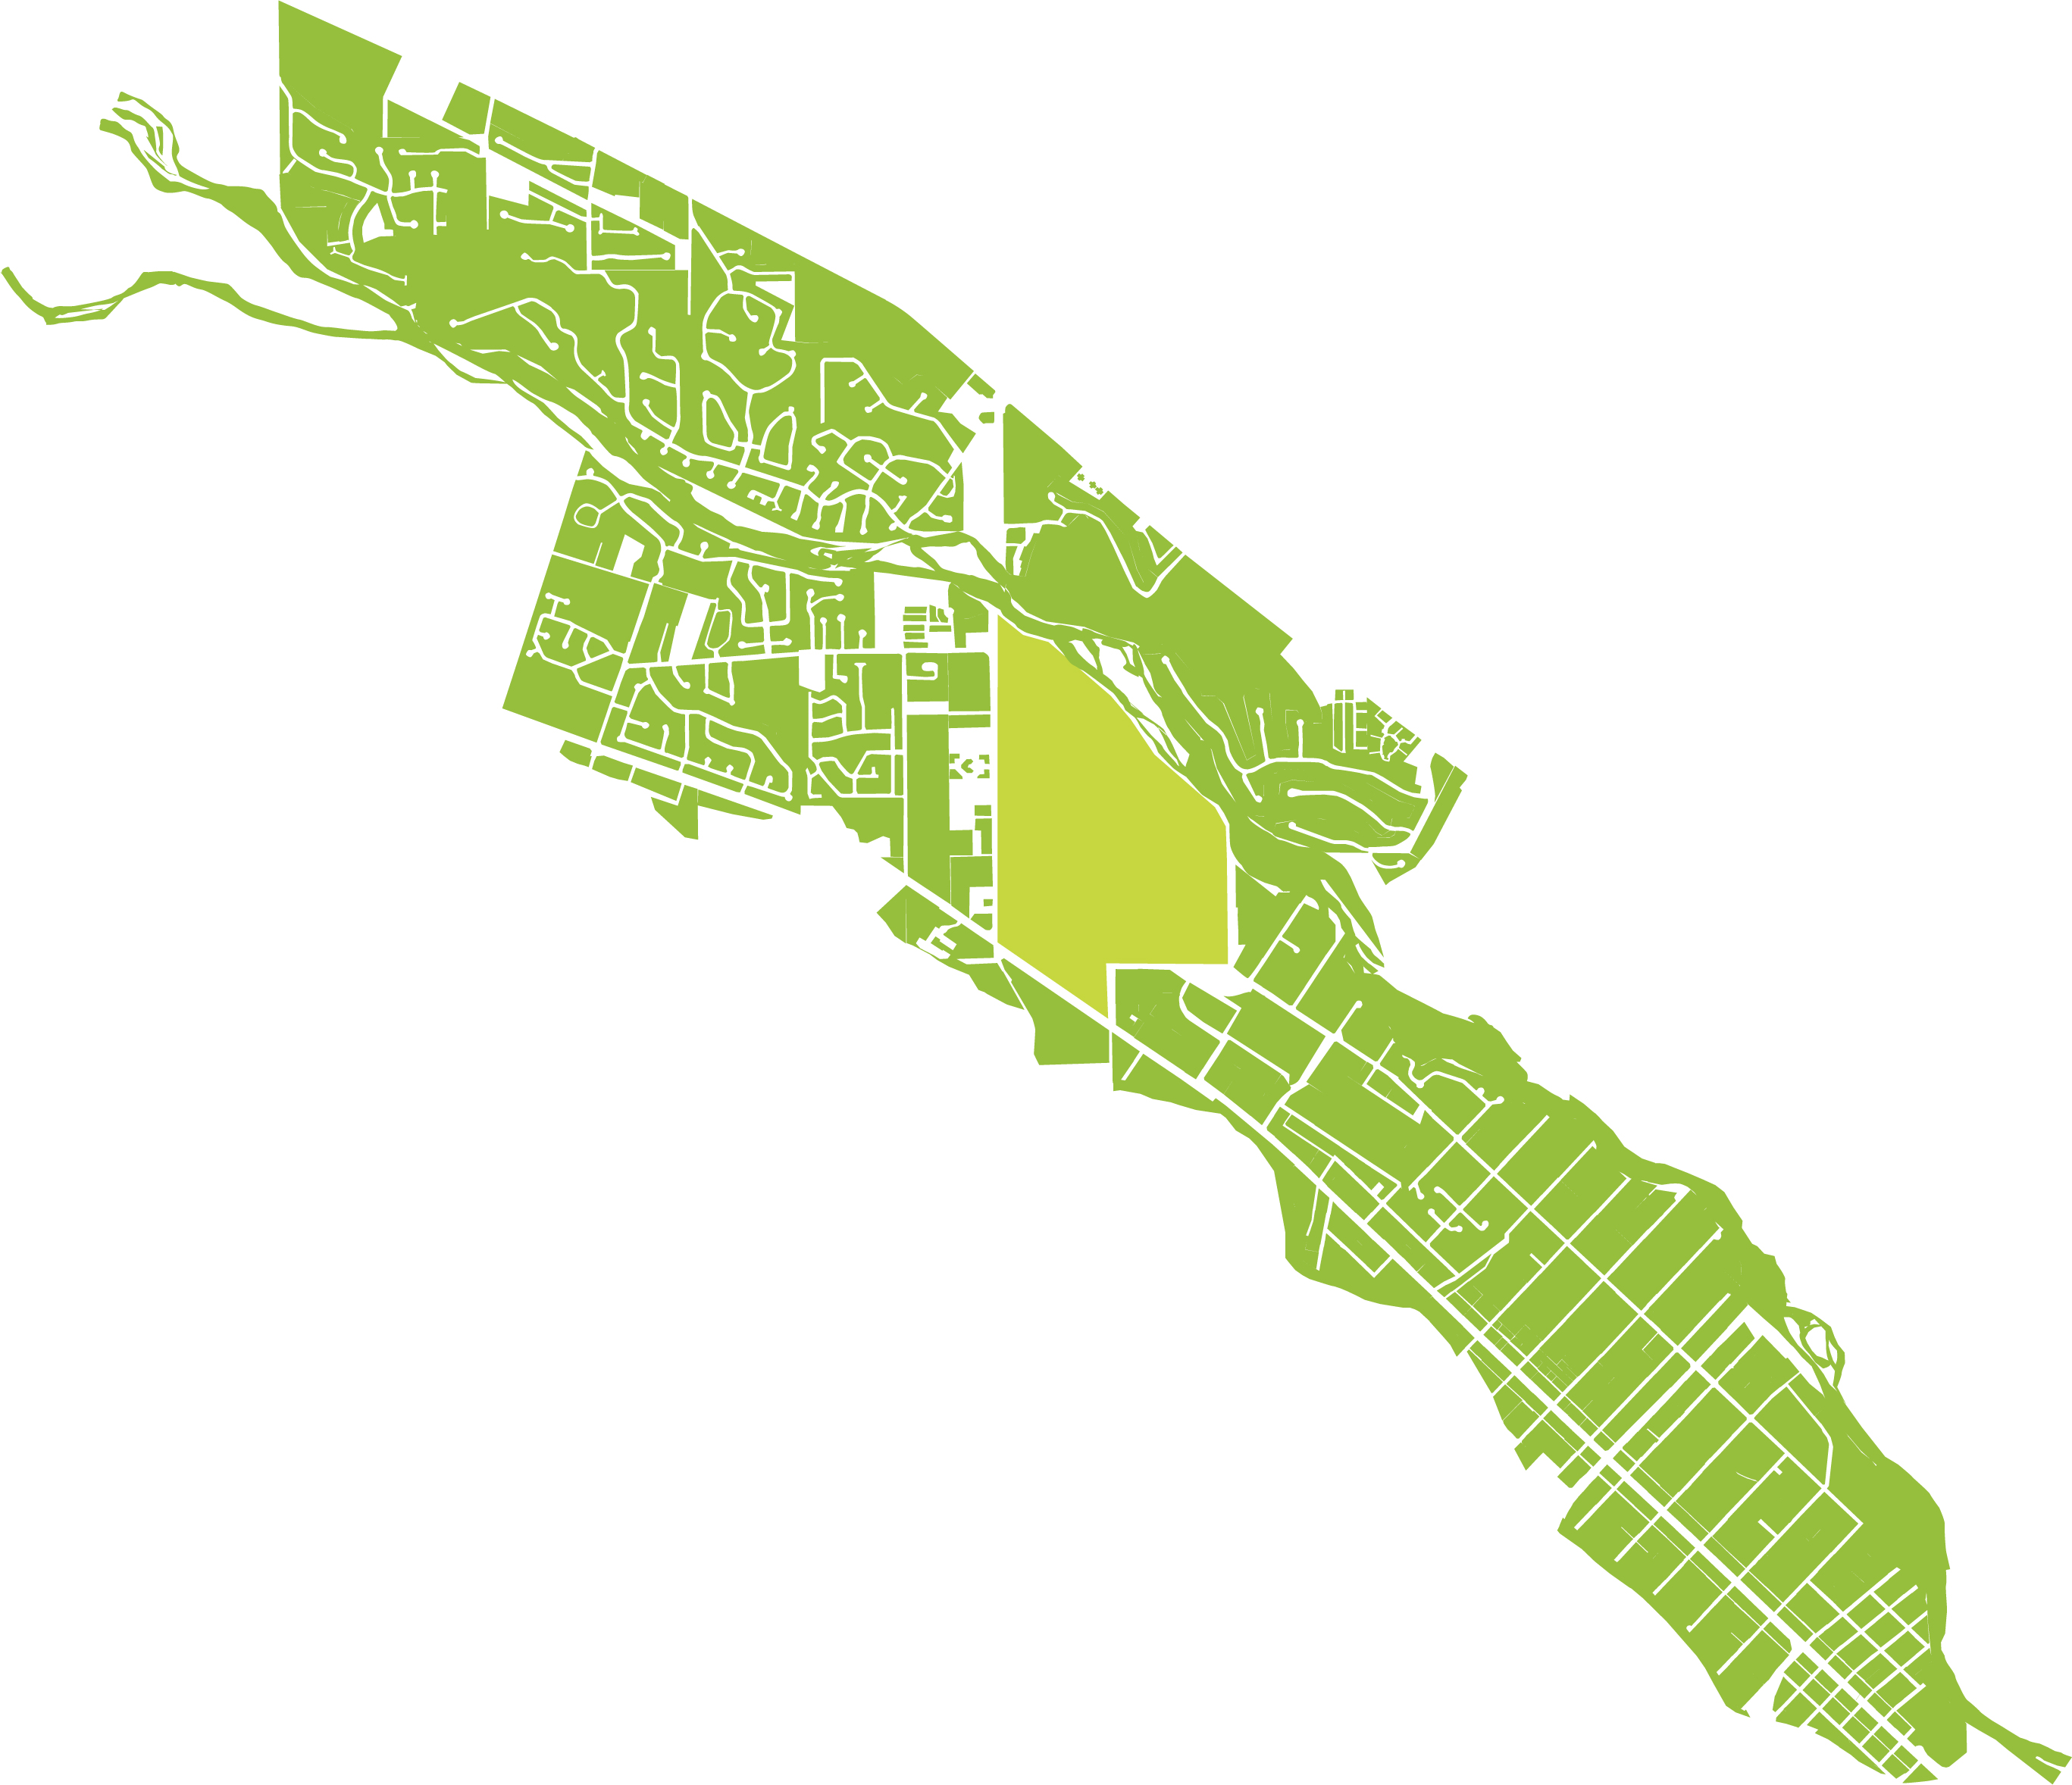

Slide 28
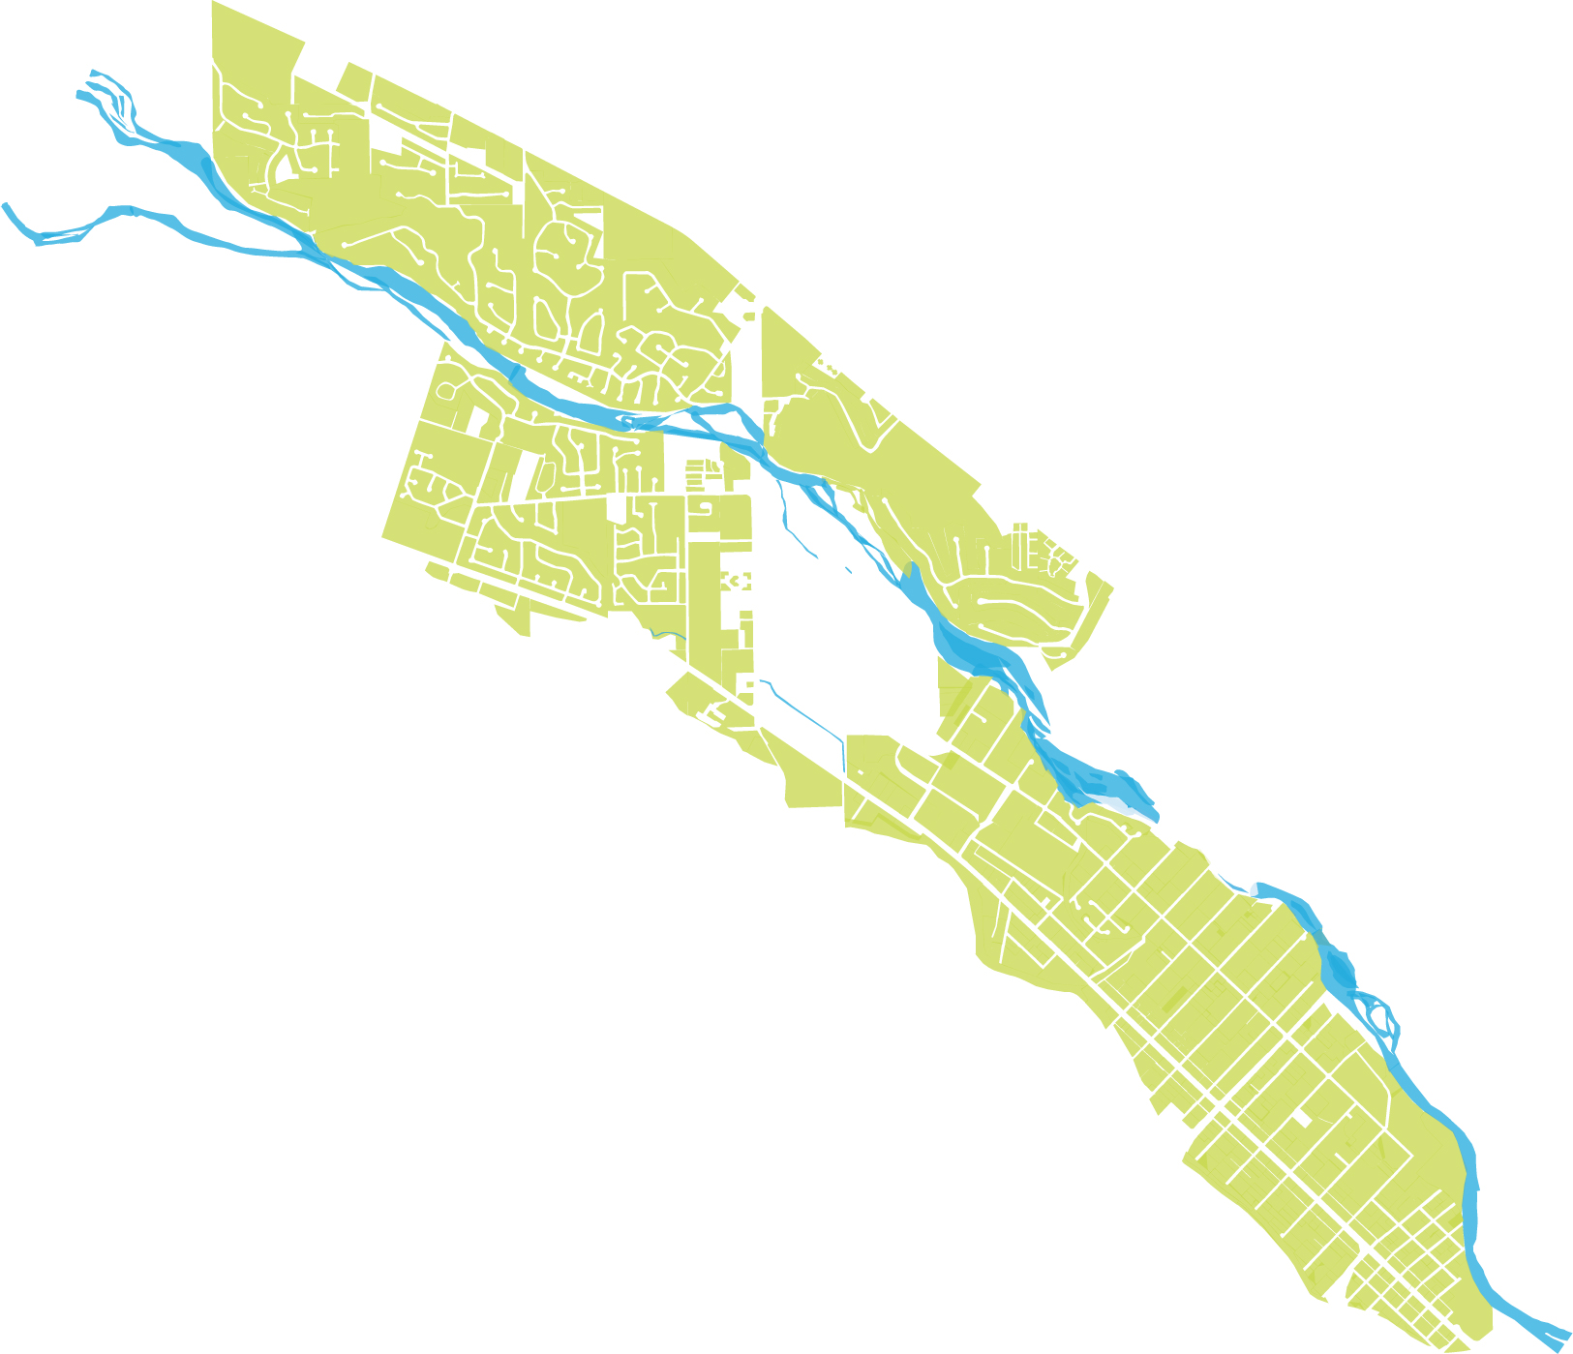

Slide 29
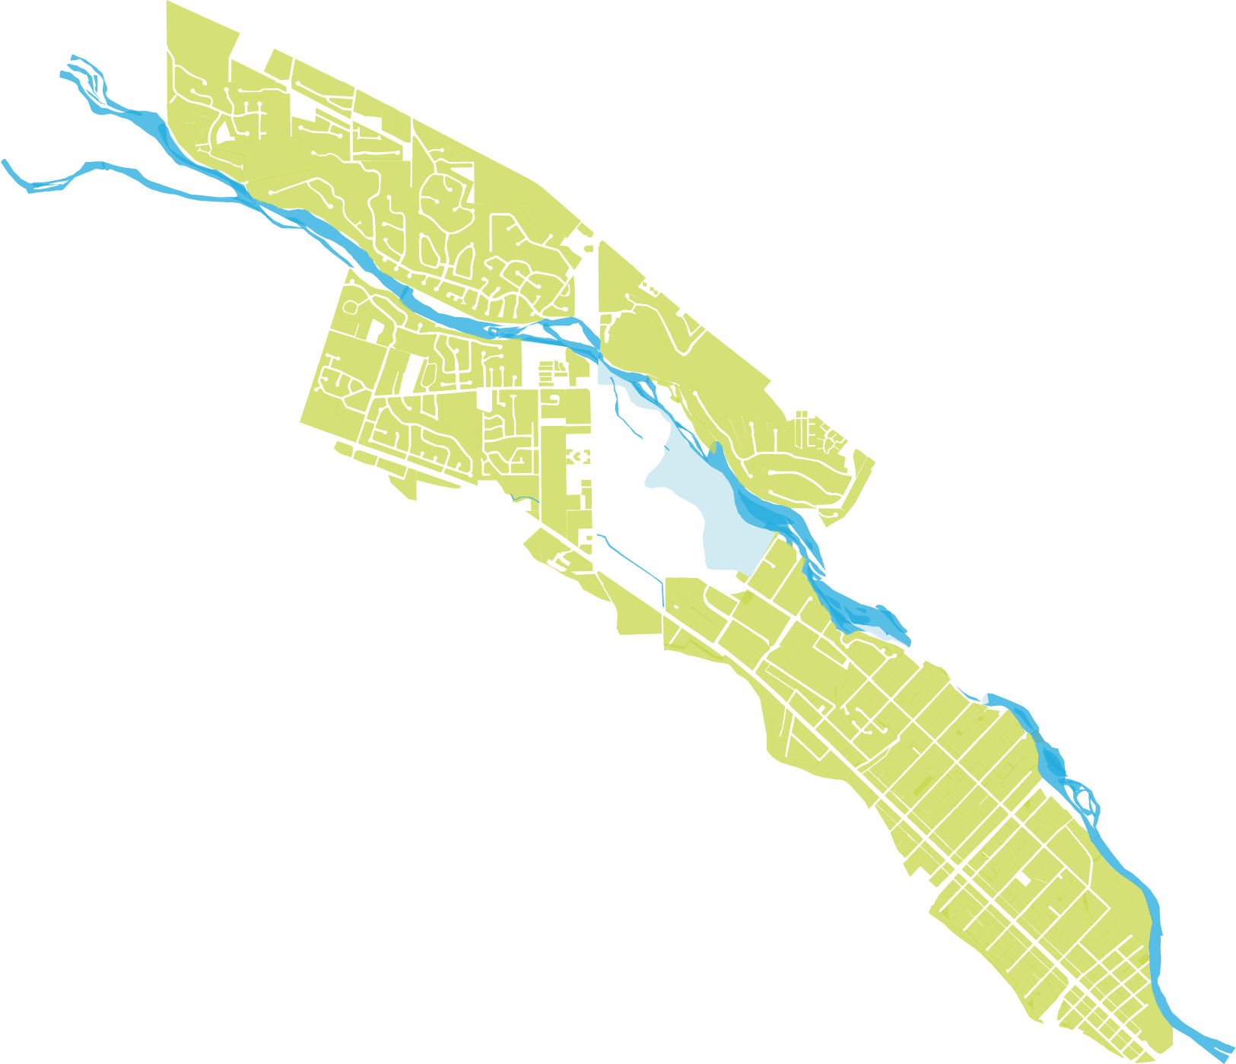

Slide 30


Slide 31
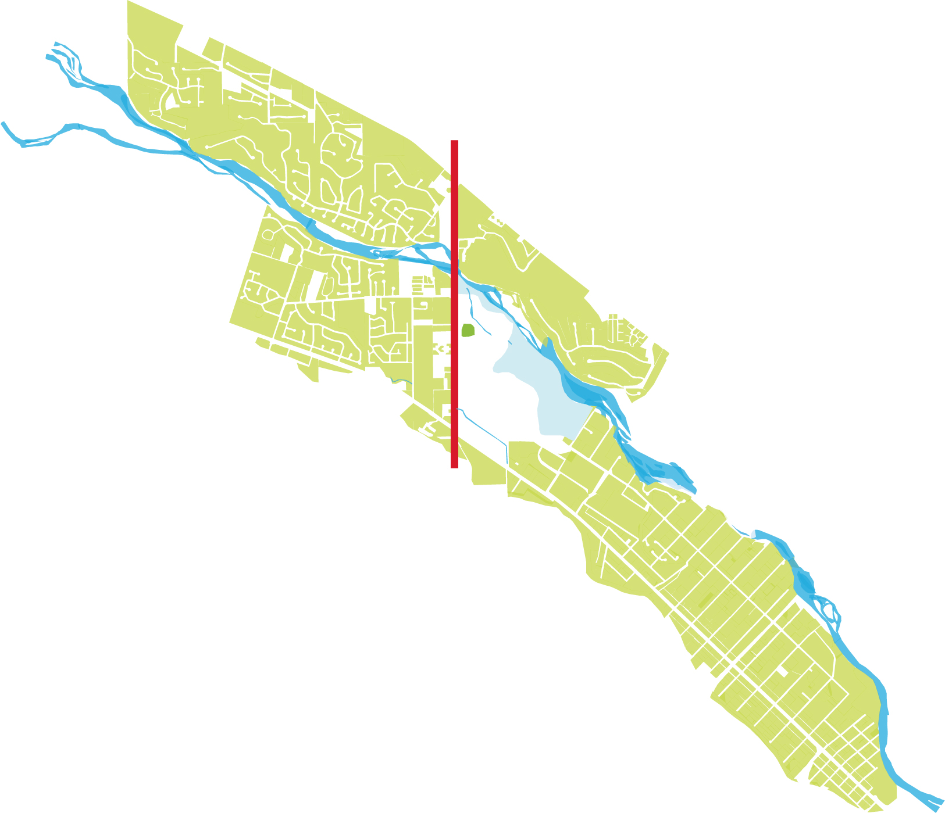

Slide 32
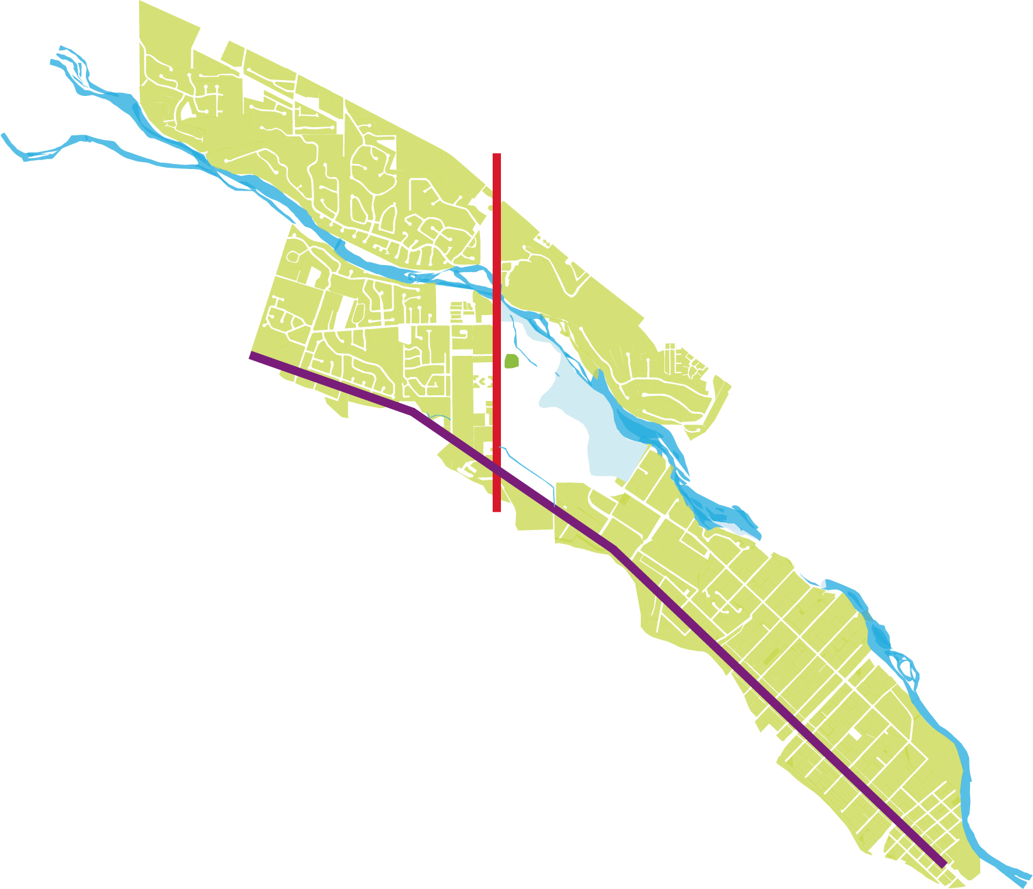

Slide 33
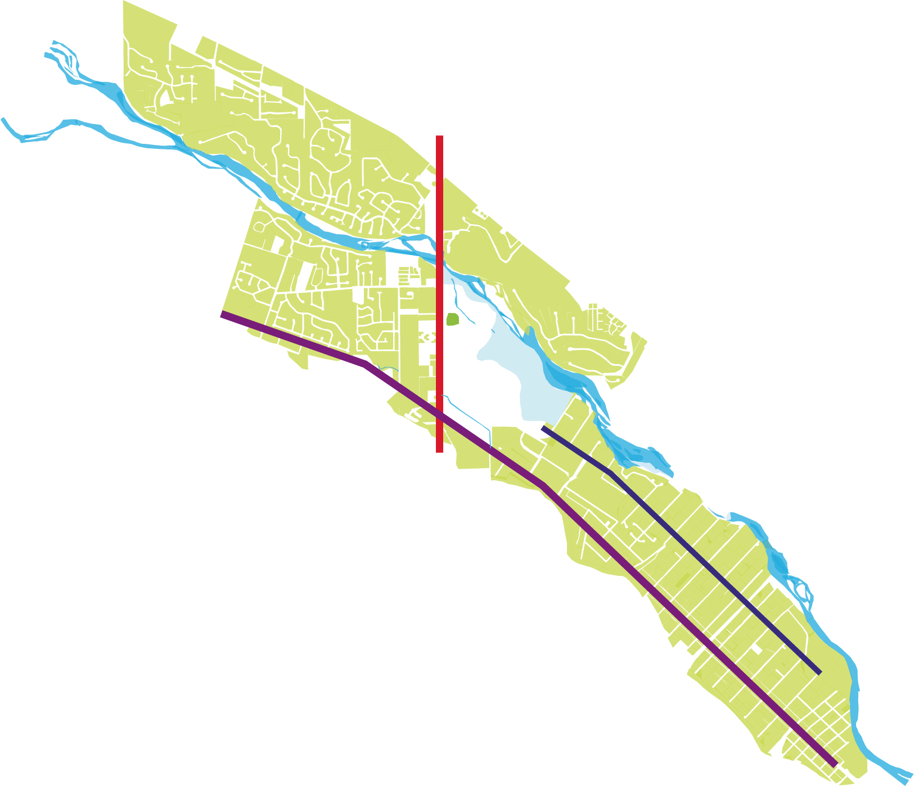

Slide 34
Vehicular Pathways as Garden Path

Slide 35
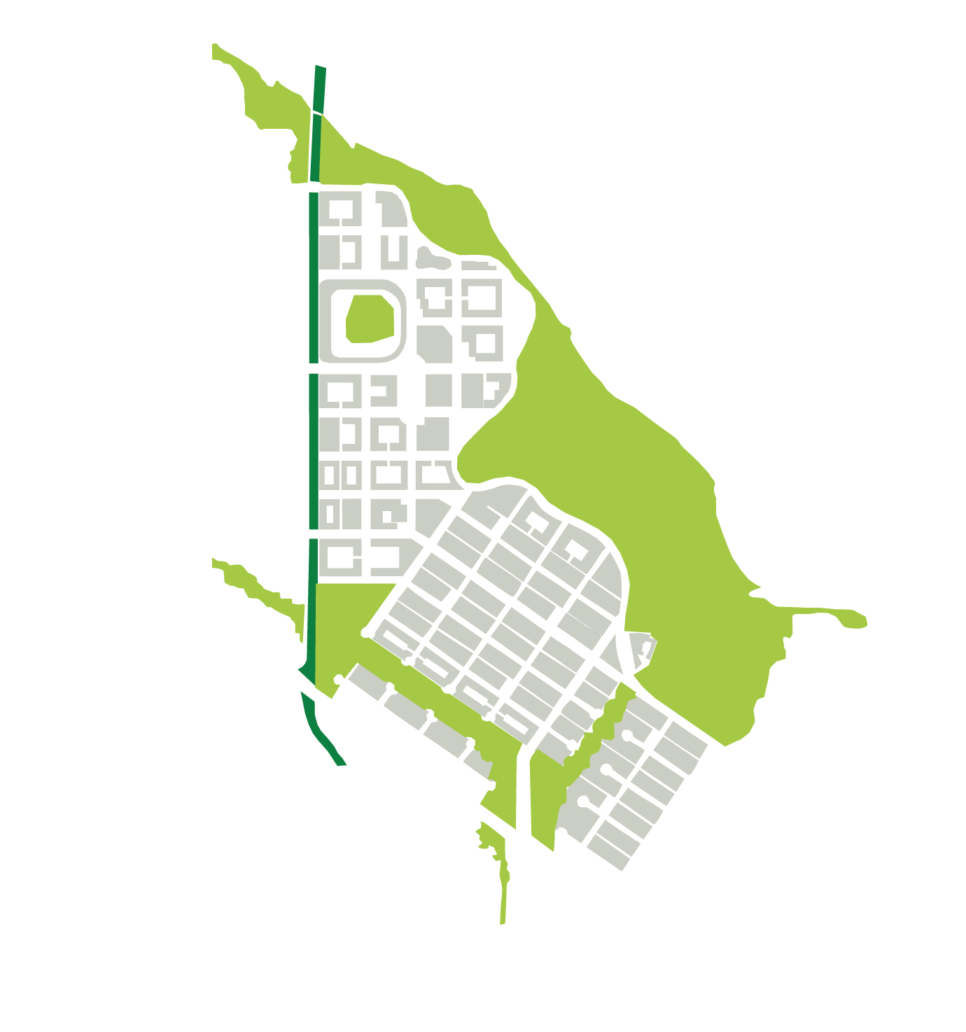

Slide 36
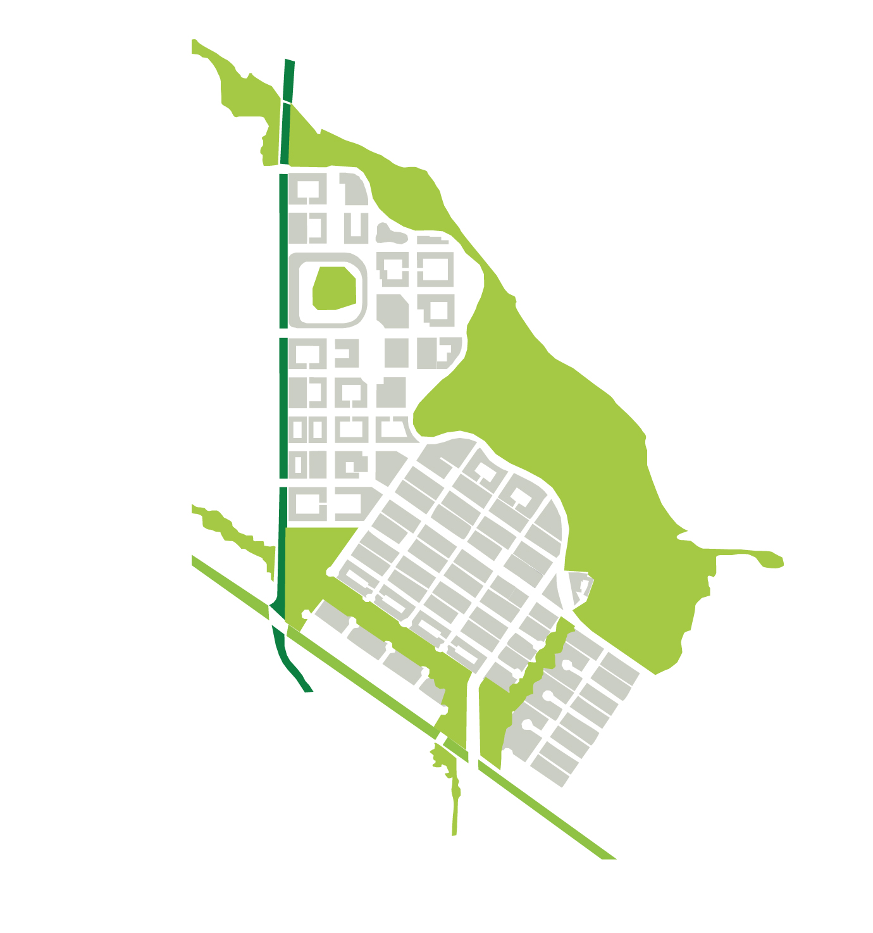

Slide 37
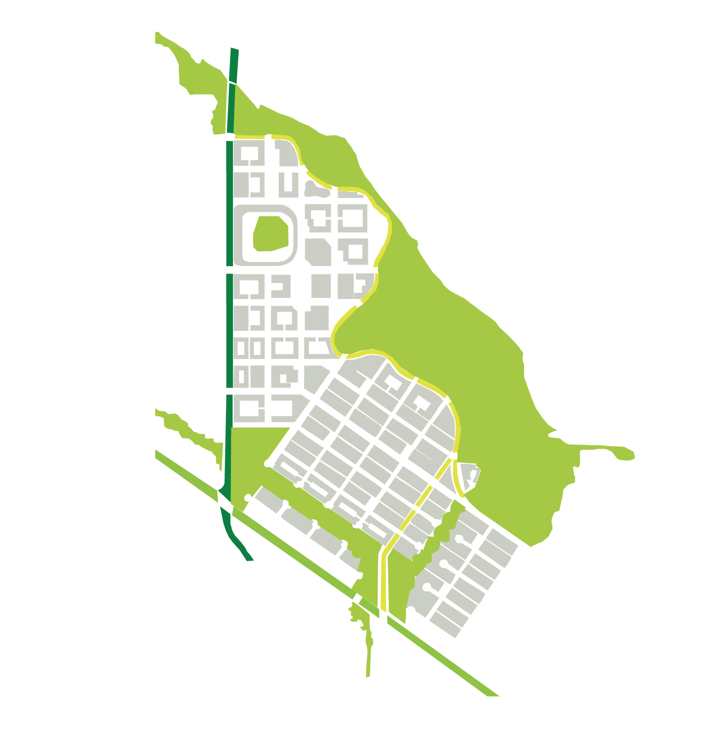

Slide 38
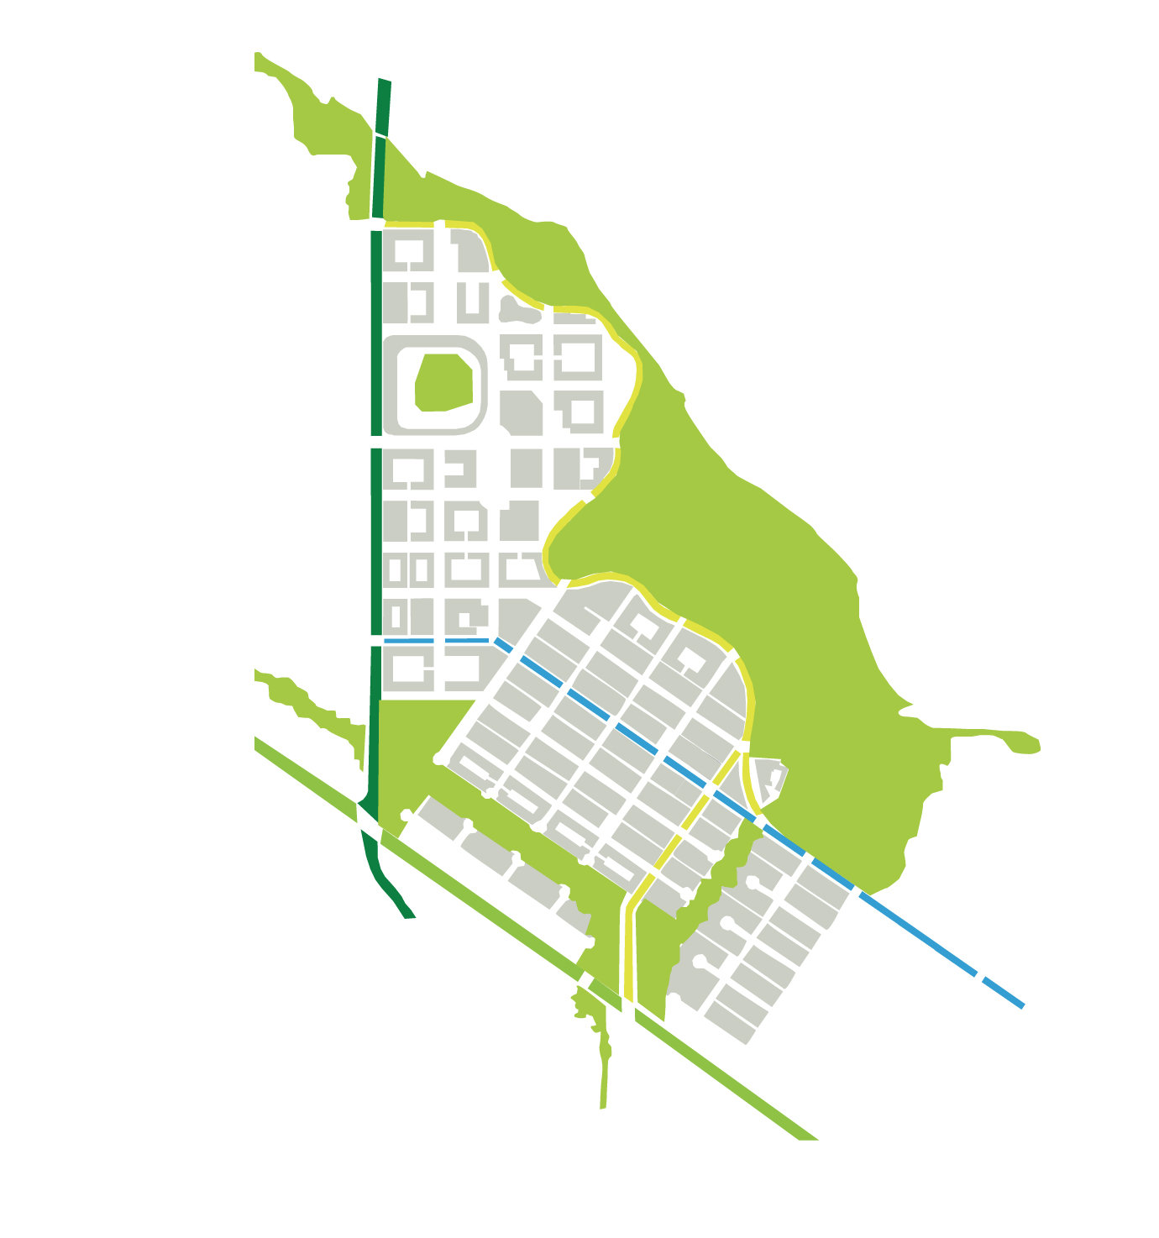

Slide 39


Slide 40
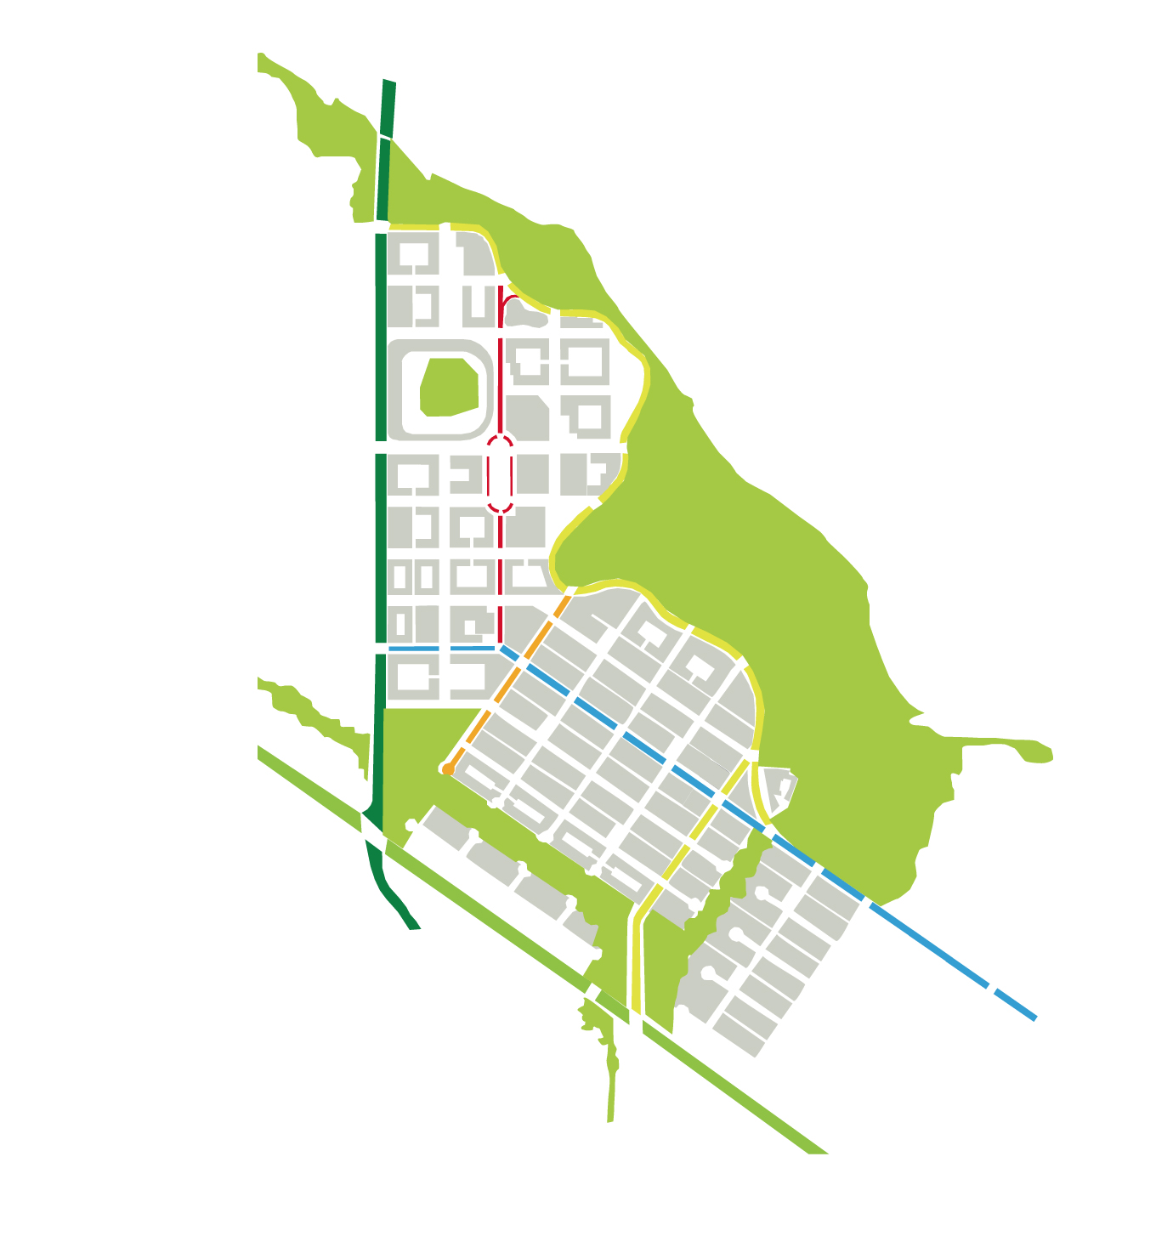

Slide 41
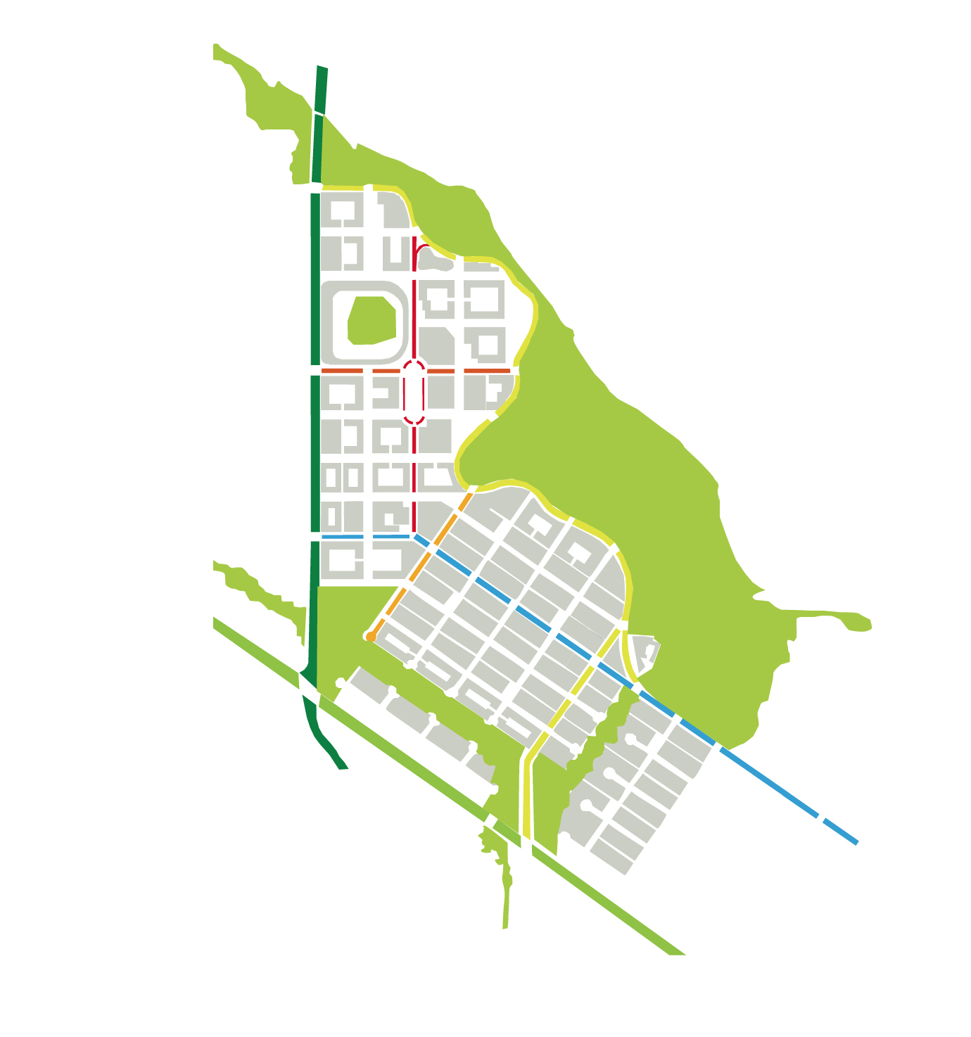

Slide 42
Pedestrian Pathways as Garden Path

Slide 43
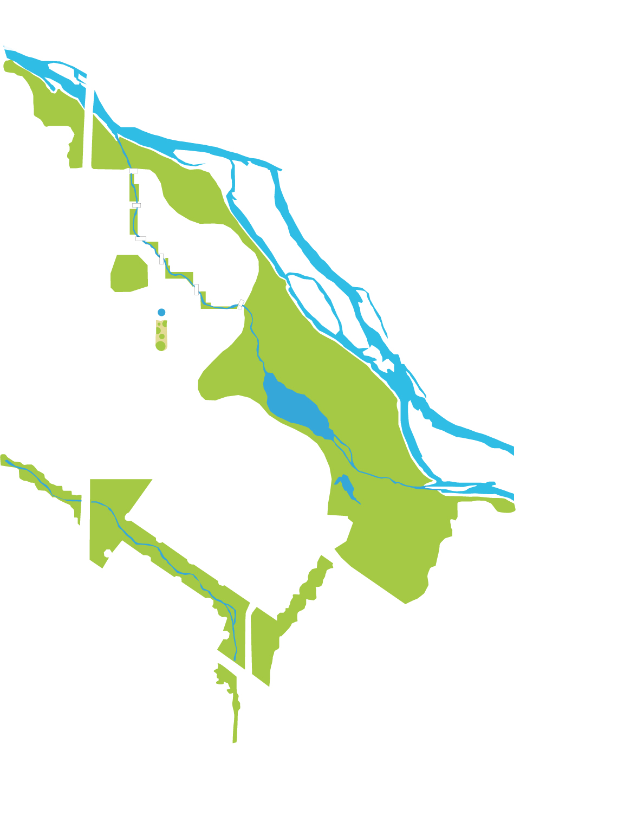

Slide 44


Slide 45


Slide 46


Slide 47
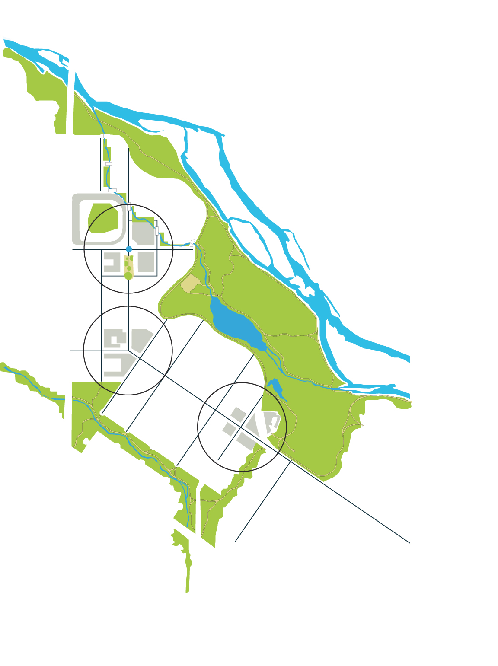

Slide 48
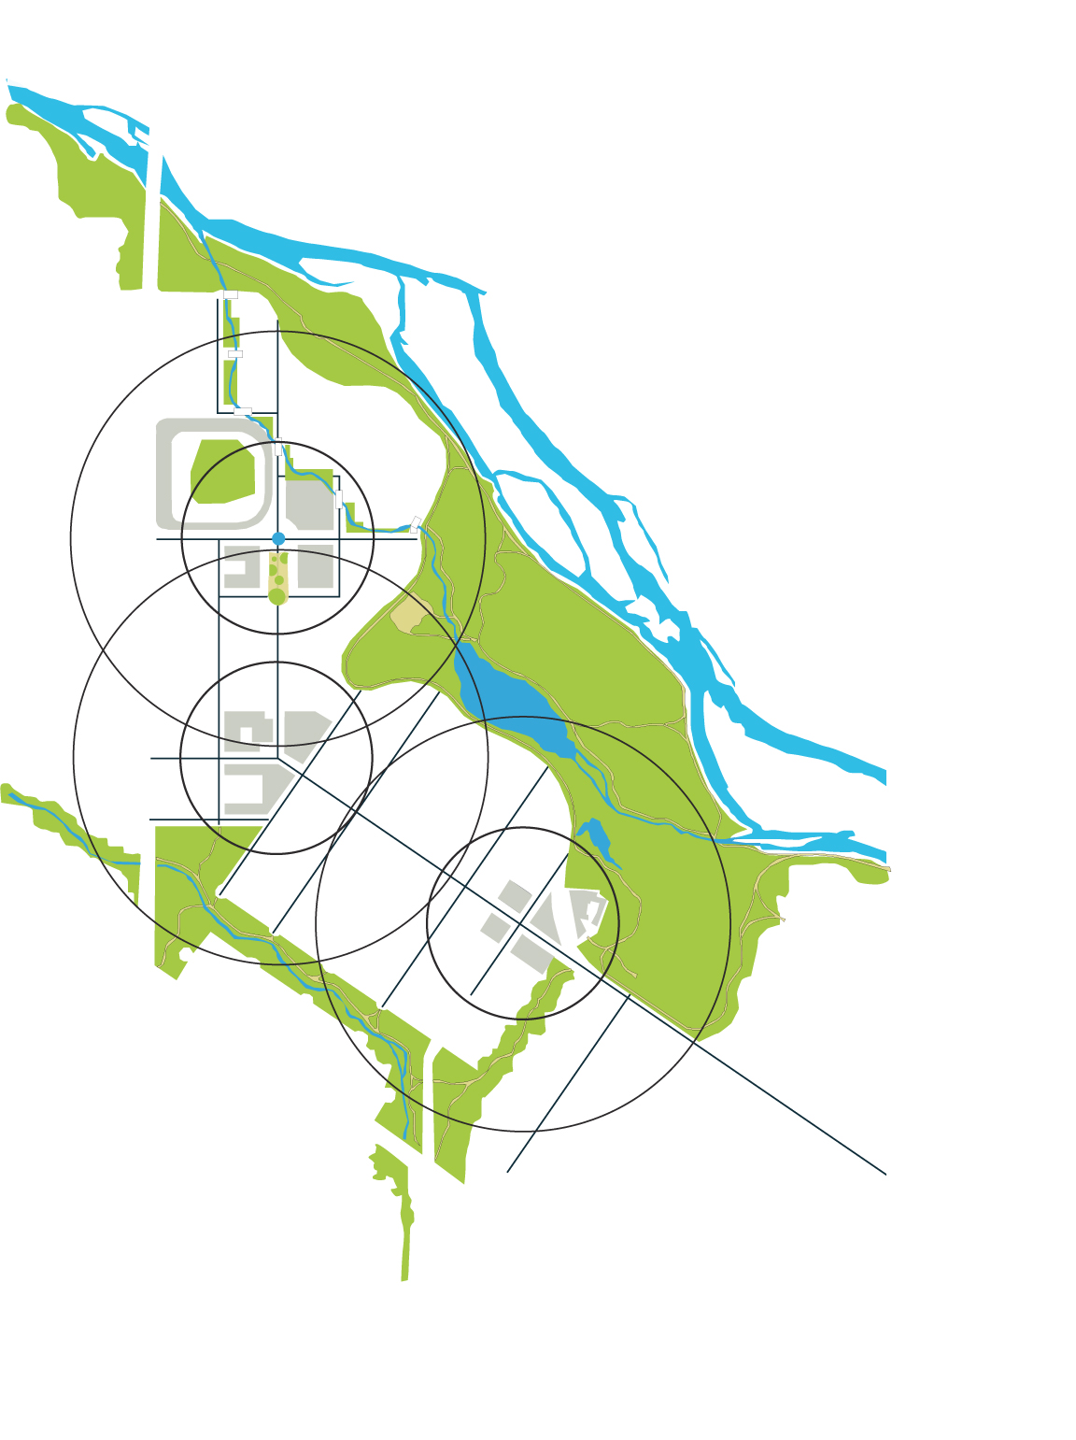

Slide 49
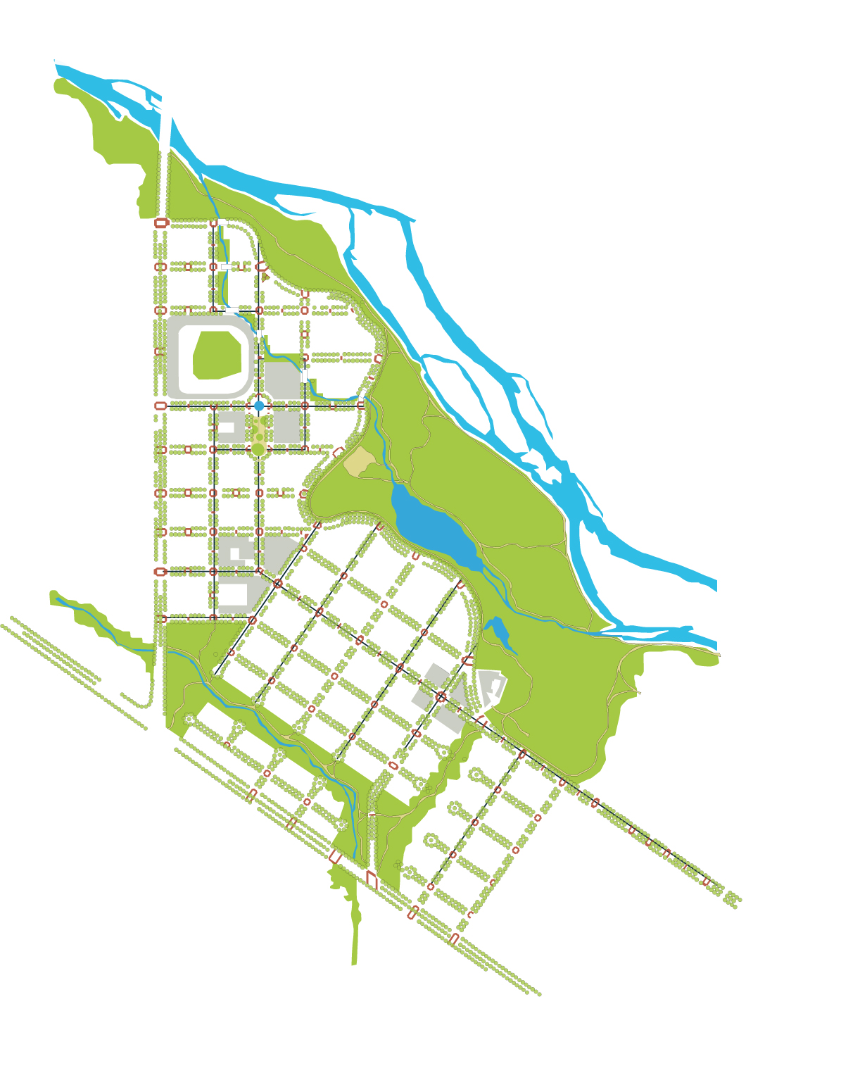

Slide 50
Gardens Within the Garden
Districts + Large Green Space

Slide 51
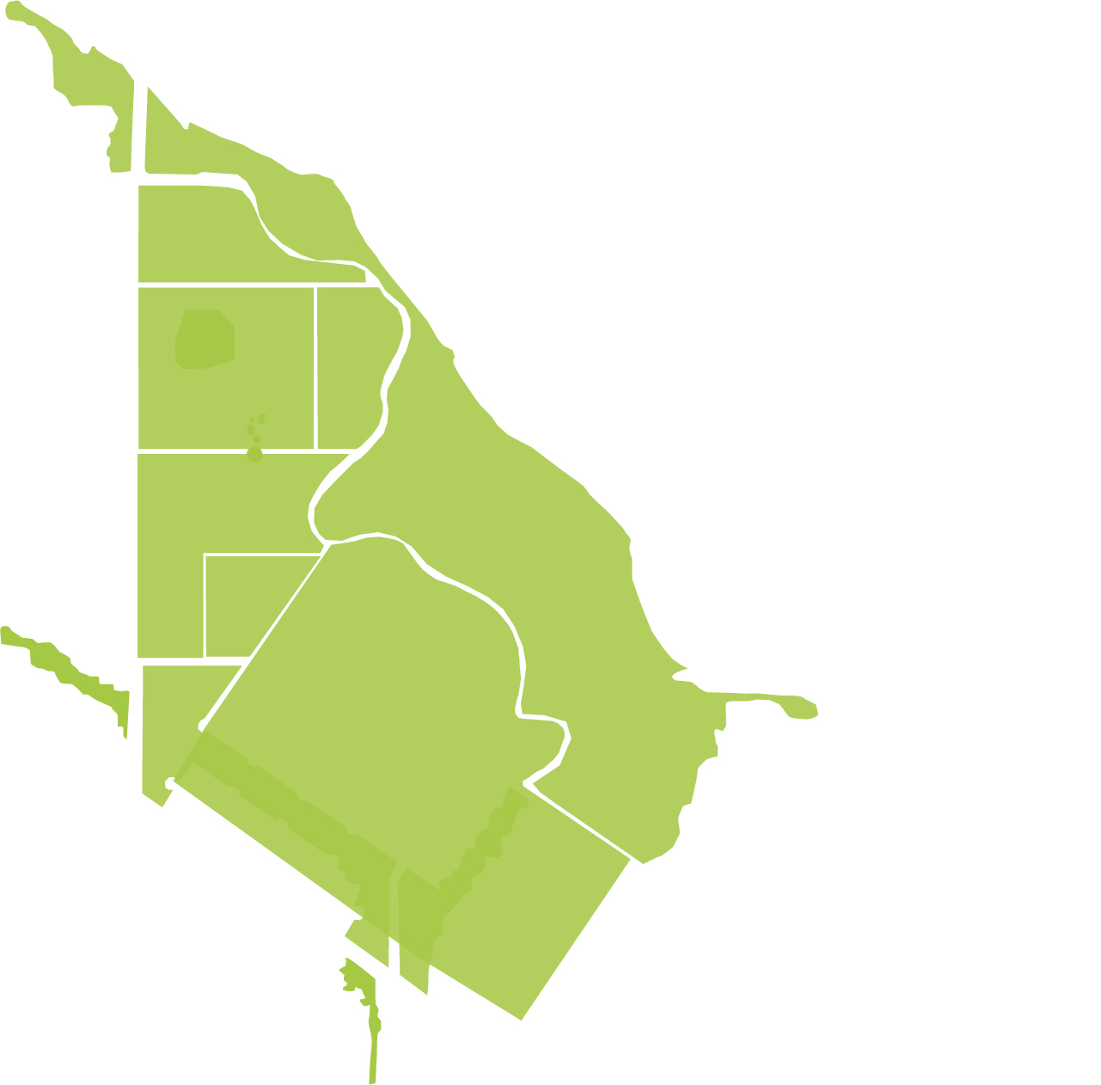

Slide 52
Real
Trees + Flowers + Mountain + Buildings = Garden Scenery

Slide 53
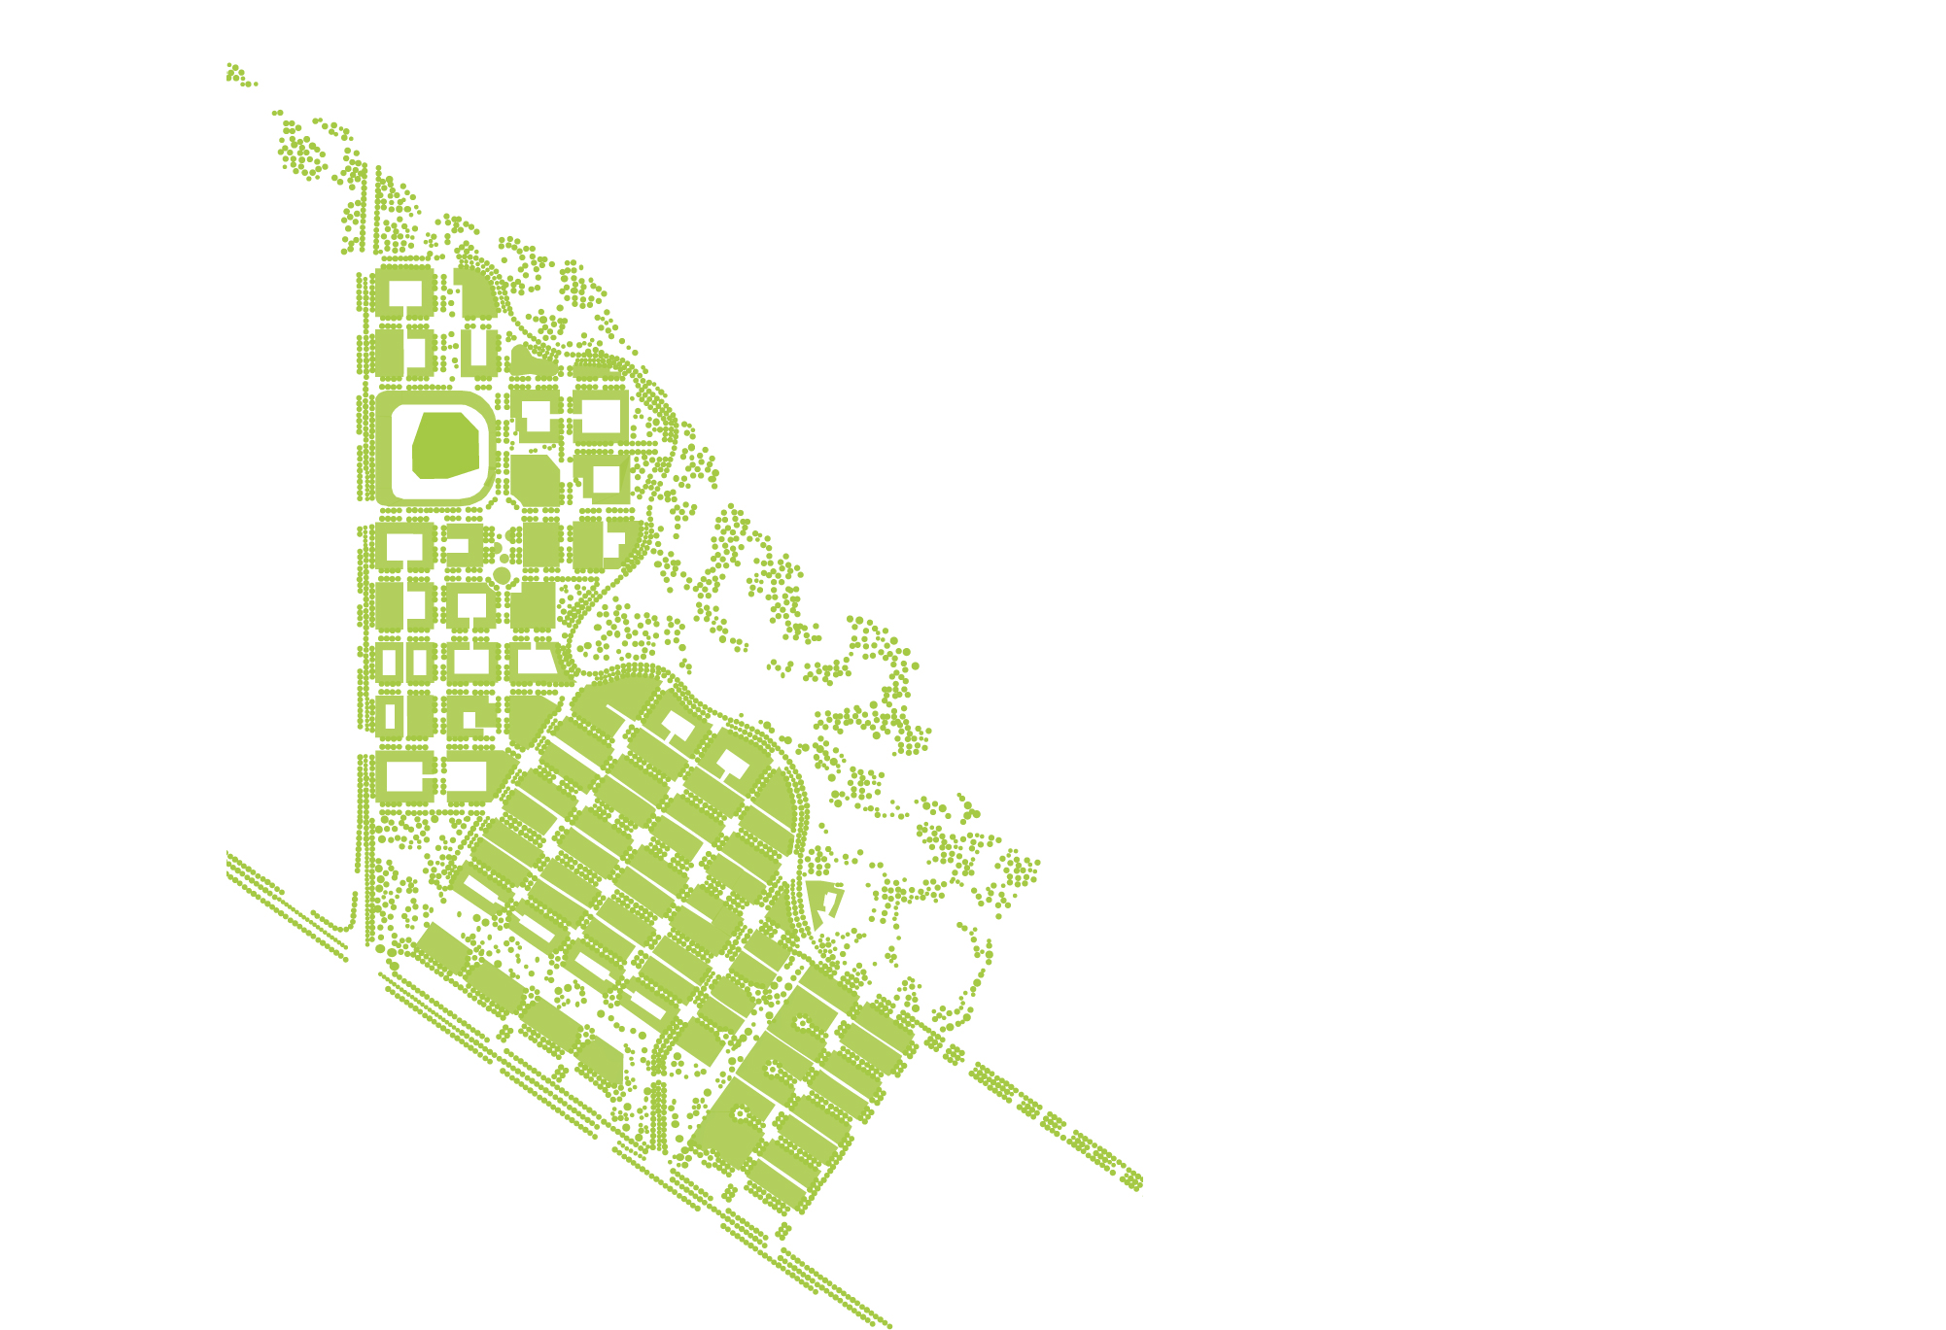

Slide 54
Districts as Smaller Gardens

Slide 55
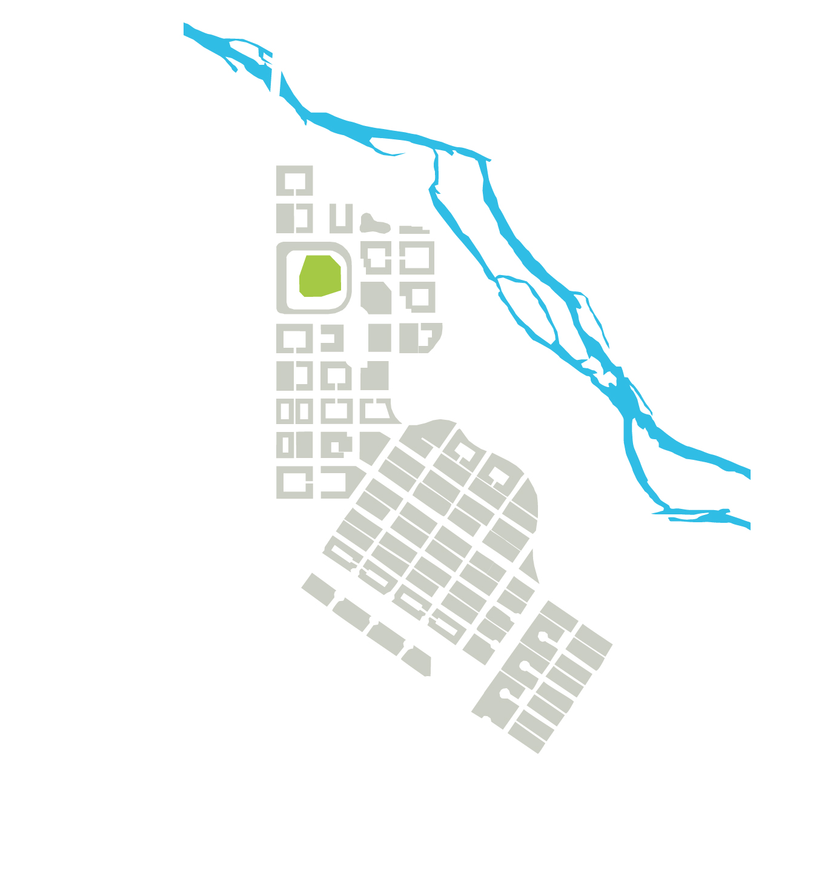

Slide 56


Slide 57


Slide 58


Slide 59


Slide 60


Slide 61


Slide 62


Slide 63


Slide 64


Slide 65


Slide 66


Slide 67


Slide 68


Slide 69
Garden City Urban Center

Slide 70


Slide 71

Thank you!

