Slide 1
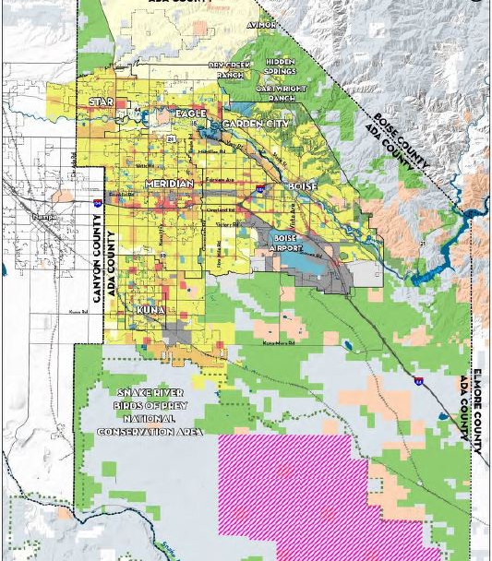
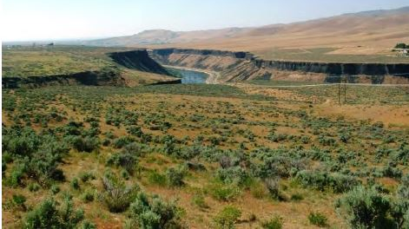
Citizens Zoning Code Advisory Committee
February 18, 2021
White & Smith, LLC | Logan Simpson

Slide 2
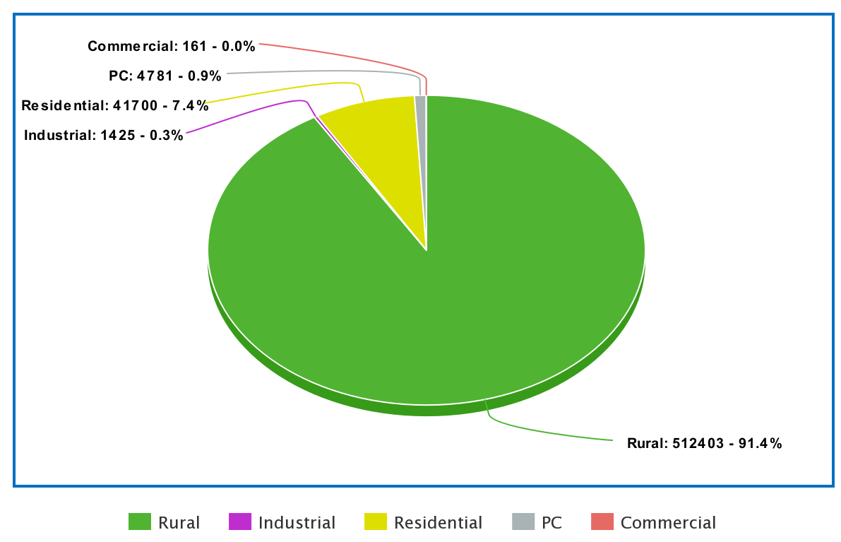
Zoning Ordinance Format
General Regulations
Base District Regulations
Overlay Districts
Regulations Applying to All Districts
Administration
Specific Use Standards
Subdivision Regulations
Planned Community Subarea Development Regulations
Notes:
Mostly zoned for AG
Ch 1 definitions, legal
Ch 2 5 base districts with uses and dimensions
Ch 4 where signs, landscaping, screening, parking occur
Ch 5 use regulations

Slide 3
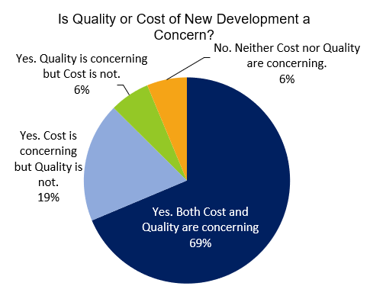
Phase 1: Survey Results
43 total responses
69% - Cost & Quality for new development are concerning
Top 3 Development Concerns
Zoning & land Uses
Land Preservation & growth
Integration of Agricultural Industry
Notes:
Survey from May 7 to June 5

Slide 4
Phase 2: Survey Results
776 total responses
59% - Are not very familiar with the code
62% - the code is not easy to use
55% - Zoning processes are not transparent, communicative, and effective
Notes:
Survey from Aug 1 to Aug 31

Slide 5
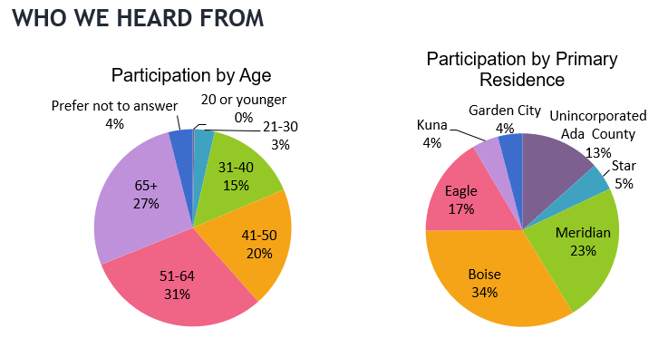
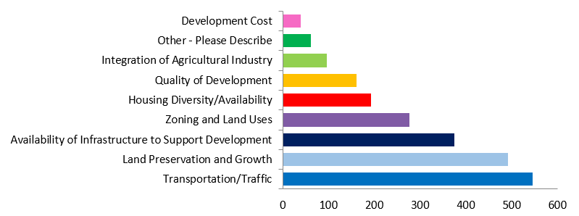
Phase 2: Survey Results
Top 4 Suggestions
Adding graphics & tables
Consolidating repetitive sections
Simplifying language
Adding online resources
Top 3 Development Concerns
Transportation & traffic
Land preservation & growth
Sufficient infrastructure

Slide 6
Formatting Goals
Relocate
Relocate all definitions to a new definitions article at the end of the Zoning Ordinance.
Consolidate
Consolidate existing zoning districts that are similar in function to reduce the number of zoning districts.
Create
Create a use matrix that aligns with standards from the North American Industry Classification System (NAICS) and Land Based Classification Standards (LBCS).
Consolidate
Consolidate the zoning review procedures and relocate technical information to the back of the Zoning Ordinance.
Continue
Continue to codify supplemental use standards in a single chapter.
Add
Add illustrations, tables, and flowcharts.
Use
Use clear and concise language and well-defined terms.
Notes:
1. Relocate all definitions to a new definitions article at the end of the Zoning Ordinance. Most code users expect to find definitions at the end of the document, not the beginning. A front definitions section distracts readers and users from the most pertinent sections of the Zoning Ordinance, which are the zoning districts, use regulations, and development standards.
2. Consolidate existing zoning districts that are similar in function to reduce the number of zoning districts. All zoning districts differ to some degree, but some more than others. Zoning districts that are underutilized or separated by minute details like lot size or a particular use should collapse into a similar district to improve the Zoning Ordinance’s functionality. These minor separations and characteristics can provide meaningless and unnecessary zoning district regulations.
3. Create a use matrix that aligns with standards from the North American Industry Classification System (NAICS) and Land Based Classification Standards (LBCS). Consolidating all uses into a single matrix that reference the NAICS and LBCS will minimize the reader’s need to flip back and forth between sections.
Consolidate the zoning review procedures and relocate technical information to the back of the Zoning Ordinance. Revise the procedures (currently in Chapter 7) to include an article for common procedures that apply to all processes (such as notice, public hearings, and pre-application neighborhood outreach) and do not need to be listed more than once. For each individual process, such as rezonings, create a common workflow beginning with applicability (i.e., what situations trigger the process?) and continuing to initiation, notice, decision-making, reapplication, and the scope of the approval (i.e., what the decision authorizes). Move technical application requirements to a later chapter of the ordinance, or to an appendix. This avoids cluttering the standards and processes with technical information that are usually important only to the applicant and zoning administrator.
5. Continue to codify supplemental use standards in a single chapter. Keeping specific standards all uses to one chapter of the Zoning Ordinance will make it easier for the reader by eliminating the need to flip back and forth between different sections that discuss use regulations.
6. Add illustrations, tables, and flowcharts. Modern zoning ordinances typically include graphics and tables to help explain or simplify material that is sometimes hard to understand. These graphics should not have their own miscellaneous section, but should be carefully integrated into the zoning ordinance to applicable regulations to increase readability, usability, and comprehension.
7. Use clear and concise language and well-defined terms. The Zoning Ordinance often establishes general admonitions, unclear standards, poorly defined terms, or unlimited delegations to staff. This can confuse applicants, staff, and the public which results in inconsistent interpretations and applications of the Zoning Ordinance. There are some situations where flexible language or broad delegations of authority are unavoidable or even beneficial. For example, certain uses that require conditional approvals, require case by case review to customize conditions of approval to a specific location.

Slide 7
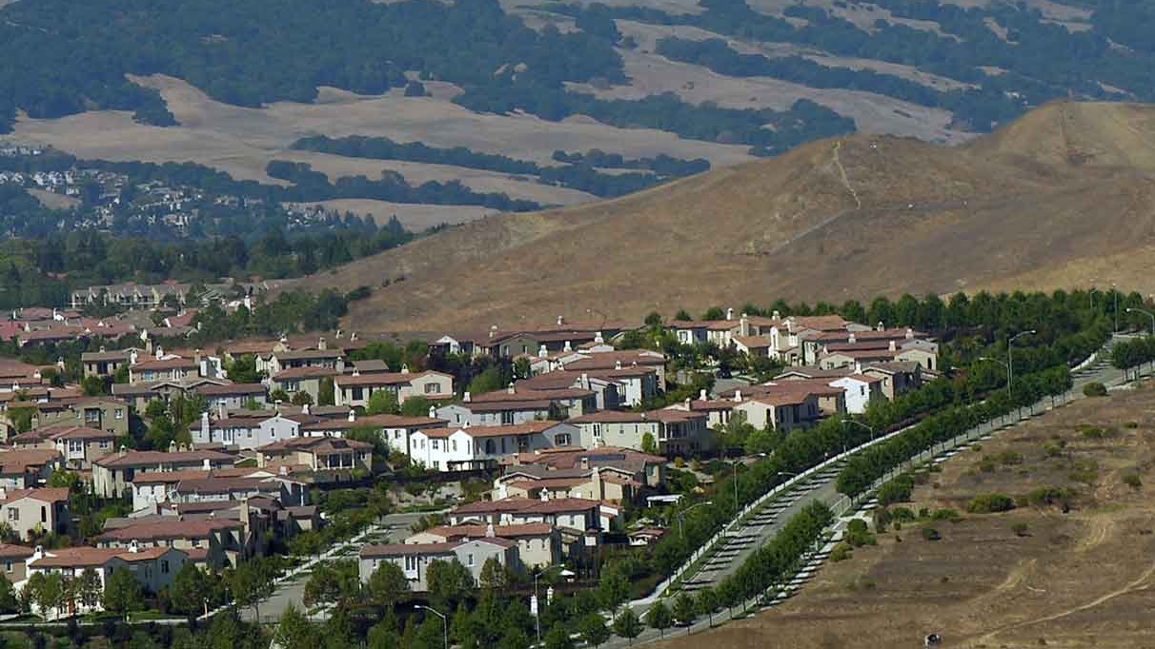
Zoning Recommendations
Rural - Stricter open space requirements, landscape buffers, and conservation easements
Residential - Consolidate existing residential districts with new dimensional standards.
Residential - Add regulations to low density residential districts that accommodate adequate public infrastructure requirements, preserve rural character, and create cohesion.
Commercial - Consolidate the 4 commercial districts into 3 districts
Commercial - Remove antiquated commercial uses
Commercial - Provide contemporary commercial uses
Industrial - Remove TI district and consolidate into other industrial districts
Industrial - Rename industrial districts that align with the district’s intent
Industrial - Update permitted uses with revised industrial districts
Notes:
Buffers and easements provide multiple environmental benefits critical for new, responsible development. Buffers are small areas within agricultural land designed to manage environmental concerns like pollution. Strategically placed buffers and easements in the RP and RR districts can effectively mitigate the movement of sediment, nutrients, and pesticides from property to property. This should help improve agricultural operations while also enhancing wildlife and protecting biodiversity.
1) Minimum lot area, lot dimensions, and setbacks are similar in most residential districts. There are opportunities to consolidate or recalibrate these districts to provide for more diverse housing options, including small-lot detached single-family uses and accessory dwelling units. R4 and R6 zones are medium density districts that are relatively indistinguishable from one another. The new Zoning Ordinance could merge these districts where dimensional and density standards are similar.
2) The low-density districts could limit infrastructure demand by tying new subdivisions to facility levels of service, and rural design standards such as limits on impervious surface, cluster and conservation options, and revised dimensional standards.
1) The C3 district has not been used. If not consolidating, the Zoning Ordinance could recalibrate standards that are more suitable and practical to C3 development. These options should allow commercial development outcomes that are compliant with County planning policy.
2 & 3) Instead implement modern commercial/office uses in commercial districts and provide standards that accommodate for contemporary commercial/office development. The Zoning Ordinance should implement site layout standards that encourage a variety of commercial developments.
1) The TI district has not been utilized, so flexible, technologically based industrial parks could fit into a revised M1 district. Low intensity industrial development should include technological industrial parks.
2) Instead of “limited” and “general” industrial, the industrial districts could read as light and heavy industrial districts. The terms “limited” and “general” does not tell the reader about the intensity of the industrial development.
3) Update permitted uses with the newly consolidated and revised industrial districts. The County should ensure all industrial uses fit appropriately with the district’s intent. This will help avoid land use conflict and unnecessary staff interpretations.

Slide 8
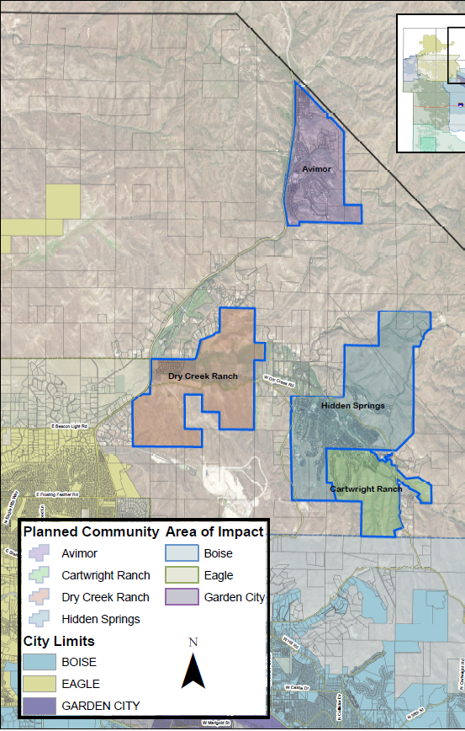
Overlay Recommendations
Create
1
New and improved base district regulations that encourage innovative projects
Articulate
2
Standards for new development instead of negotiating compatibility issues
Revise
3
Hillside Overlay to improve development along steep geography
Revise
4
Boise River Greenway and Flood Hazard Overlays to include more flexibility related to setbacks and uses
Clarify
5
Distinctions between Planned Unit Development, Planned Community Regulations, and Overlay districts
Keep
6
Planned Community regulations but move them to an appendix.
Notes:
1) Updating and modernizing the current lineup of zoning districts can help accommodate straightforward, ordinance-based development.
2) The County should provide clear and objective standards in the revised Zoning Ordinance that anticipate the problems and concerns Ada County is currently negotiating on a case-by-case basis.
3) A drafted revised Hillside Overlay uses a tier system to determine regulations for new development. The tier system categorizes regulations according to slope ranges. Incorporating higher standards and detailed geotechnical reports for new developments on steep slopes will ensure that structures are safe and do not provide adverse or severe impact on the landscape.
4) Adding common-sense setback and use flexibility to these overlays will reduce variance requests for structures that do not meet the 100’ floodway boundary setback. Light structures like livestock fences pose little to no threat to floodway boundary setbacks, so prolonging the development process with these types of variances makes little sense.
5) All three items do not act as true overlays. Also, the Zoning Ordinance can confuse the reader because the distinctions between the three are not clear. The Zoning Ordinance should better emphasize the functional differences between PUDs, PCs, and overlays to avoid confusion.
6) These specific regulations increase the length of the zoning ordinance and create unwarranted code clutter. The current arrangement of these regulations appear as random code parts, which directs the reader’s attention away from the main zoning district regulations.

Slide 9
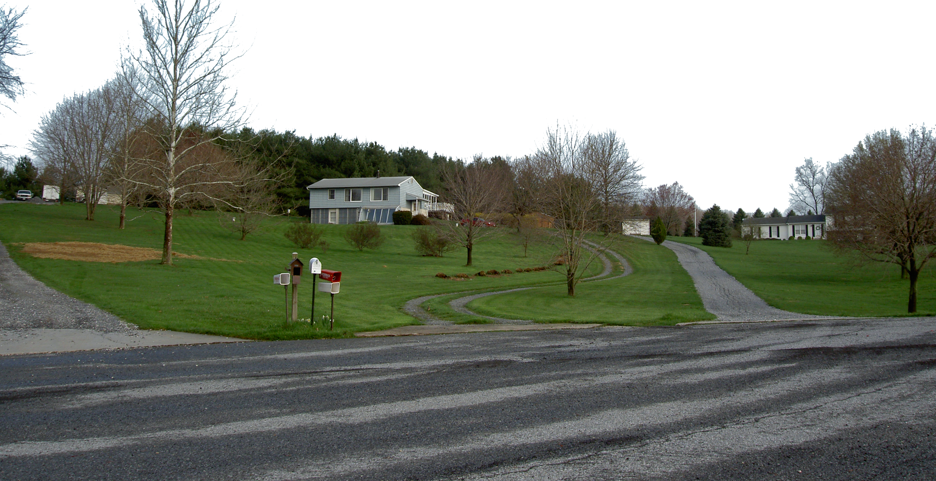
Development Standards Recommendations
Recalibrate densities within newly revised and defined residential districts to provide for more diverse housing options.
Consider implementing maximum impervious surface coverage requirements in all districts
Provide clear dimensional tables, measurements, and graphics
Consider using floor area ratio to limit bulk in commercial and industrial districts
Provide flexible setbacks within different residential districts that provide a range of housing options to address housing affordability
Reduce or right-size minimum parking requirements.
Add an administrative process for minor adjustments to parking standards on a project-specific basis.
Establish adequate public facilities regulations to control new development in unincorporated Ada County
Simplify the point system and landscaping requirements by using effective graphics.
Consider further regulating the placement of landscaping on a site while establishing more context-sensitive landscaping regulations.
Implement xeriscape landscaping options for non-irrigated developments.
Revise the sign regulations and create regulations that meet content neutrality standards.
Growth
Capacity
Time
Notes:
1) This explanation will indicate why certain residential districts require less or more density. Additionally, the density calculation explanation can include graphics to depict preferential development densities for the layperson.
2) Densities that include small-lot detached single-family uses and accessory dwelling units for most residential districts should aid the County’s need for housing in an affordable manner.
1) Impervious cover is a surface that does not absorb rain effectively. There is currently a provision that requires a drainage study if there is “an increase in impervious surface area of 1,000 square feet or 10% of the property area”. Replacing this provision with maximum impervious surface coverage requirements will provide clear rules to the game for developers while minimizing land development impact from large areas of concrete and asphalt. This will also ensure that the County has adequate infrastructure for new development by reducing a site’s drainage demands.
2) The current code provides dimensional tables, but they are rudimentary and could better communicate material to the reader. The tables can take a reader a while to digest so providing the reader with graphics that relate the different dimensional standards in 2D or 3D form will improve readability and usability.
3) FAR is used in planned community districts but are not used in commercial and industrial districts where bulk regulations are typically needed. Bulk is often regulated in modern codes to ensure land use compatibility is maintained by controlling development intensity to a particular zoning district. FAR should apply to lower intensity industrial districts and all commercial zones to reduce development impact in Ada County.
4) Flexible or reduced setbacks allow primary dwelling owners with more usable land, thus permitting more development flexibility. For each new residential development that wants to provide an ADU, a setback encroachment zone could be applied to make an ADU addition fit appropriately on site. This approach could incentivize housing development because dimensional requirements are not as stringent as the standard residential setbacks.
5) Setback terminology varies in tables and figures particularly with commercial and industrial districts. Commercial districts have interior side yard and side street setbacks while industrial districts have side yard and flanking street setbacks. These terms create inconsistency and confuses the reader when it comes to applying setbacks to different zoning districts. The new Zoning Ordinance will also define the revised setbacks to increase readability.
1) This process should link parking uses and the general use table for consistency purposes. Align with the process for determining where new or unlisted land use is allowed.
2) Parking minimums may facilitate unnecessary parking spaces for new development. For instance, medical offices parked at 2 spaces for every 500 square feet could necessitate unwarranted parking for medical developments. A minimum parking reduction to 1 space for every 400 square feet could save a 20,000 square foot medical facility 30 parking spaces (80 spaces required at current parking ratio; 50 spaces required at 1:400 ratio).
3) The strict, one-size-fits-all approach to parking can hinder development and prolong the development approval process. A simple, administrative process that provides development tradeoffs – like additional, enhanced landscaping for a 10% parking reduction - can provide staff and the development community with additional flexibility to right-size parking ratios. This process could prevent development delays and encourage preferential development patterns.
4) The current graphics and illustrations are difficult to read, so improved graphics that depict parking arrangements, dimensional requirements, and other information could benefit all users of the Zoning Ordinance.
5) Parking is measured with an array of metrics, which can cause reader disorientation over what parking regulations apply to a specific use. For instance, some parking requirements are determined by building square footage, while others by employee count. This inconsistency is problematic but using consistent metrics for all uses will make parking ratios easier to communicate to applicants, staff, and the public.
1. Dense information in this section can overwhelm the reader, so implementing clean and impactful graphics can provide relief to the reader and help improve comprehension. Color coding tables and illustrating landscaping options will catch the user’s eye, which can relate critical context needed to understand landscape regulations.
2. Removing the point system by using stricter, baseline standards can improve predictability. For instance, the Zoning Ordinance could require all new development in commercial and industrial zoning districts to provide a shade tree for every 50 linear feet with an ornamental tree for every 25 feet along street frontage. This could increase landscaping standardization for new development.
3. The point system provides flexibility for the developer, but this flexibility does not guarantee consistent development. Providing more consistent on-site landscaping requirements like the location of street frontage trees and parking lot shrubs could improve predictability and uniformity, thus fostering better development cohesion.
4. Not all areas within the County are irrigated. Xeriscaping provisions could replace conventional landscaping regulations for new development where irrigation is not feasible. This would include using native plants, soils, and rocks as landscape elements to provide similar conventional landscaping effects.
5. Landscape screening typically uses landscape elements to serve a similar function as a wall. The intent is to restrict viewing capabilities and shield neighboring properties with a set of landscaped screening features. Stipulations to provide a landscape screening device that functions as a wall and buffers non-residential development from residential uses could benefit development aesthetically and physically. For instance, implementing a regulation like “every non-residential development shall provide landscape screening that abuts residential uses with a continuous row of 6 foot tall evergreen shrubs” could strengthen landscape screening. Instead of a porous screening look, a perpetual wall of shrubs would act as true screening device like a masonry wall.
1. This includes reclassifying sign typologies explicitly by physical characteristics instead of by use. For instance, collapsing “business signs” and “home signs” into revised sign categories like wall, roof, projecting, and monument signs will promote content neutrality.
2. The Zoning Ordinance is text heavy and matrixes that condense this information can improve readability. The matrix includes physical characteristics like size, colors, setbacks, and location. Other graphics illustrating sign, lettering, and font types will add to sign regulation clarity.
3. There are inconsistencies with sign definitions because they are in two sections of the Zoning Ordinance and do not fully capture all pertinent terms. For example, on-premises signs needs a definition and that definition should fit into the same section with the other sign definitions. Also, improved sign definitions will omit message regulations and emphasize physical characteristics.
4. Instead of regulating "off-premise" signs, establish a physical definition of billboards and control their aesthetic and traffic safety impacts. Regulations that control spacing, dimensions, location, electronic displays, and animation of billboards can protect the County’s scenic areas and promote traffic safety. Placing spacing requirements between billboards (i.e. spacing billboards 1,500 feet from one another on either side of a roadway), limiting placement within zoning districts (i.e. prohibiting new billboards in residential and commercial districts), and reducing size (i.e. 650 square feet to 325 square feet) are common practices that reduce billboard impacts.
1) The Zoning Ordinance could establish LOS standards for new development, and the LOS could vary by location in the County based on growth policy and the availability of public facilities and services. For instance, more stringent APF regulations could apply to new development in the northern portion of the County where the Foothills terrain may pose more development risk.

Slide 10
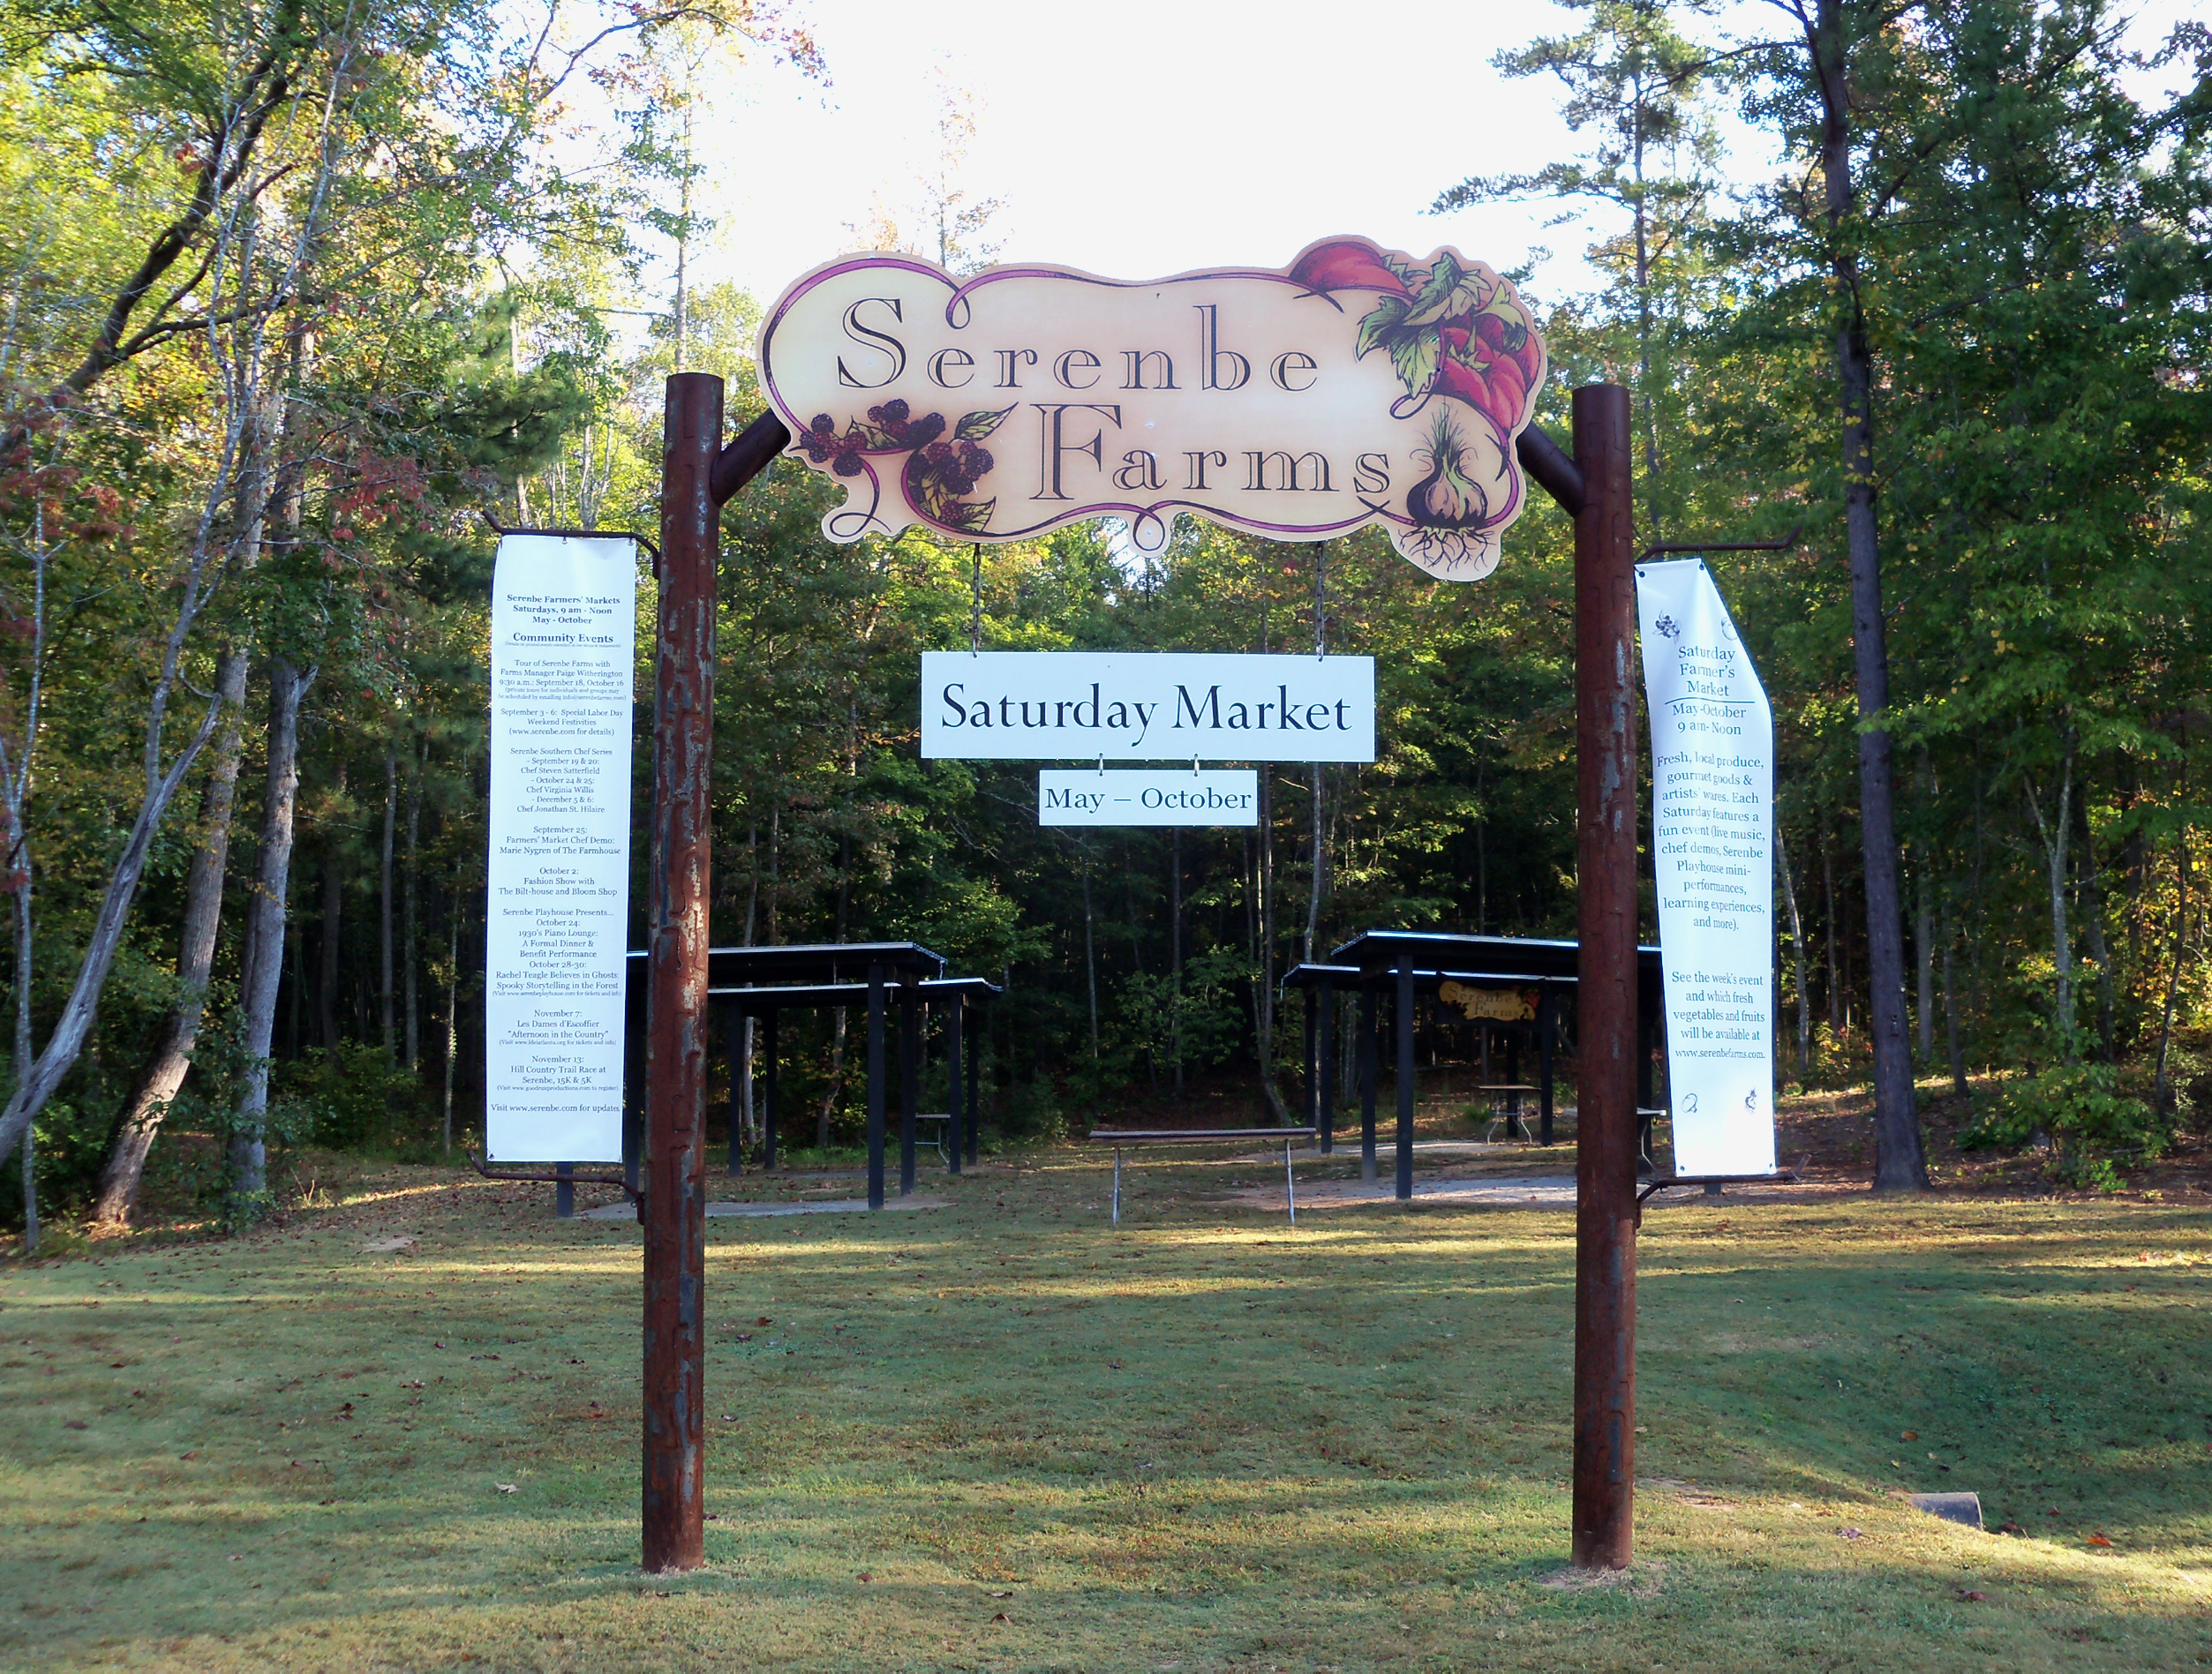
Supplemental Use Recommendations
Ensure
Ensure the list of permitted uses is as complete as possible in one use matrix.
Review
Review permitted and conditional uses in all districts, especially for frequent conditional use applications.
Ensure
Ensure all permitted uses are consistent with each district’s purpose.
Revise
Revise the specific use standards to avoid miscommunication with staff and the development community.
Review
Review use definitions and amend appropriately by providing simple and clear definitions that fully encompass a particular use.
Add
Add an agritourism or agritainment use to capture special uses (wineries, riding arenas, wedding/event centers) associated with rural context.
Update
Update housing uses and definitions and implement MMH concepts.
Provide
Provide clear regulations and dimensional standards for ADUs in applicable zoning districts.
Remove
Remove stipulations that require ADU dwellers to be directly related to the primary dwelling owners.
Notes:
1) While this may make the list of permitted uses longer, it also minimizes the need for formal interpretations. The goal is to capture all uses without having an exhaustive use list.
2) Conditional uses that are commonly discussed at public meetings could be revised to incorporate conditions that are commonly negotiated, rather than negotiating them on a case-by-case basis.
3) It is imperative that the use list aligns with each district’s intent to provide land use compatibility. A permitted use that does not fit the district’s characteristics can create an erratic built environment.
4) Certain specific use standards (i.e. wineries) are more nuanced than others. More specialized, but straightforward specific use standards can benefit all users by alleviating interpretation inconsistencies.
5) This will clarify staff interpretation misnomers and enable greater usability for all users.
6) This added use and its associated regulations can effectively regulate agricultural properties in a way that protects agricultural operations while providing clear standards to promote rural tourism.

Slide 11
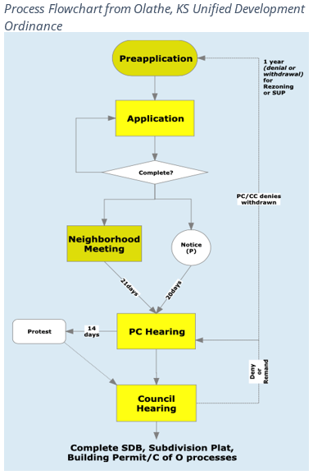
Process Recommendations
Consolidate
Consolidate all procedures into a single chapter
Summarize
Summarize the development approval processes in a table
Map
Map each process with a common workflow with the following subsections
Consolidate
Consolidate the submittal requirements
Create
Create a process for plat modifications
Create
Create a specific, streamlined process for ADUs
Notes:
1) This chapter should be organized around the overall process "workflow," beginning with plan amendments, and followed by rezoning, master site plan approval, and administrative processes like building permits, certificates of occupancy, zoning certificates, and similar actions. The Zoning Ordinance can include administrative agencies and enforcement in separate articles towards the rear of the document.
2) Like Table 19. The process table is a useful tool, showing clear lines of authority, notice requirements, and decision-making authority.
1. If they are codified at all, include them in an Appendix. Otherwise, authorize Development Services to prescribe the formats and submittal requirements for application intake and completeness review.
2. This process would amend the substantial conformance clause and provide additional flexibility for staff and the development community to alter previously approved plats without adding burdensome delays. Other platting concerns with vacations and boundary adjustments processes could facilitate improved communication with applicants, staff and the public.
3. ADUs can add to the County’s housing stock, but there is not a clear, sensible process for their construction. This process could detail ADU initiation, describe plan requirements, and illustrate the various steps to receive approval.

Slide 12
What Are our Next Steps?

Slide 13
Steps to Code Reform
Plan
Start with a good plan
Select a project manager
Identify your budget
Select a code writer or consultant
Write a clear scope
Scope
Public Process
Talk to people
Listen to people
Facilitate
Diagnose
Write
Adopt
Train
Diagnose your code
Decide what kind of code you want
Write the standards
Vet the standards
Train the staff
Train the applicants

Slide 14
contact Information
Mark Perfect, Planning and Zoning Administrator
Development Services
Ada County
(208) 287-7923
DSPERFMA@adacounty.id.gov
Mark White
Project Manager
White & Smith, LLC
(816) 221-8700
mwhite@planningandlaw.com

